Slide 1
Am I Fit? Fitness & ‘S’ Factors
Lockdown Science with Miss Loughran

Slide 2
Lesson Objective (Aim): Understanding what being fit means
Learning Outcomes (Targets):
All: Recall and list the 4 ‘S’ factors.
Most: Explain how different organ systems work together.
Some: Evaluate your fitness practical.

Slide 3
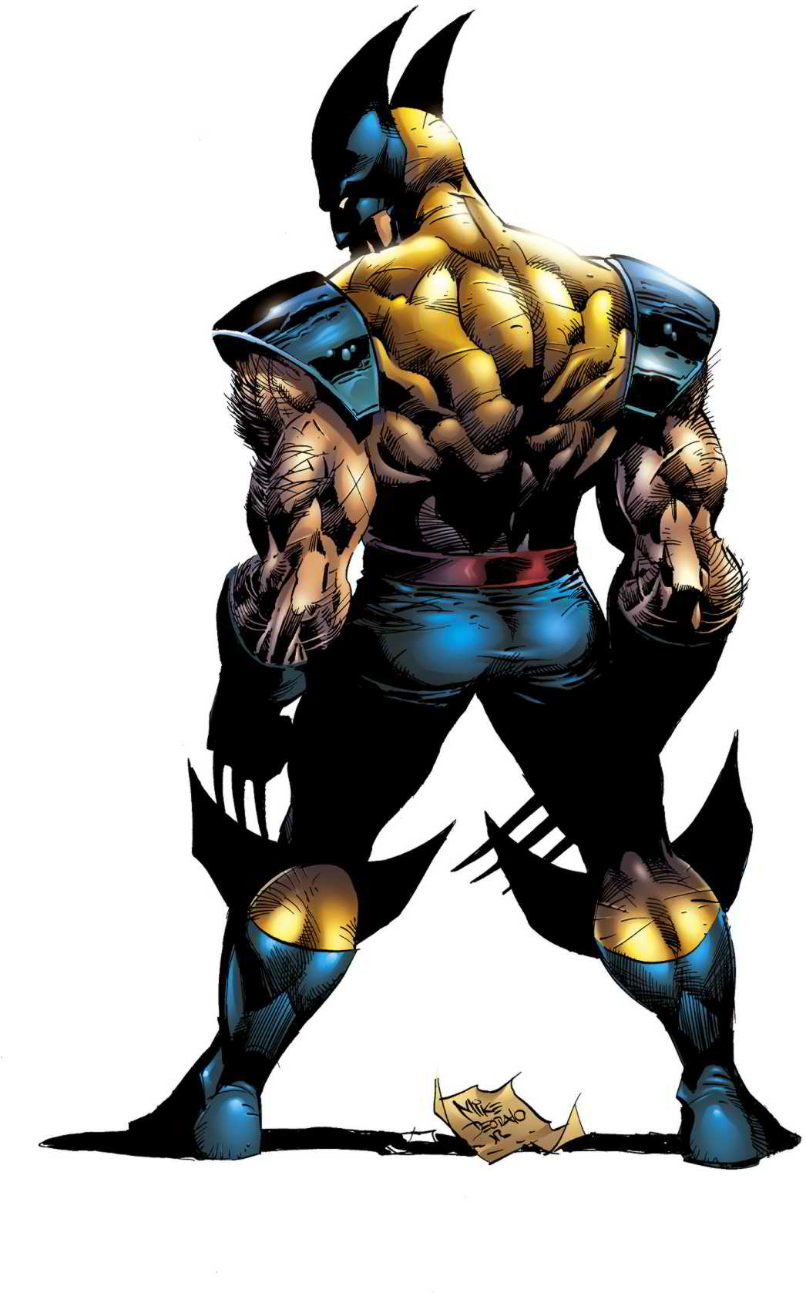
Do you have more Stamina then Wolverine?
Due to a genetic mutation Wolverine has amazing stamina. But what exactly does this mean?
Discuss
Stamina Challenge
Run on the spot with your family for as long as you can
See who has the most stamina
What do you think might be the reasons for this...?

Slide 4
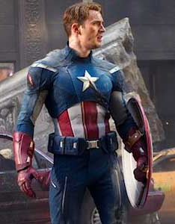
Is Cap Fit?
Do you think Captain America is fit? Decide yes or no and try and
explain your answer.

Slide 5
Being Fit
Being fit is being able to do the activities your lifestyle demands.
Fitness can therefore mean different things to different people.
There are many different types of fitness. Stamina, strength, suppleness and speed are four types of fitness.
These are known as the 4 ‘S factors.’

Slide 6
Being Fit
Fitness programmes help keep your bodies' organ system working properly.
The Circulatory system and the respiratory system work to provide muscles with glucose and oxygen during exercise.
All your cells use respiration to release energy.
Glucose + Oxygen → Carbon Dioxide + Water
This is the equation for RESPIRATION.
Try and LEARN IT!

Slide 7
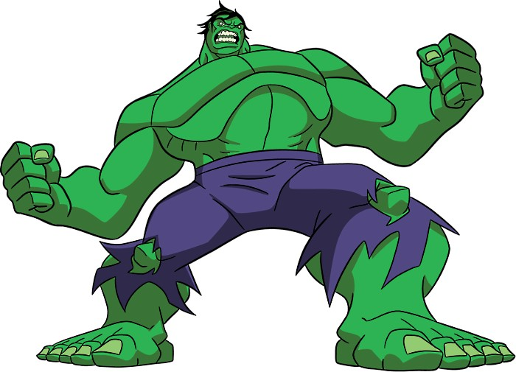
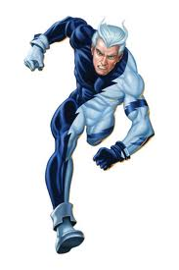
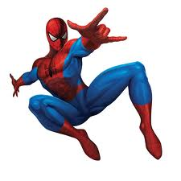
Superhero ‘S’ Factor Training Programme!
It’s time to find out!
Do you have the stamina of Wolverine? The strength of The Hulk?
The suppleness of Spiderman? Or the speed of Quicksilver?

Slide 8
The Superhero ‘S’ Factor Training Programme!
Carry out all Superhero ‘S’ factor exercises on the worksheet. Try and get your family involved.
Record your results in the spaces provided.
We can then find out who has the ‘S’ (Superhero) Factor!

Slide 9
The Superhero ‘S’ Factor Training Programme
Evaluate the practical you just carried out.
Comment on the following:
Do you think your results were accurate? why?
Do you think the test was fair? Why?
If you did this experiment again, how would you make it better?

