Slide 1
My biome fact-file extension task
Choose any location!
Choose your own places for this activity.
Use the information tool to find three more interesting facts.

Slide 2

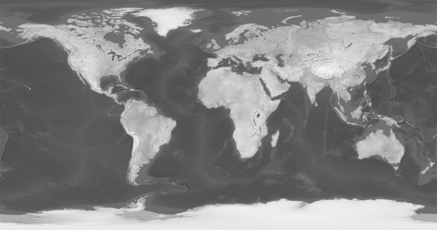

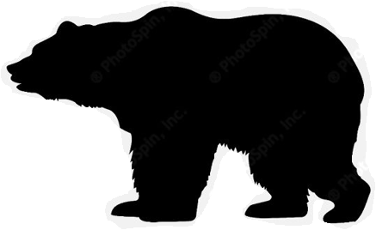
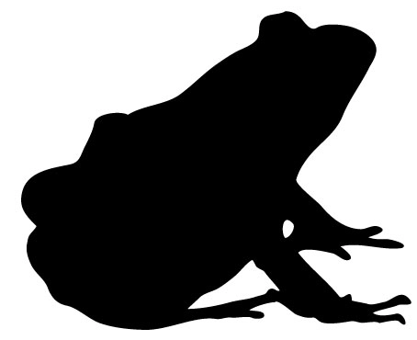
My biome fact-file
Where is it in the world?
Move the red pin to the correct location on the map.
Place: ??????
The biome here is a
????????????????
There are ? reptile species.
There are ? mammal species.
There are ? amphibian species.
Find an image of this place and paste it here:
Interesting fact #1: ?????
Interesting fact #2: ?????
Interesting fact #3: ?????

Slide 3
My biome fact-file
Where is it in the world?
Move the red pin to the correct location on the map.
Place: ??????
The biome here is a
????????????????
There are ? reptile species.
There are ? mammal species.
There are ? amphibian species.
Find an image of this place and paste it here:
Interesting fact #1: ?????
Interesting fact #2: ?????
Interesting fact #3: ?????

Slide 4
My biome fact-file
Where is it in the world?
Move the red pin to the correct location on the map.
Place: ??????
The biome here is a
????????????????
There are ? reptile species.
There are ? mammal species.
There are ? amphibian species.
Find an image of this place and paste it here:
Interesting fact #1: ?????
Interesting fact #2: ?????
Interesting fact #3: ?????

