Slide 1
Question
The Perfect Tea – Milk or Water First?

Slide 2
The Perfect Tea: The Context
Making a cup of tea the ‘right way’ is a controversial subject! There’s the debate over the strength of the tea, how long you should let it brew for, whether you can ‘over-mash’ it and of course… whether the milk goes in before or after the water.
This is a fierce debate among tea drinkers! Some argue that milk in first allows you to control the amount of milk in your tea, while the opposing camp believe that water first allows the tea to brew properly. Very serious stuff!
Then there’s the issue of when to add the milk to your mug when you use a teapot…
Is there a perfect way to make a cup of tea?

Slide 3
“Milk first, all the way. By putting milk in first, I can carefully control just how much milk is in the mug and therefore the strength of the tea! It also means you’re not going to ruin a cup of tea by adding too much milk at the last hurdle or splashing milk on the kitchen counter. No one wants to start the process all over again!”
“Water first, without doubt! By letting the tea sit in boiling water for longer, the tea brews properly and allows it to reach the desired flavour and strength, before reducing it by adding a precise amount of milk afterward! If you’re putting milk in first, you’re denying yourself the true potential of a brew…”
What Do You Think? Who do you agree with? Why?
What Do You Think?
Who do you agree with? Why?

Slide 4
Research Activity
Using the Internet or your mobile phone, undertake a research task into the perfect cup of tea and answer the questions below.
Which group is most popular in the UK? Milk or water first?
What is the most popular brand of tea in the UK?
Is there a perfect colour/strength of a cuppa?

Slide 5
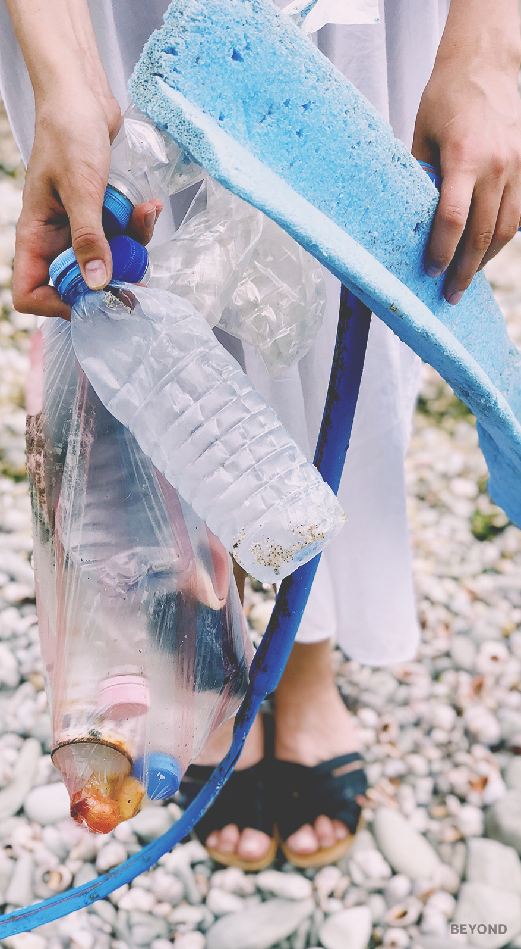
Personal Response
It’s your turn to argue your thoughts on the matter and outline the perfect method for making a cup of tea… think about how long you’d let the tea brew, whether you stir, how much sugar you need and of course, whether or not you add milk or water first.
Write down your own personal thoughts and feelings on the topic.

Slide 6
The Big Question: The Perfect Tea – Milk or Water First?
Working with your group, prepare a speech or presentation to tackle the question above. Consider the pros and cons and come to a conclusion that you can present to the rest of your class.

