Slide 1
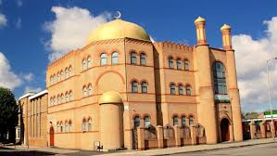
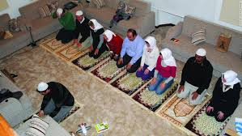
Debate:
You do not need to go to a place of worship to be a Muslim

Slide 2
Aims
Identify arguments for and against the statement ‘You do not need to go to a place of worship to be a Muslim’.
Identify your own opinion.

Slide 3
We are going to think about all everything we learned before and ask ourselves:
Can you be a good Muslim and not attend Mosque?
OR
Are you a bad Muslim if you do not go to Mosque?

Slide 4
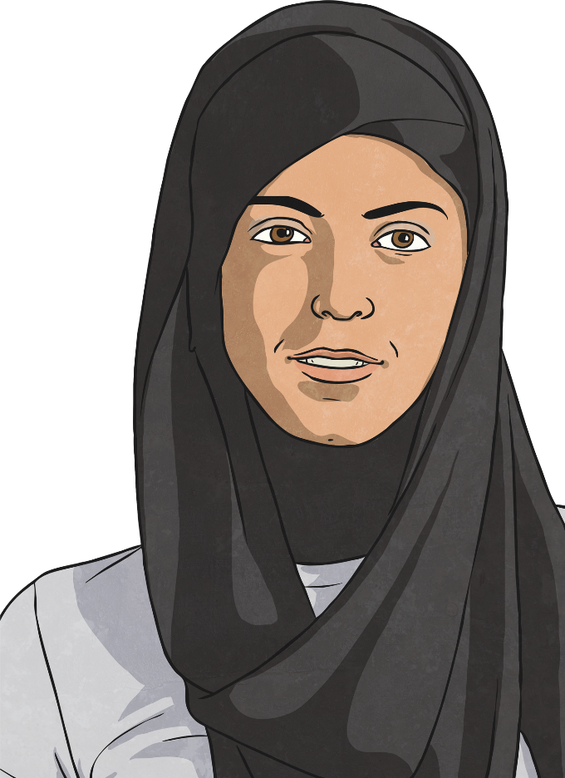
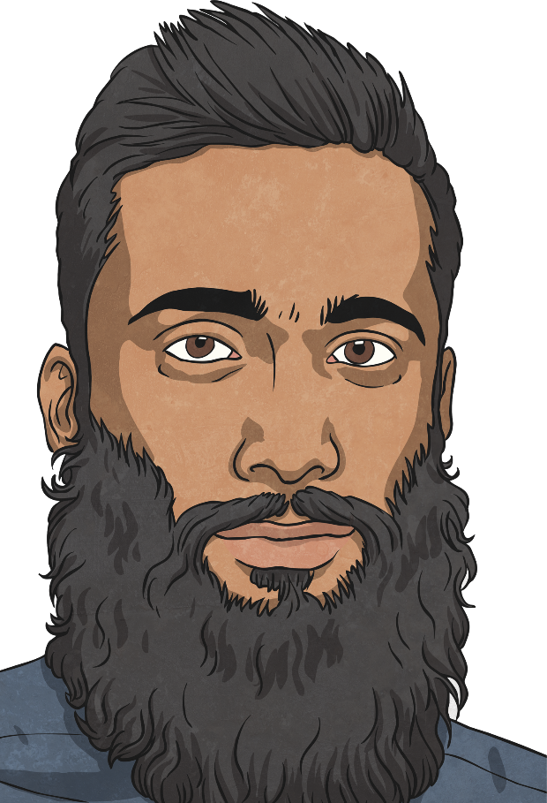
Key Beliefs Recap
In Islam there is a key principal belief, which is that there is only one God. Muslims call their God Allah (which is the Arabic word for God). Muslims believe Allah is the only ruler of the universe.
Muslims then have 6 main beliefs. These are:
Belief in Allah as the one and only God.
Belief in angels.
Belief in the holy books.
Belief in the prophets (special messengers) and that Muhammad was the final prophet.
Belief in the Day of Judgement (the day when Allah decides if a person goes to Heaven or Hell).
Belief in predestination (the belief that Allah has already planned out what will happen).

Slide 5
Pillars of Islam Recap
As well as holding their main beliefs, there are five things that Muslims are expected to do. These five things are called the Five Pillars of Islam. Muslims believe that doing these five things helps put their faith into action. They are:
Shahadah (declaration of faith): ‘I bear witness that there is no god, but God; I bear witness that Muhammad is the prophet of God’. (Muslims say this to enter the Islamic faith).
Salah (prayer): Muslims pray five times a day. Before prayer, they must wash themselves and then face Mecca whilst praying.
Zakat (giving a fixed proportion to charity): Muslims give a percentage of their income to those who have less money (they don’t just give to Muslims – they will give to anyone who is less fortunate than them, regardless of religion).
Sawm (fasting during the month of Ramadan): Muslims fast for one month during a time called Ramadan. This is a time for Muslims to reflect on their behaviour and try to purify their thoughts.
Hajj (pilgrimage to Mecca): Muslims are to travel to Mecca once in their lifetime, if they can afford to.

Slide 6
Points that agree with ‘You do not have to go to Mosque to be a Muslim’ statement

Slide 7
Allah says:
‘The whole world has been made a mosque for you to worship’
What does this mean?

Slide 8
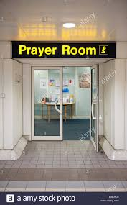
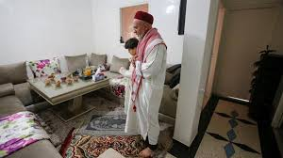
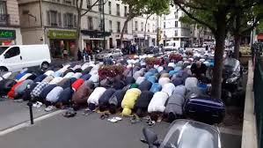
This means that:
Muslims do not have to go to Mosque to pray.
They can use a prayer mat and prayer anywhere.
Before we watch a video, can you think three different places?

Slide 9
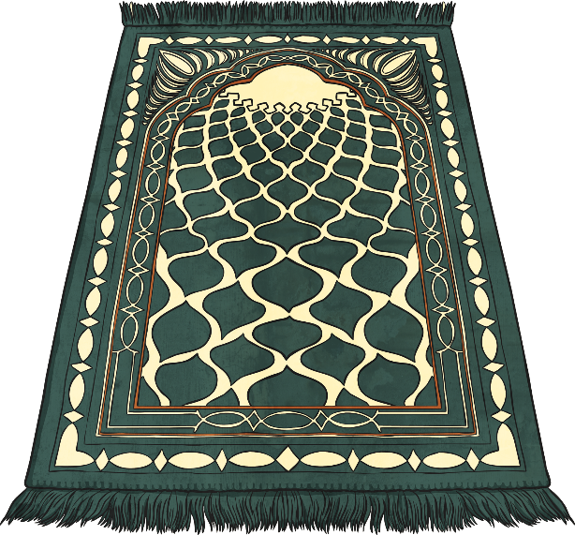
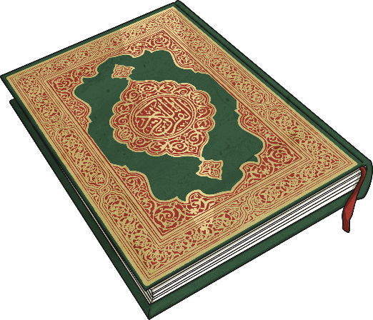
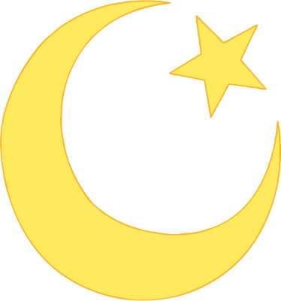
Worship at Home recap
Muslims have to pray 5 times a day.
Watch the video to find out more about where this can be done outside mosque.
http://www.bbc.co.uk/learningzone/clips/muslim-prayer/5965.html

Slide 10
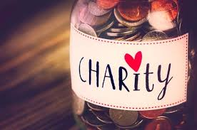
Do you have to go to Mosque to give to charity?
You can give to charity in the community, on the phone or on the internet.
This means that you can still do Zakat (giving to charity) as a Muslim without visiting Mosque.

Slide 11
Reasons to Pray away from Mosque
Mosque maybe closed,
You might be poorly,
The mosque might be too far away,
You might have to take care of someone,
Allah believes that you can pray anywhere.

Slide 12
Question:
Can we think somebody is not a good Muslim if they cannot go to mosque but still choose to pray?

Slide 13
Points that disagree with ‘You do not have to go to Mosque to be a Muslim’ statement

Slide 14
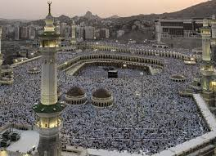
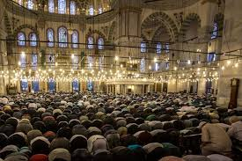
Allah also said …
“A prayer in mosque of mine is a thousand times greater” than prayer anywhere else.
What does this mean?

Slide 15
Allah explained that prayers aid in a mosque are more important than ones said anywhere else.
We might think that this means that prayer in mosque is better than prayer said at home or work.
Lets think about that while we watch the next video.

Slide 16
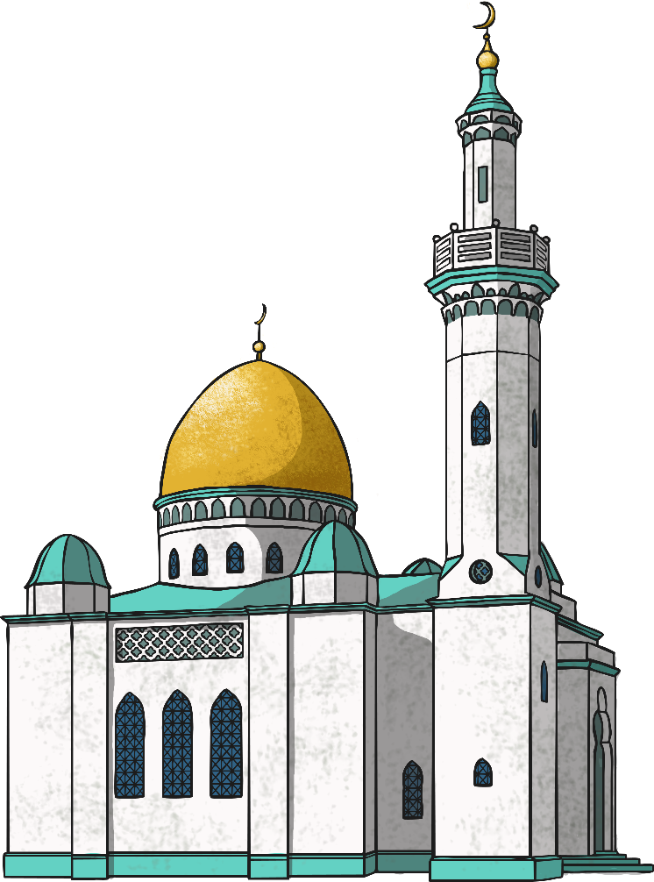
Why Do People Go to Mosque?
Muslims go to mosque to pray and services are held every day.
The most important weekly service is held on a Friday.
Watch the video to find out exactly what this is like.

Slide 17
Reasons to go to Mosque
You can be with your community and pray together,
You can go to mosque and learn more about Islam,
You can meet and support people in your community,
Allah believes prayer is stronger in Mosque

Slide 18
Task
Complete the work sheet.
List reasons in agree and disagree boxes
Write your own thoughts at the end.
There is no right or wrong answer – just your opinion.

