Slide 2
Q1
What is the official language of Japan?

Slide 3
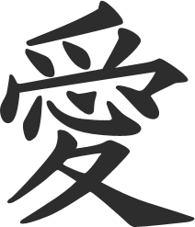
Q2
What is the Japanese name for Japan?

Slide 4
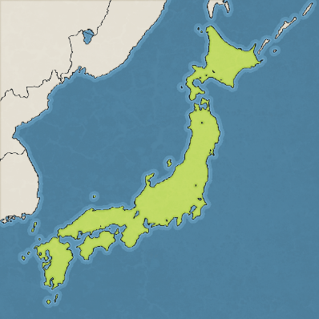
Q3
How many main islands does Japan have?

Slide 5
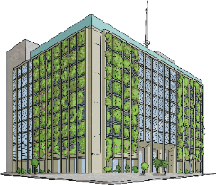
Q4
What is the capital (and largest) city of Japan?

Slide 6
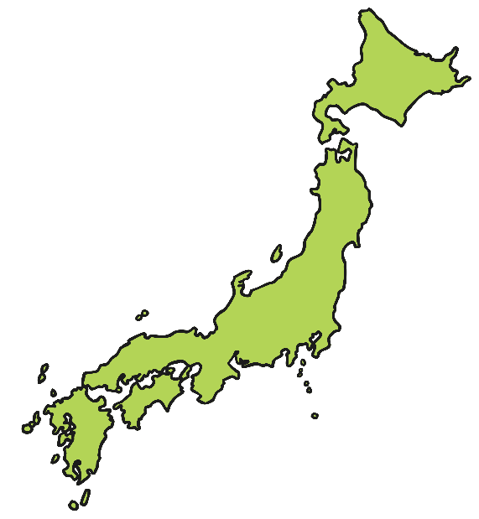
Q5
The capital city of Japan is located on which island?

Slide 7
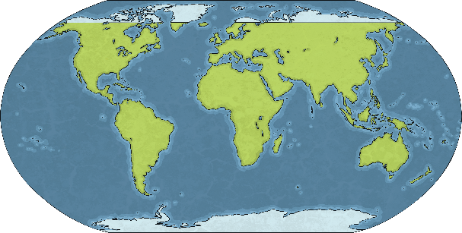
Q6
Which continent does Japan belong to?

Slide 8
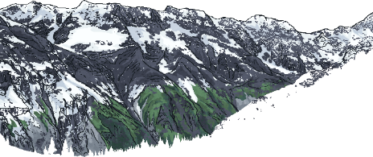
Q7
What is the name of the mountain that is also the highest point in Japan?

Slide 9
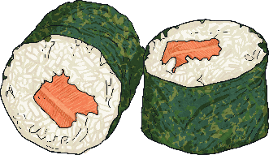
Q8
What foods are most commonly associated with Japan?

Slide 10
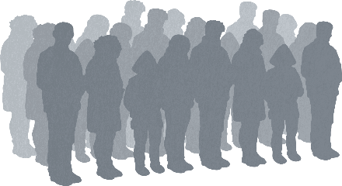
Q9
What is the approximate population of Japan?

Slide 11
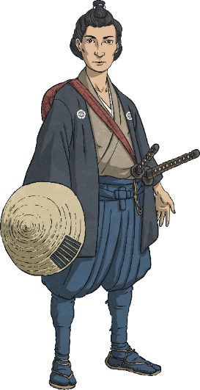
Q10
What were ancient warriors of Japan known as?

Slide 12
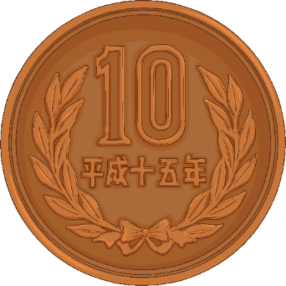
Q11
What is Japan’s currency called?

Slide 13
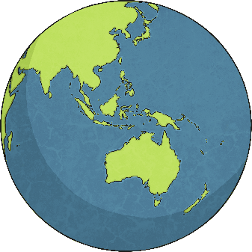
Q12
Which countries are located closest to Japan?

Slide 14
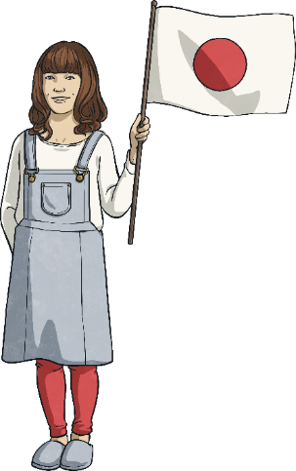
Q13
What does the red circle in the middle of Japan’s flag represent?

Slide 15
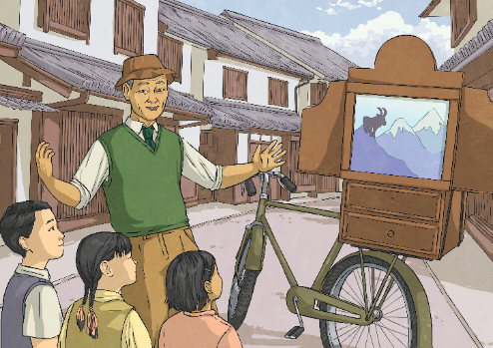
Q14
What covers more than half of Japan?

Slide 16
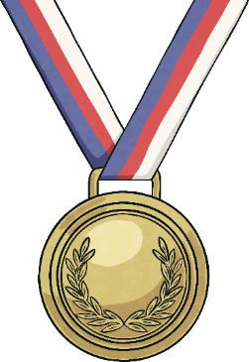
Q15
What is considered Japan’s national sport?

Slide 17
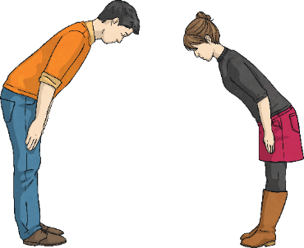
Q16
What does ‘arigatou gozaimasu’ mean?

Slide 18
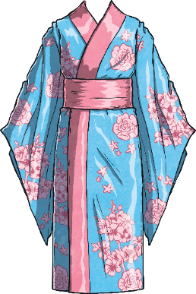
Q17
What clothing is considered traditional Japanese wear?

Slide 19
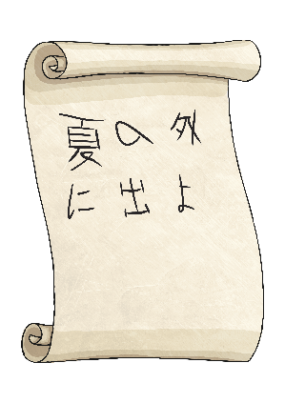
Q18
Japanese writing uses characters instead of the letters of the alphabet that we are familiar with. In what other way is traditional Japanese writing different?

Slide 20
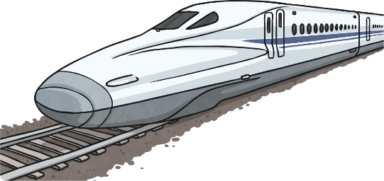
Q19
What is the shinkansen train?

Slide 21
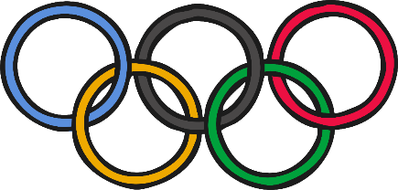
Q20
How many times has Japan hosted the Olympics?

Slide 22
Q1
What is the official language of Japan?
Click here to see the answer!
Japanese
Like te reo Māori, Japanese is separated into several different dialects.

Slide 23
Q2
What is the Japanese name for Japan?
Click here to see the answer!
Nippon or Nihon
Nippon means sun origin. It is often translated as land of the rising sun.

Slide 24
Q3
How many main islands does Japan have?
Click here to see the answer!
There are five main islands
The five main islands are Hokkaido, Shikoku, Kyushu, Honshu and Okinawa.

Slide 25
Q4
What is the capital (and largest) city of Japan?
Click here to see the answer!
Tokyo
Tokyo has over 9 million inhabitants.

Slide 26
Q5
The capital city of Japan is located on which island?
Click here to see the answer!
Honshu
Honshu is the seventh-largest island in the world.

Slide 27
Q6
Which continent does Japan belong to?
Click here to see the answer!
Asia
The continent of Asia is the world's largest and most populated continent.

Slide 28
Q7
What is the name of the mountain that is also the highest point in Japan?
Click here to see the answer!
Mt Fuji
The peak of Mt Fuji is at an altitude of 3776m. Mt Fuji is still considered an active volcano.

Slide 29
Q8
What foods are most commonly associated with Japan?
Click here to see the answer!
Sushi, fish, rice, soy products
Japan has one of the highest healthy life expectancies in the world.

Slide 30
Q9
What is the approximate population of Japan?
Click here to see the answer!
The population of Japan is approximately 127,000,000
Over 90% of the population live in cities.

Slide 31
Q10
What were ancient warriors of Japan known as?
Click here to see the answer!
Samurai
Samurai warriors were experts in martial arts.

Slide 32
Q11
What is Japan’s currency called?
Click here to see the answer!
The Japanese Yen
The highest yen paper note value is ¥10000.

Slide 33
Q12
Which countries are located closest to Japan?
Japan’s closest neighbours are North Korea, South Korea, Russia and China.
Click here to see the answer!
Japan is made up of islands and because of this it does not share a land border with any other countries.

Slide 34
Q13
What does the red circle in the middle of Japan’s flag represent?
Click here to see the answer!
The red circle represents the sun.
The red colour of the symbolic sun is said to represent prosperity. The white background represents the purity, honesty and integrity of the people of Japan.

Slide 35
Q14
What covers more than half of Japan?
Click here to see the answer!
Mountains
There is a mountain range running through each of the four main islands. Many of the mountains are heavily forested.

Slide 36
Q15
What is considered Japan’s national sport?
Click here to see the answer!
Sumo Wrestling
To win a sumo bout, a wrestler has to force their opponent to either step out of the ring or touch the ground.

Slide 37
Q16
What does ‘arigatou gozaimasu’ mean?
Click here to see the answer!
Thank you
Sometimes thank you is shortened to just arigato.

Slide 38
Q17
What clothing is considered traditional Japanese wear?
Click here to see the answer!
Kimono
Traditional kimono are made from silk.

Slide 39
Q18
Japanese writing uses characters instead of the letters of the alphabet that we are familiar with. In what other way is traditional Japanese writing different?
The characters are written from right to left and/or in columns from top to bottom.
Click here to see the answer!
Learning to speak Japanese is considered much easier than learning to write in Japanese.

Slide 40
Q19
What is the shinkansen train?
This is the high-speed train in Japan, also known as the bullet train.
Click here to see the answer!
It is the world’s fastest passenger train, reaching speeds of over 300km per hour.

Slide 41
Q20
How many times has Japan hosted the Olympics?
Click here to see the answer!
Three times
Japan will host the Olympics again in 2020.

