Slide 1
French
Getting to Know You
Year One
French | Year 3 | Getting to Know You | Goodbye! | Lesson 4

Slide 3
Aim
To choose appropriate phrases for the situation.
Success Criteria
I can say goodbye in a variety of ways.
I can use formal and informal language.

Slide 4
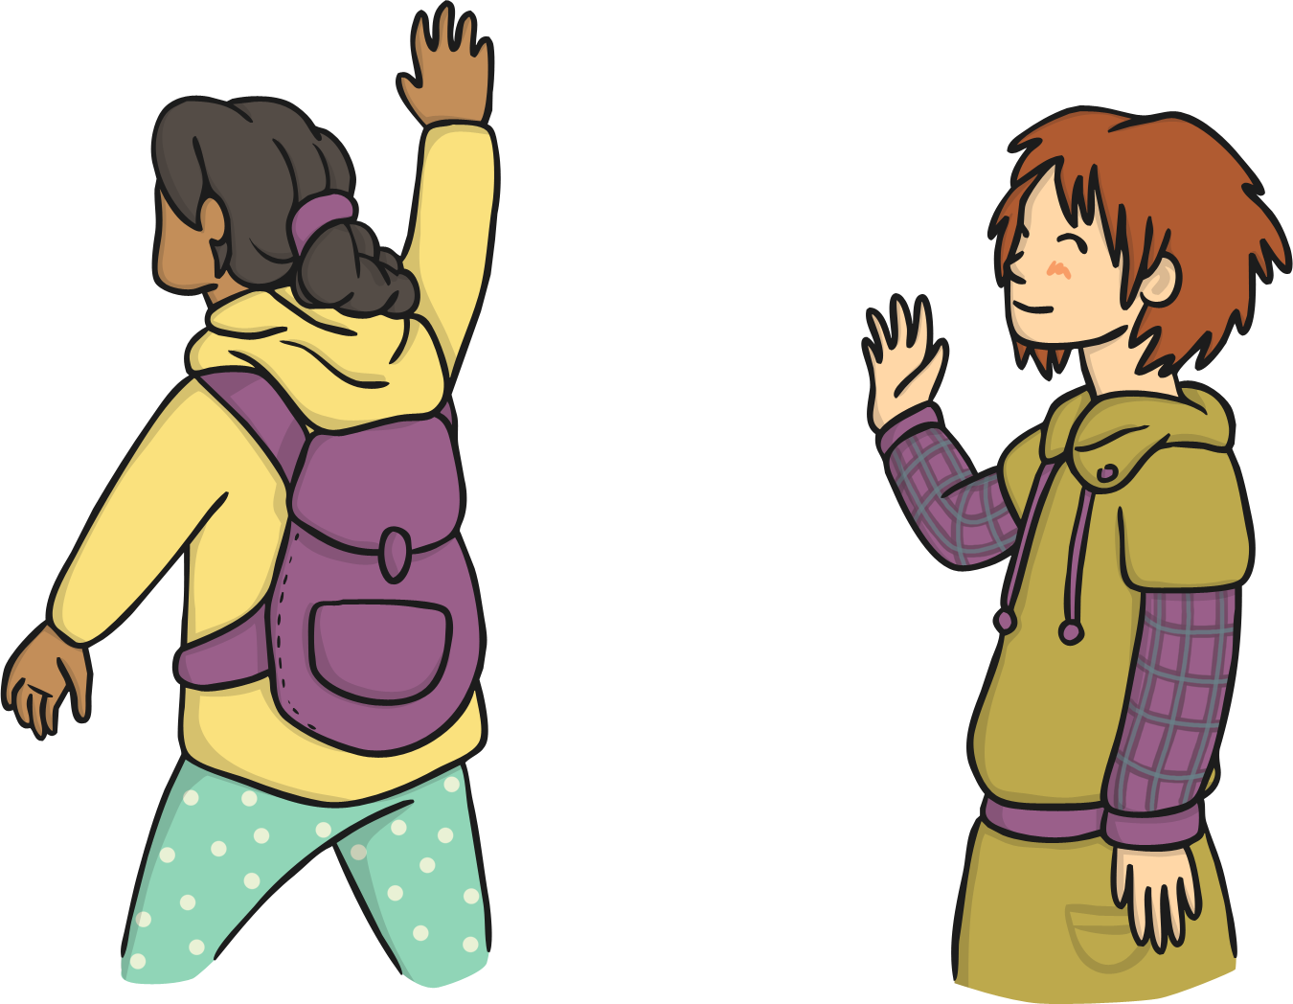
Goodbye!
How many different ways can you think of to say goodbye?

Slide 5
Au revoir.
Au revoir Jean.
Au revoir Brigette.

Slide 6
À bientôt.
À bientôt.

Slide 7
À tout à l’heure.
À tout à l’heure.

Slide 8
Salut!
Salut!
Salut!

Slide 9
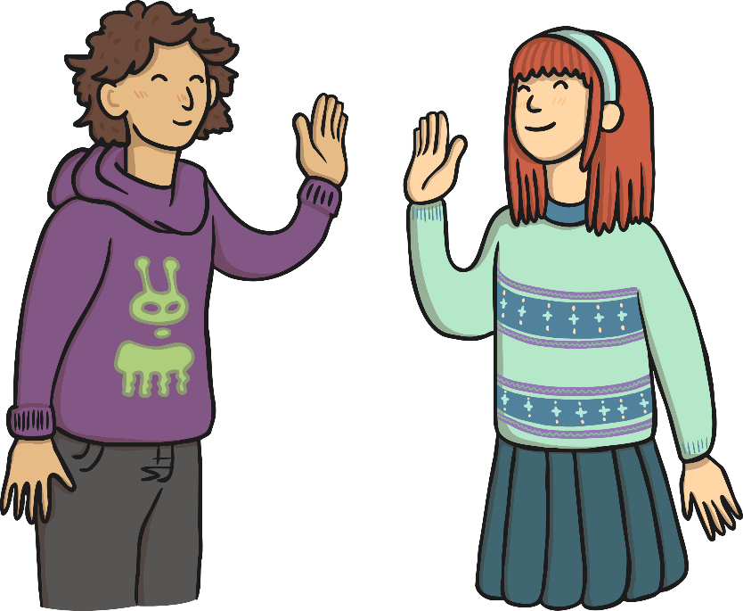
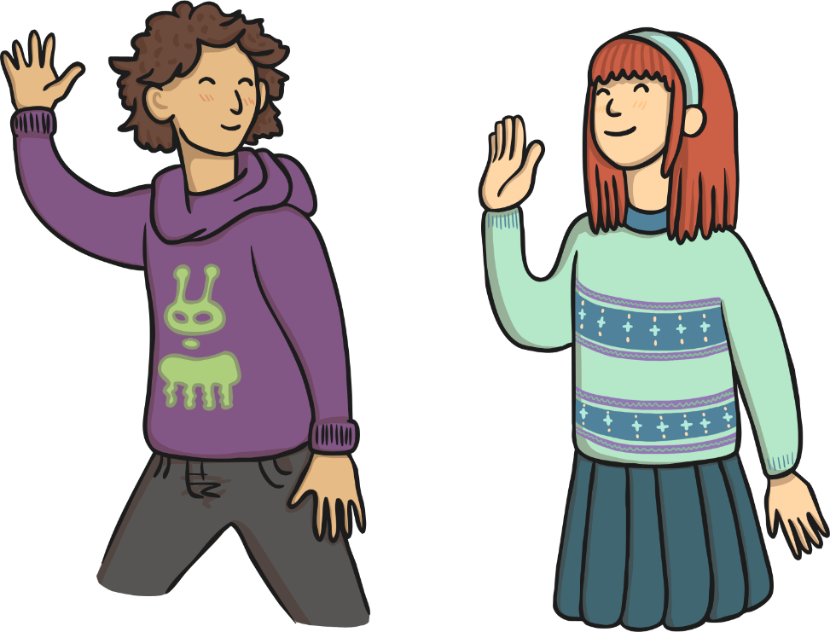
A demain.
A
demain.
Bonjour!
Tuesday
Wednesday

Slide 10
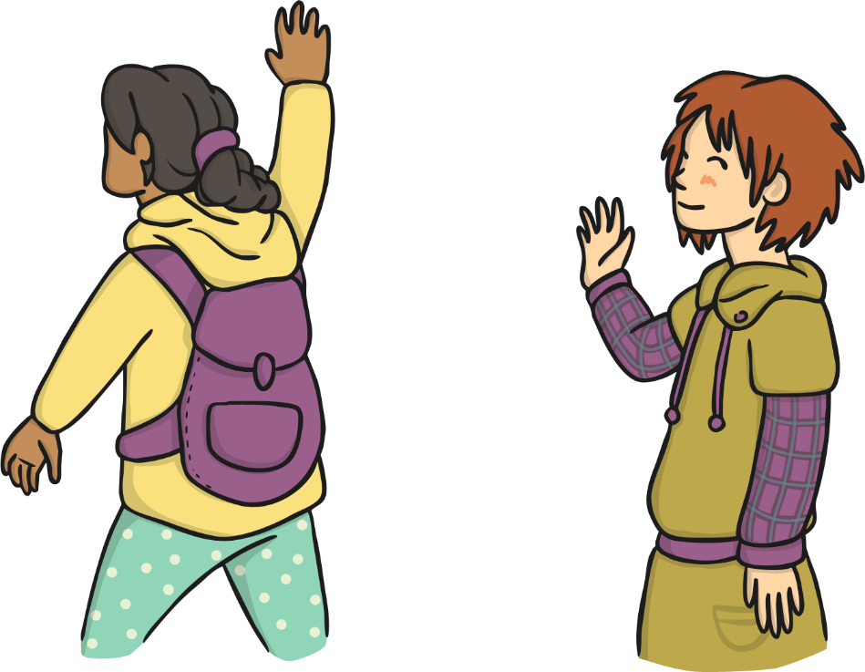
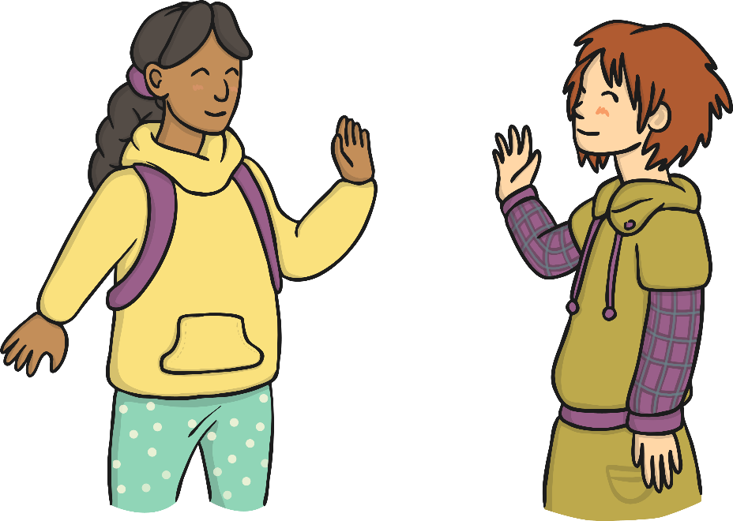
Bon week-end.
Bon
week-end.
Bonjour!
Friday
Monday

Slide 11
Aim
To choose appropriate phrases for the situation.
Success Criteria
I can say goodbye in a variety of ways.
I can use formal and informal language.

