Slide 1
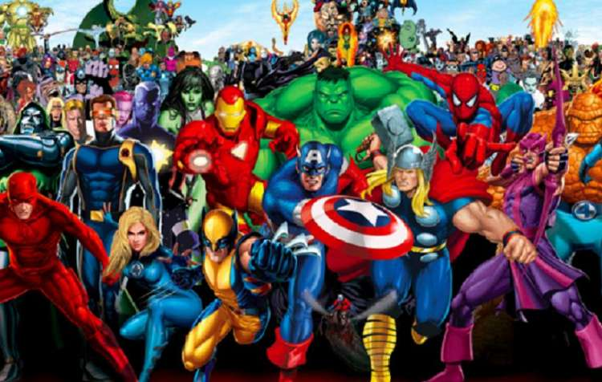
Learning Objective: Designing a super hero
Task
It is time to design your Superhero! You can chose to use one of the templates provided, or if you want to challenge yourself, draw your superhero from scratch!
Make sure you use colour, and give your hero a name!
It is important to think about what you said made a good superhero in your mind map so look back at that for ideas!
Useful Tips:
Think about what colours make a hero stand out?
Think about what a hero does and how you can represent that in your design.
Be different! You can take inspiration from others but don’t copy! Your hero should be something new!

