Slide 1
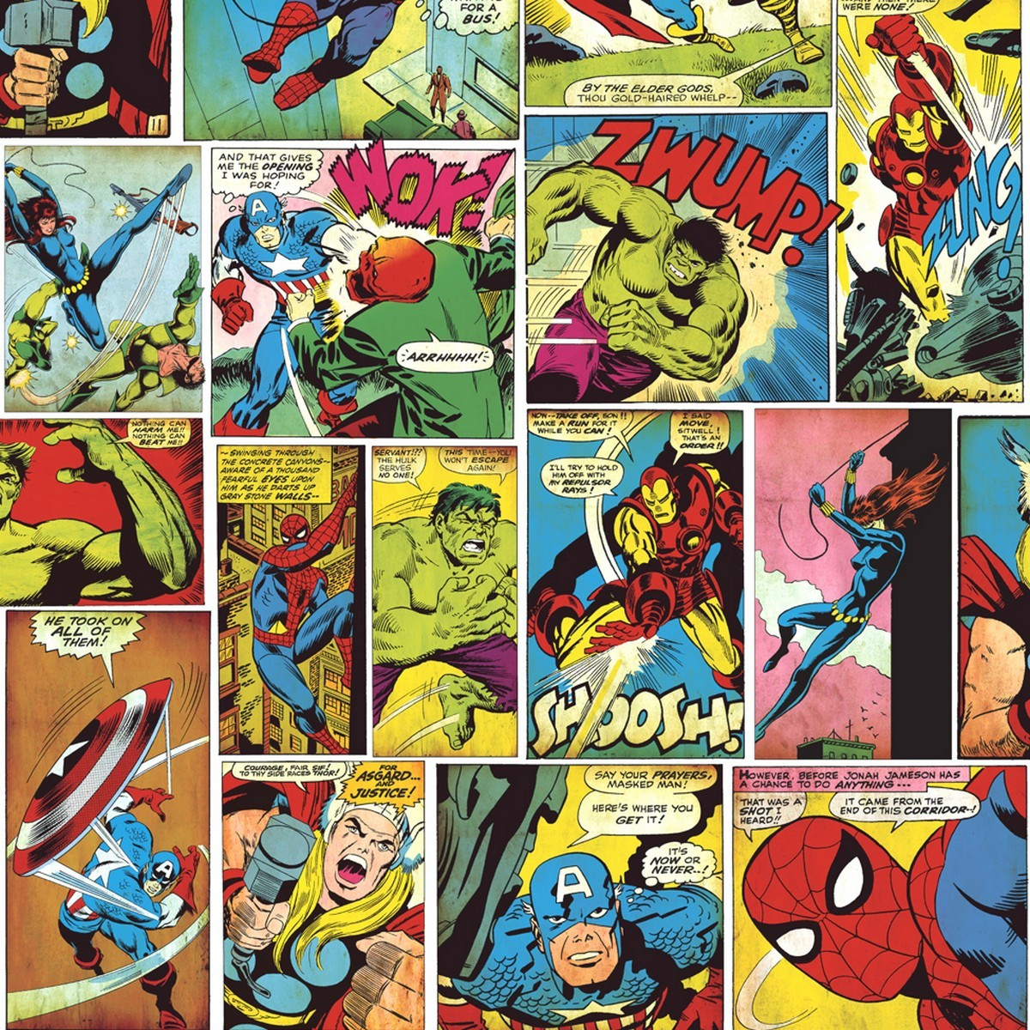
Learning Objective: Designing a comic strip
Task
It is time to design a comic strip for your Superhero! Your comic strip should tell a story. You can use the comic template or if you want to really challenge yourself you can draw your own!
Your Story should have:
A beginning:
This could be used to introduce your hero
A twist:
Something is wrong or there is a problem
It gets worse:
It looks like your hero is in trouble, maybe he cant do it?!
An Ending:
Somehow, your hero turns things around and saves the day!

