Slide 1
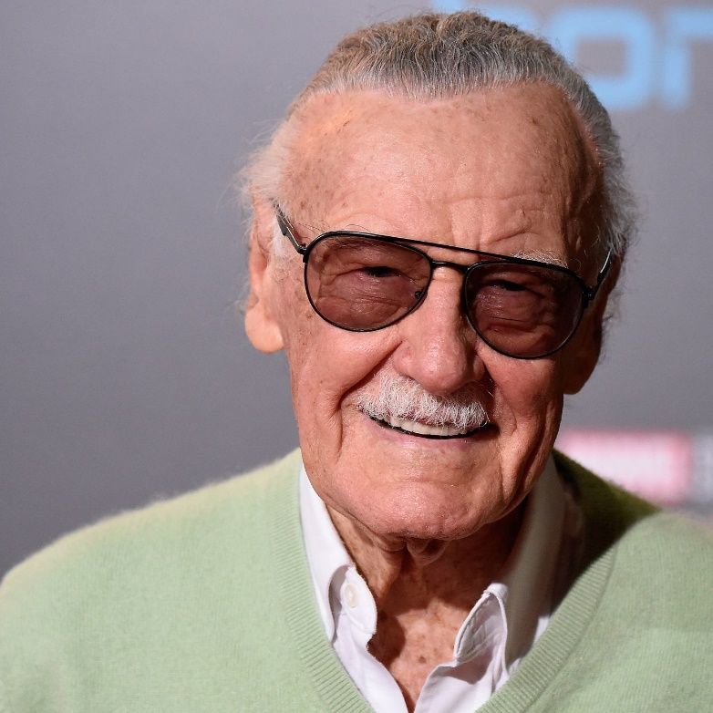
Learning Objective: Research a comic book artist
Stan Lee
Stan Lee is one of the greatest and most well known comic book artists. He is responsible for creating or influencing some of the most famous superheroes known today, including Spiderman, The Avengers, The Incredible hulk and many more!
Task:
Complete Artist Write up template
Facts
Stan Lee was born in 1922 in New York.
He died in 2018
He was an American comic book writer, editor, publisher, and producer.
His real name was Stanley Martin Lieber
His favourite character was Spider man
Lee was inducted into the comic book industry's Will Eisner Award Hall of Fame in 1994 and the Jack Kirby Hall of Fame in 1995. He received the NEA's National Medal of Arts in 2008.

