Slide 1
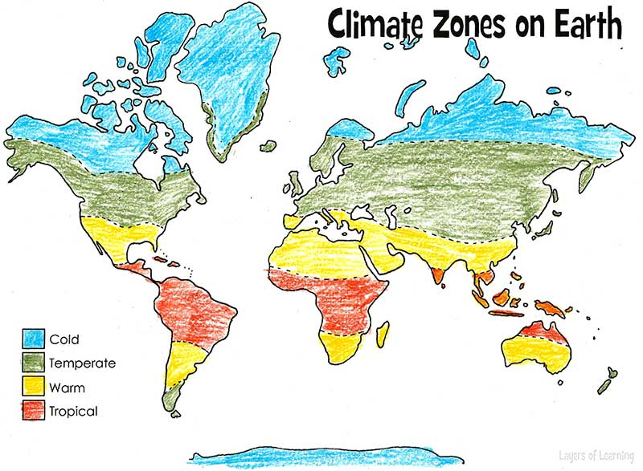

Slide 2
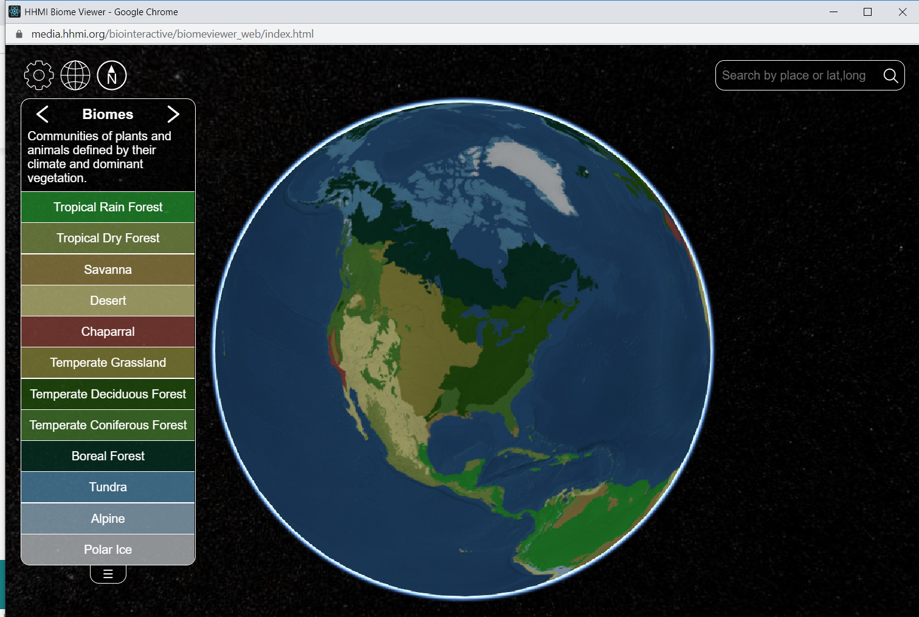
A biome is a word for a particular environment on Earth. Biomes have different climates. It could be a desert, a forest or a grassland. Different animals live in different biomes. You are going to find out about some different biomes using this website: media.hhmi.org/biointeractive/biomeviewer_web/index.html
The website should look like this:
Follow the examples in this presentation.
This will show you what to do.
Then you will need to find different places to complete your own fact files.

Slide 3
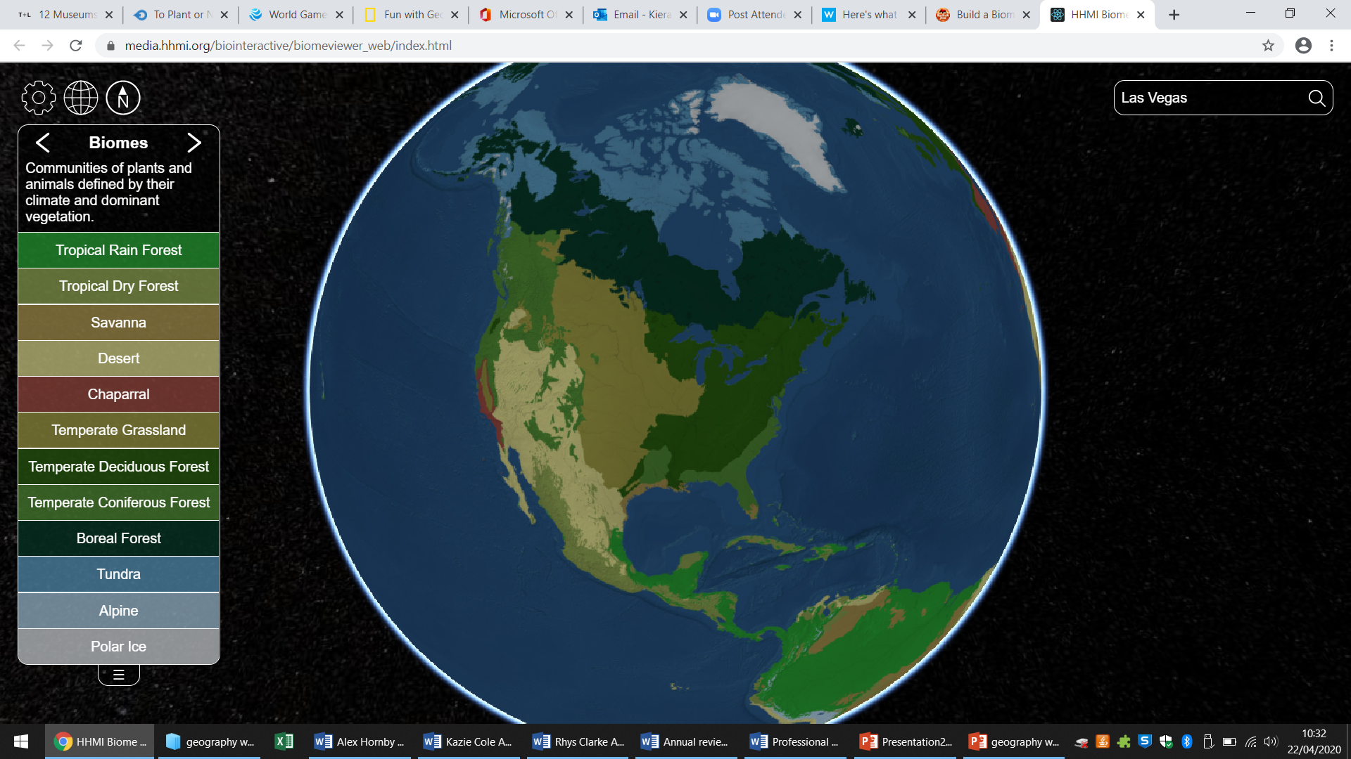
This is an example of what to do.
I am going to search for Las Vegas in the United States of America.
Type the place you are searching for here.
Here, I type in Las Vegas.

Slide 4
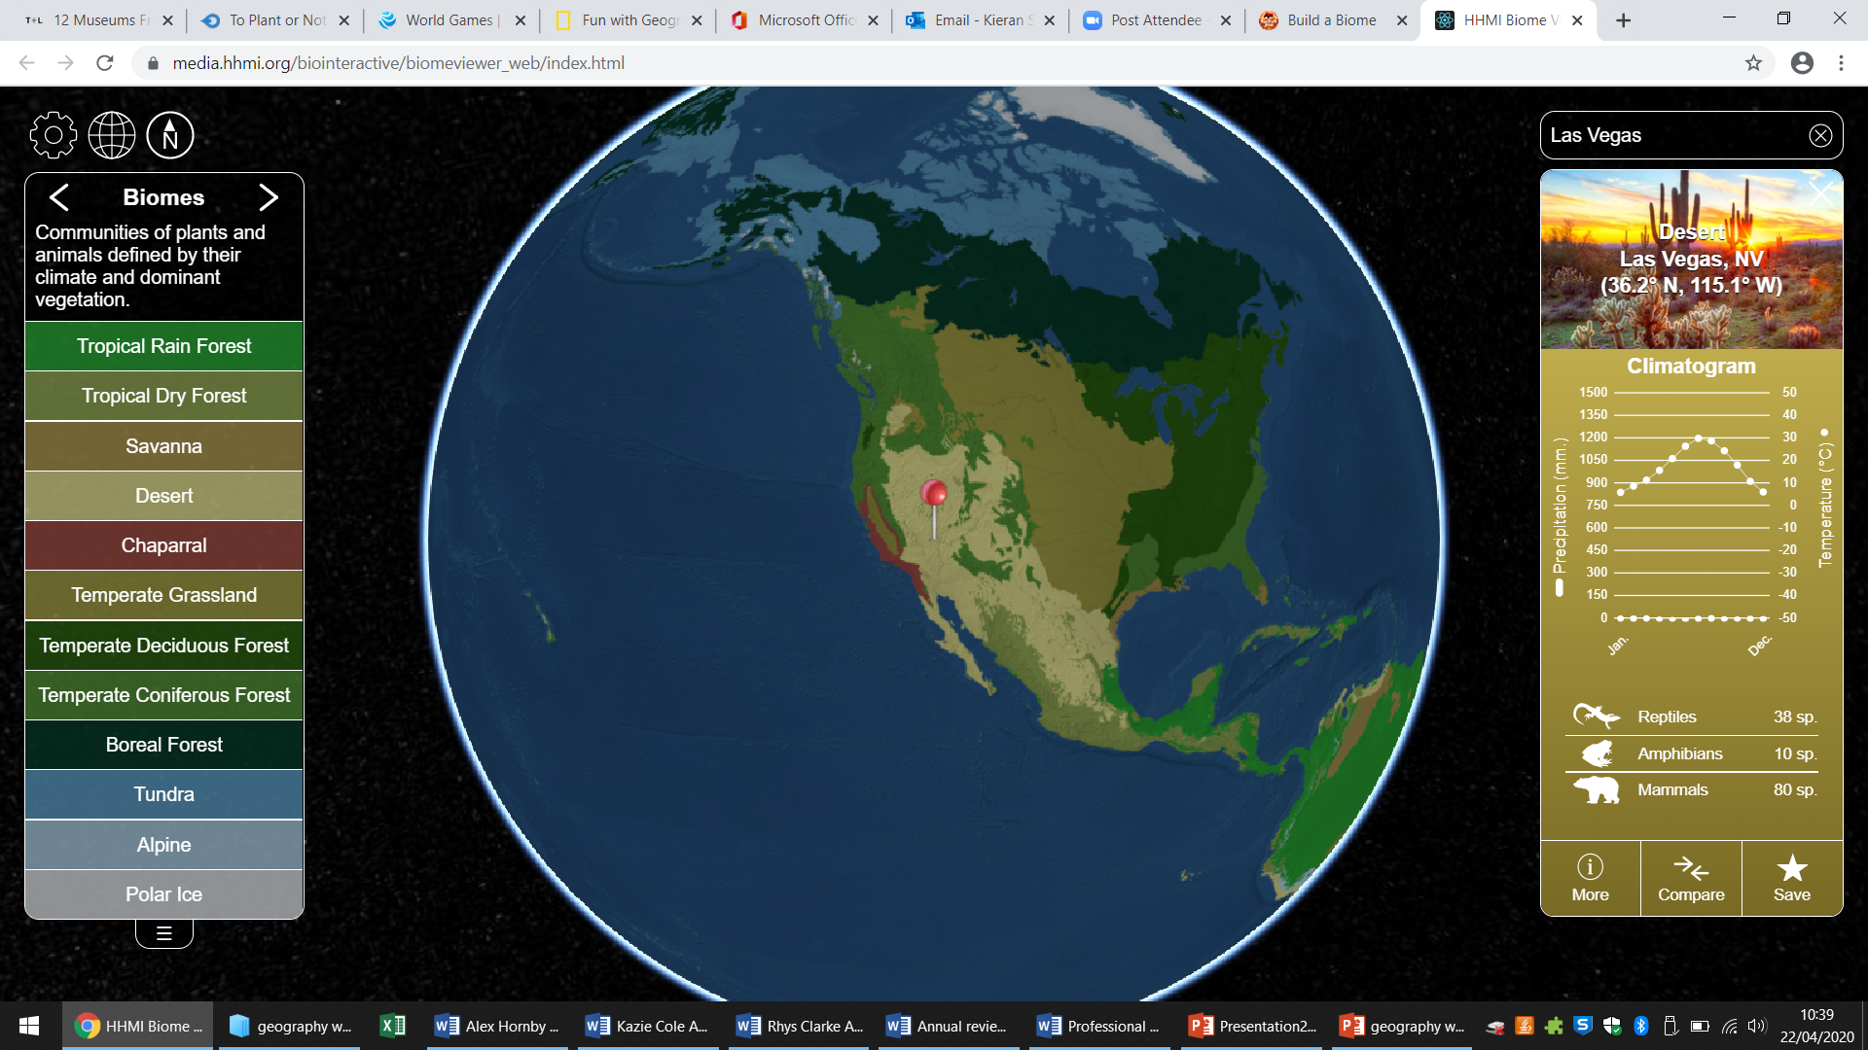
This is an example of what to do.
It then tells me where Las Vegas is and what type of Biome is there. In this case it is a desert.
Here it tells you the name of the biome.

Slide 5
This is an example of what to do.
Now I can find out more information by looking at the side bar. It tells me how many species
of different animals live here.
Here it tells you the number of animal species.

Slide 6
This is an example of what to do.
I can find more information by clicking on more at the bottom.
This is where you click to find out more information.

Slide 7
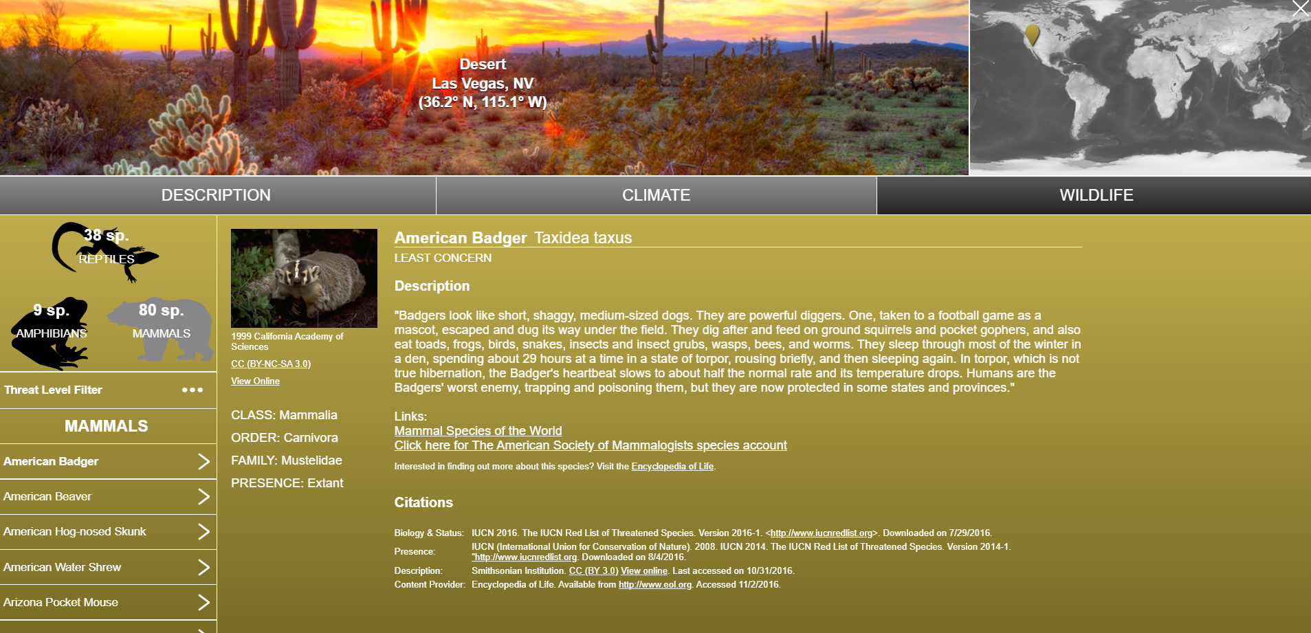
This is an example of what to do.
This tells me about the climate is like what wildlife can be found here.
Where it is in the world

Slide 8
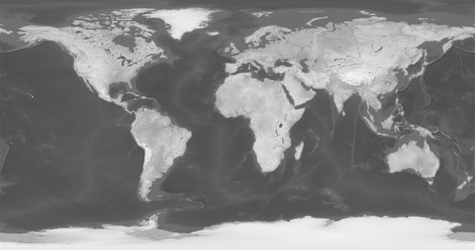



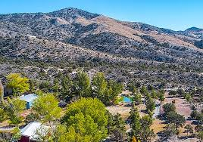
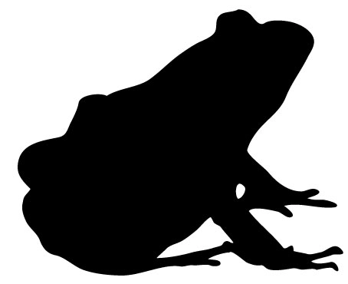
This is an example of how to complete the fact file. This is what it should look like.
The first line tells you the place to search. The part in purple are for you to fill in with the information you find.
Where is it in the world?
Place: Las Vegas.
Move this red pin to the right location it on the map.
The biome here is a desert.
There are 38 reptile species.
There are 80 mammal species.
Find an image of this place and paste it here:
There are 9 amphibian species.

