Slide 1
Sex and Relationships part 2

Slide 2
TASK: Write down everything you
know about sexting or discuss with your parent?
Sending sexually explicit photographs or messages via mobile phone
Rude text messages or videos
Explicit or ‘dirty’ pics
‘Underwear shots'
They can be sent to or from a friend, boyfriend, girlfriend or someone you've met online
Naked pictures or 'nudes'

Slide 3
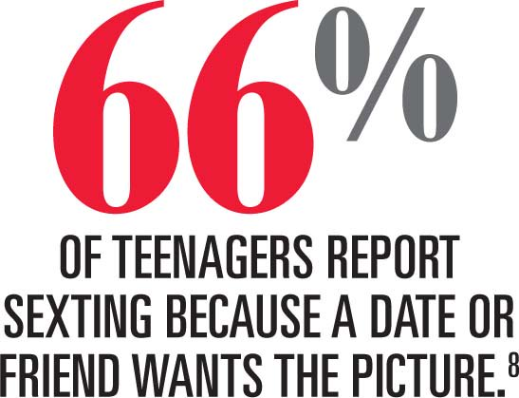
Did you know?
Worst case scenarios of sexting have led to blackmail, depression and even suicide

Slide 4
Why is sexting harmful?
Sexting can damage reputations – social and digital.
Emotionally, sexting can take a toll on a person, especially if it backfires and gets into the wrong hands.
Texts or images sent (even via “disappearing” messaging apps) can be, and usually are, screenshotted and shared or forwarded.
Online, peers can use social media to repost the image, to taunt and harass the original sender.
In a school setting, gossip and rumours can lead to bullying, even physical harassment.
Young people may feel like they're caught in a trap with no way out.
Consequences could be life long: images could re-surface years after being taken and posted. Employers may find things out from online searches etc.

Slide 5
Sexting and the law
It is illegal to possess, take or distribute sexual images of someone who is under 18, even if that person is yourself.
Breaking that law can result in under-18s receiving a police caution or being put on the sex offender register.

Slide 6
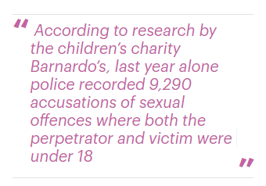
Sexting and the law
Boy of five among nearly 400 sexting cases dealt with by police
If you are under the age of 18, the law sees you as a child. Therefore, if you have any indecent images or videos of somebody who is under 18 you would technically be in possession of an indecent image of a child – even if you are the same age.
Where sexual imagery of young people is created, stored or distributed, young people could be added to the police database

Slide 7
TASK: What can you do if you experience sexting? Write down the steps you would take.
Talk to an adult you trust about the situation e.g. parent, carer or teacher
Un-invite or block users
If you've been sent a sexual image or video, don't pass it on or share it with anyone.
Make a report about what’s happened to the Internet Watch Foundation (IWF)
Report them to the police

Slide 8
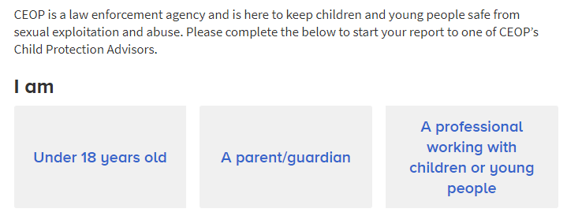
Reporting an incident
Report them using: www.ceop.police.uk/ceop-report/

Slide 9
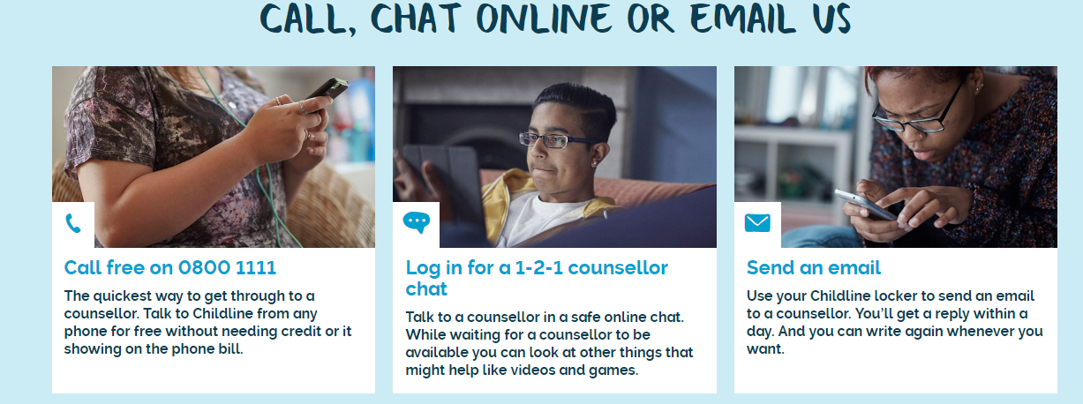
Childline can help you

Slide 10
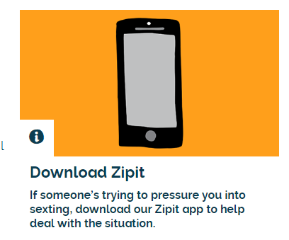
Childline can help you
If you have been affected by any aspect of sexting you can get help from Childline:
Childline – 0800 11 11 or in an online chat at
http://www.childline.org.uk/Talk/Chat/Pages/OnlineChat.aspx
Family Support Workers by calling our confidential helpline on 0808 800 2222.

Slide 11
SUMMARY:

