Slide 1
The great classical composers.
Classical music is serious music in forms such as symphonies, sonatas and concertos.

Slide 2
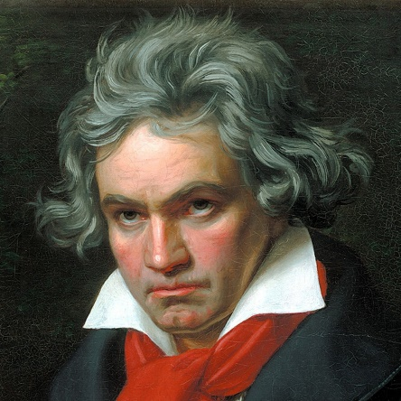
Beethoven.
Ludwig van Beethoven was a German composer and pianist; his music is amongst the most performed of the classical genre. Famed for hearing problems he suffered from early adulthood and went deaf by about age 45, though he continued to compose after that.
Born: December 1770, Bonn, Germany.
Died: 26 March 1827, Vienna, Austria.

Slide 3
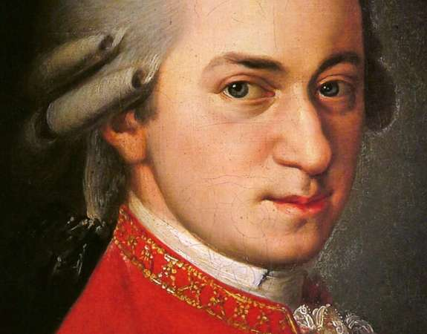
Mozart.
Wolfgang Amadeus Mozart was one of the greatest and most influential composers in the history of Western music. He composed over 600 works for all the musical genres of his day including operas, concertos, symphonies, chamber music and sonatas, and excelled in each one. He famously composed his first piano piece by age 5.
Born: 27 January 1756, Salzburg, Austria.
Died: 5 December 1791, Vienna, Austria.

Slide 4
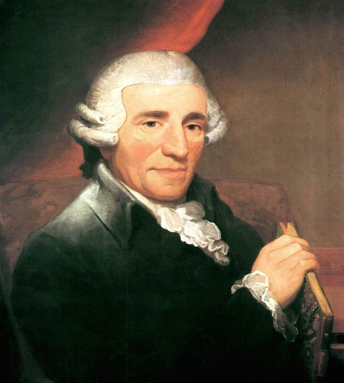
Haydn.
Franz Joseph Haydn was an Austrian composer of the Classical period. He was instrumental in the development of chamber music such as the piano trio. His contributions to musical form have earned him the epithets "Father of the Symphony" and "Father of the String Quartet".
Born: 31 March 1732, Rohrau, Austria.
Died: 31 May 1809, Vienna, Austria.

Slide 5
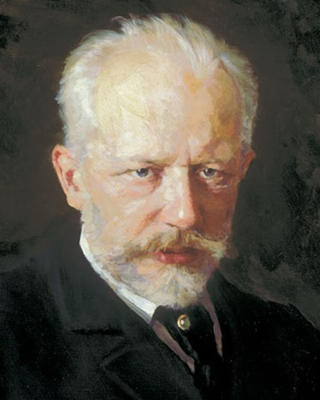
Tchaikovsky.
Pyotr Ilyich Tchaikovsky was a Russian composer of the Romantic period. His music made a lasting impression internationally, which was boosted by his appearances as a guest conductor in Europe and the United States.
Born: 7 May 1840, Votkinsk, Russia.
Died: 6 November 1893, Saint Petersburg Russia.

Slide 6
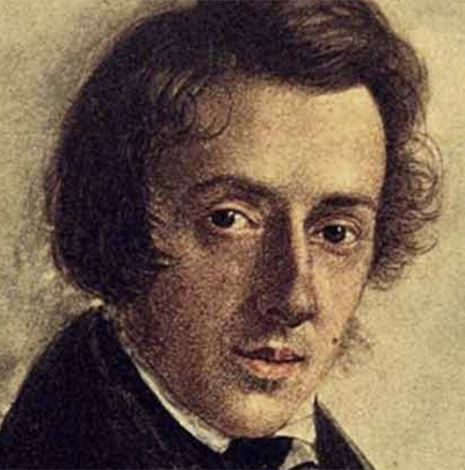
Chopin.
Frédéric François Chopin was a Polish composer and virtuoso pianist of the Romantic era who wrote primarily for solo piano. He is widely known as a leading musician of his era.
Born: 1 March 1810, Żelazowa Wola, Poland.
Died: 17 October 1849, Paris, France.

Slide 7
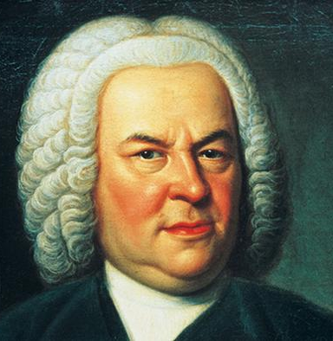
Bach.
Johann Sebastian Bach was a German composer and musician of the Baroque period. He is known for instrumental compositions such as the Brandenburg Concertos and the Goldberg Variations.
Born: 31 March 1685, Eisenach, Germany.
Died: 28 July 1750, Leipzig, Germany.

Slide 8
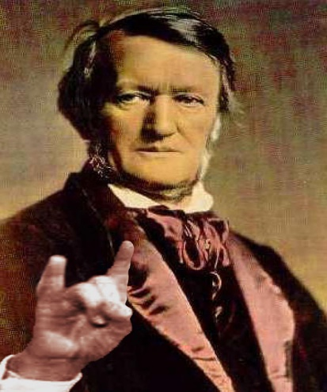
Wagner.
Wilhelm Richard Wagner was a German composer, theatre director, and conductor who is chiefly known for his operas. Unlike most opera composers, Wagner wrote both the libretto and the music for each of his stage works.
Born: 22 May 1813, Leipzig, Germany.
Died: 13 February 1883, Venice, Italy.

Slide 9
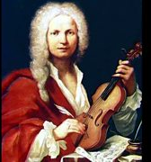
Vivaldi.
Antonio Lucio Vivaldi was an Italian Baroque musical composer, virtuoso violinist, teacher, and Roman Catholic priest. He is regarded as one of the greatest Baroque composers.
Born: 4 March 1678, Venice, Italy.
Died: 28 July 1741, Vienna, Austria.

Slide 10
Liszt.
Franz Liszt was a Hungarian composer, virtuoso pianist, conductor, music teacher, arranger, and organist of the Romantic era. He was also a writer, philanthropist, and Franciscan monk.
Born: 22 October 1811, Raiding, Austria.
Died 31 July 1886, Bayreuth, Germany.

Slide 11
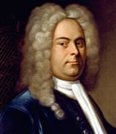
Handel.
George Frideric Handel was a German, later British, Baroque composer who spent the bulk of his career in London, becoming well known for his operas, oratorios, anthems and concertos.
Born: 5 March 1685, Halle (Saale), Germany.
Died: 14 April 1759, London.

Slide 12
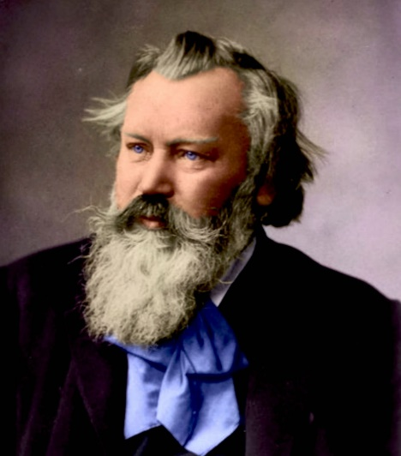
Brahms.
Johannes Brahms was a German composer, pianist, and conductor of the Romantic period. He spent much of his professional life in Vienna.
Born: 7 May 1833, Hamburg, Germany.
Died: 3 April 1897, Vienna, Austria.

Slide 13
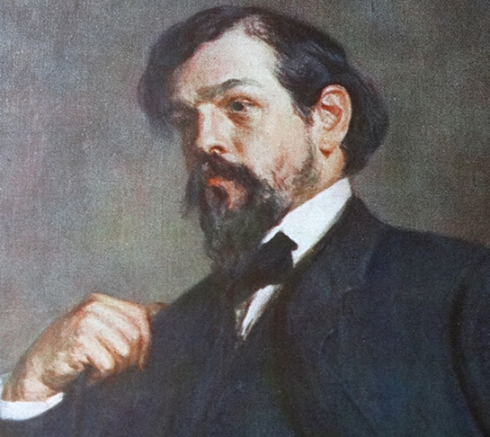
Debussy.
Claude Debussy was a French composer. Often seen as the first Impressionist composer. He was among the most influential composers of the late 19th and early 20th centuries.
Born: 22 August 1862, Saint Germain, France.
Died: 25 March 1918, Paris, France.

Slide 14
More.
If you would like to listen to the full pieces please continue.

Slide 15
Beethoven.
Symphony N.o. 5

Slide 16
Mozart.
A little night music.

Slide 17
Haydn.
Serenade.

Slide 18
Tchaikovsky.
Swan Lake.

Slide 19
Chopin.
Prelude in E minor.

Slide 20
Bach.
Toccata in D minor.

Slide 21
Wagner.
Ride of the Valkyries.

Slide 22
Vivaldi.
Winter from the Four Seasons.

Slide 23
Liszt.
Hungarian Rhapsody N.o. 2.

Slide 24
Handel.
Solomon Arrival of the Queen of Sheba.

Slide 25
Brahms.
Lullaby.

Slide 26
Debussy.
Clare De Lune.

Slide 27
Finished.

