Slide 2
Each week we will be setting you a challenge to complete in your home. We would like you to take photographs or videos of you doing the activities and send them to your class teams. (Please ask your parents for permission before sending your photos to us.)

Slide 3
Challenge 2: Hand Washing Dishes!

Slide 4
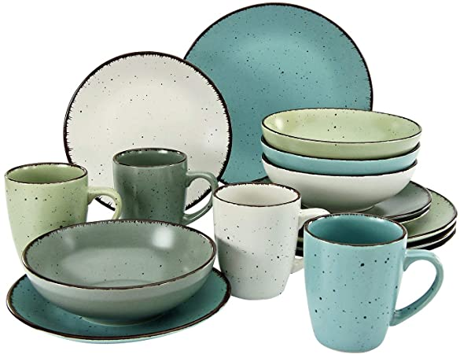
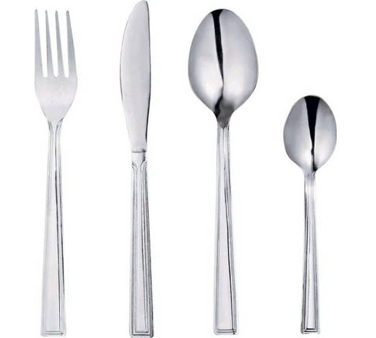
Key words:
Crockery = Plates, Bowls, Cups and Mugs
Cutlery =
Knives, Forks and Spoons

Slide 5
Top tips for washing the dishes!
Scrape all left over food into the bin.
Wash the plates, bowls and cups first.
Remember to wash the outside of the crockery.
Be extra careful when washing the cutlery especially if you have used sharp knives to prepare the food.
Check the temperature of the water before putting you whole hand in.
Rinse the bubbles off the crockery and cutlery before putting on the drainer.
Place the crockery on the drainer UPSIDE down so that the water drains out.

Slide 6
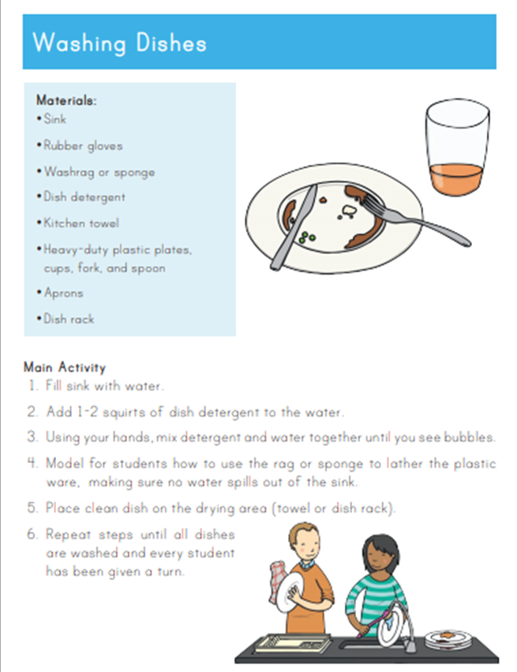

Slide 7
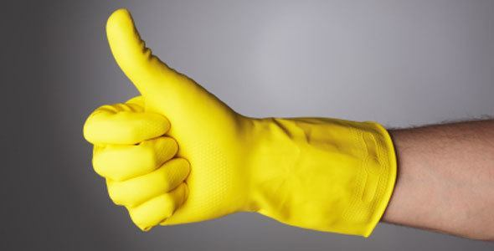
Can you do this daily? Did you need any help when you first started?

Slide 8
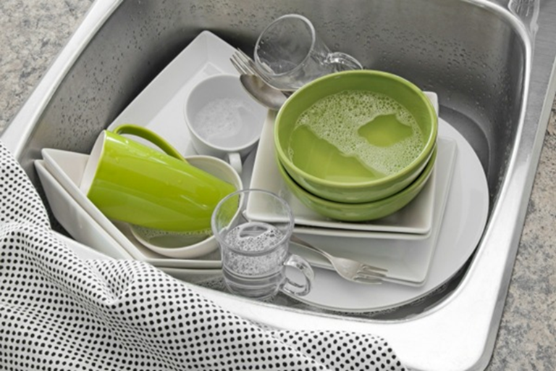
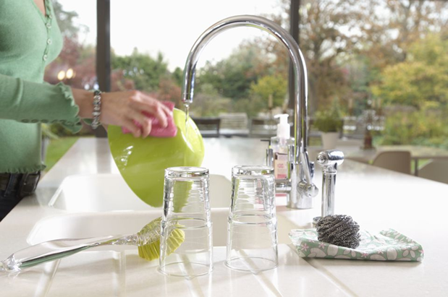
Take a photo of the before and after and share with us what you can do!

Slide 9
