Slide 2
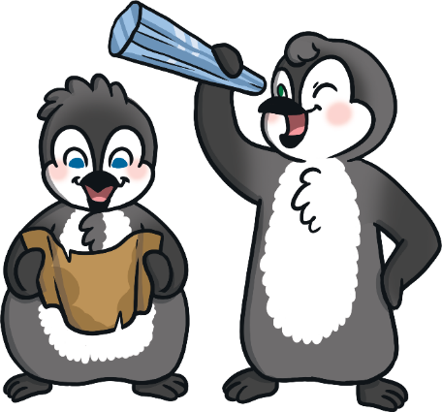
The Runaway Iceberg
Read the book ‘The Runaway Iceberg’ and look at the illustrations.
To see a question about the book, click this button:
?

Slide 3
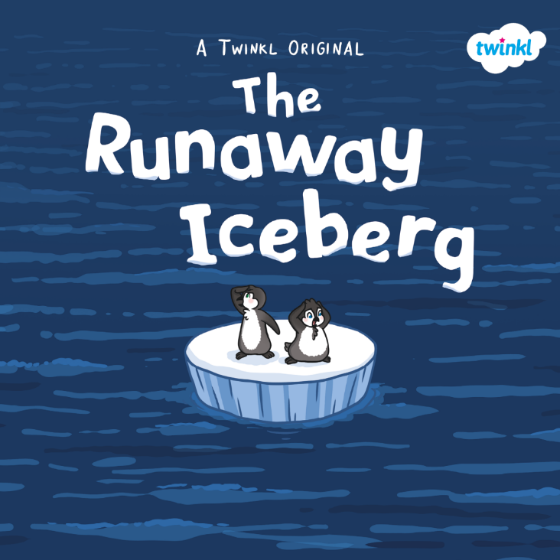
?
What do you think this book is going to be about?
?
Do you think it is fiction or non-fiction?
?
Where do you think it is set?

Slide 4
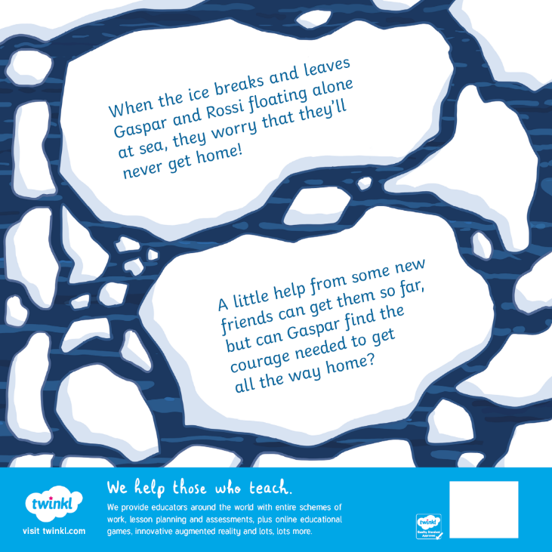
?
Who do you think could be the ‘new friends’ that the penguins meet? Who else might live in a place like this?
?
What do you think the word ‘courage’ means?

Slide 5
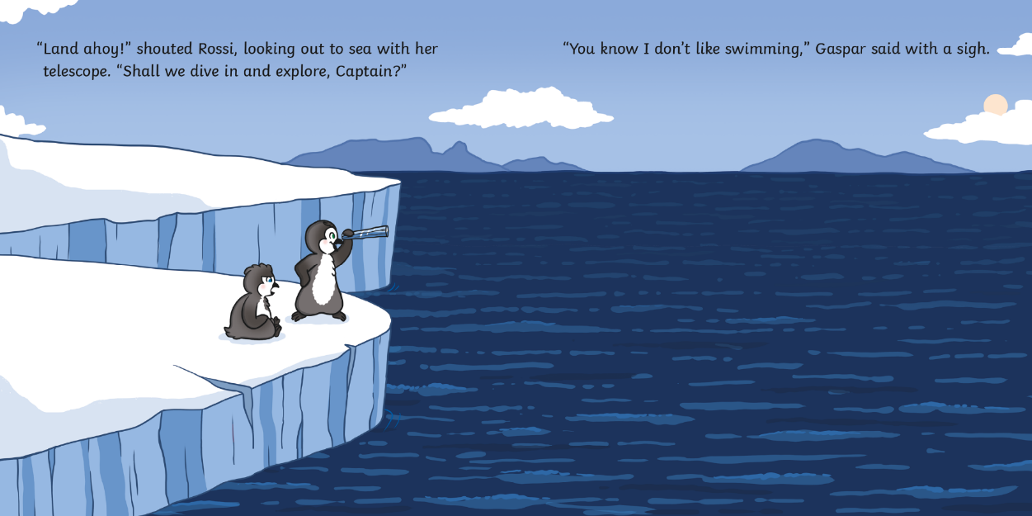
?
Why doesn’t Gaspar dive into the water?

Slide 6
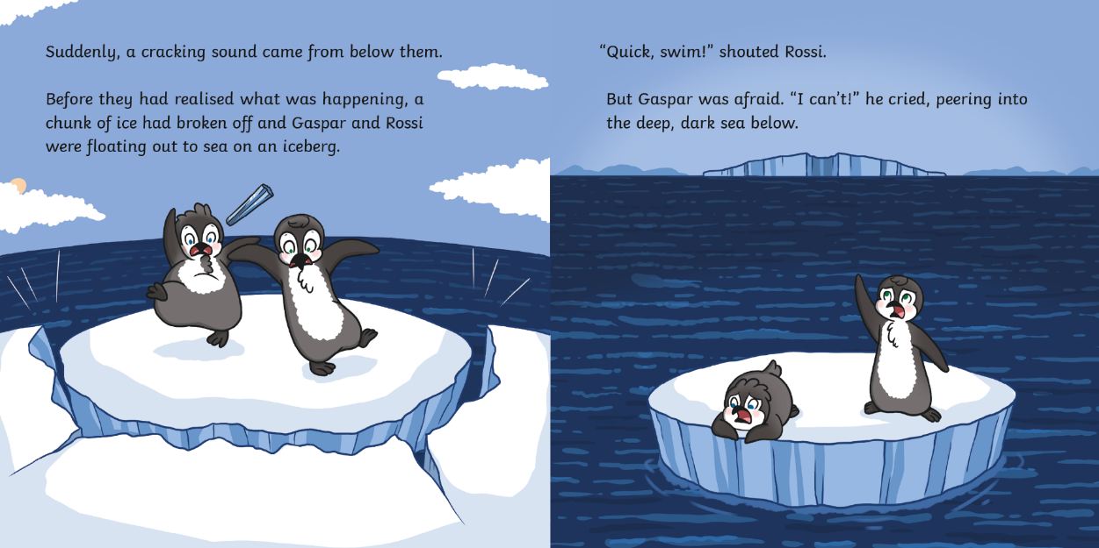
?
Do you think the ice broke quickly or slowly? How do you know?

Slide 7
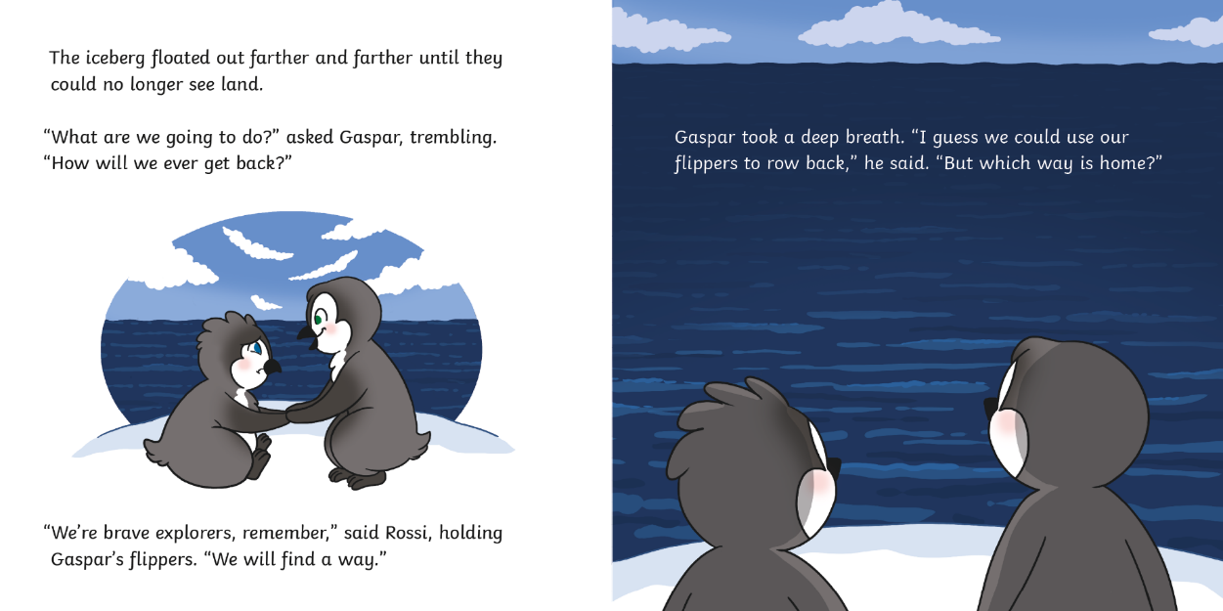
?
How do you think Gaspar feels?

Slide 8
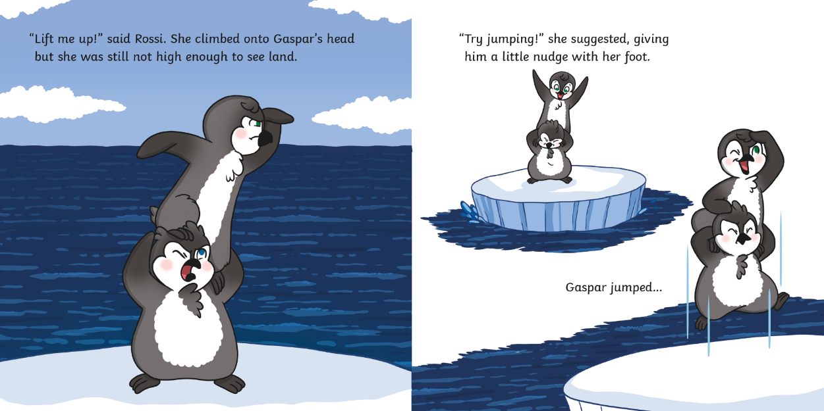
?
What are the penguins looking for?

Slide 9
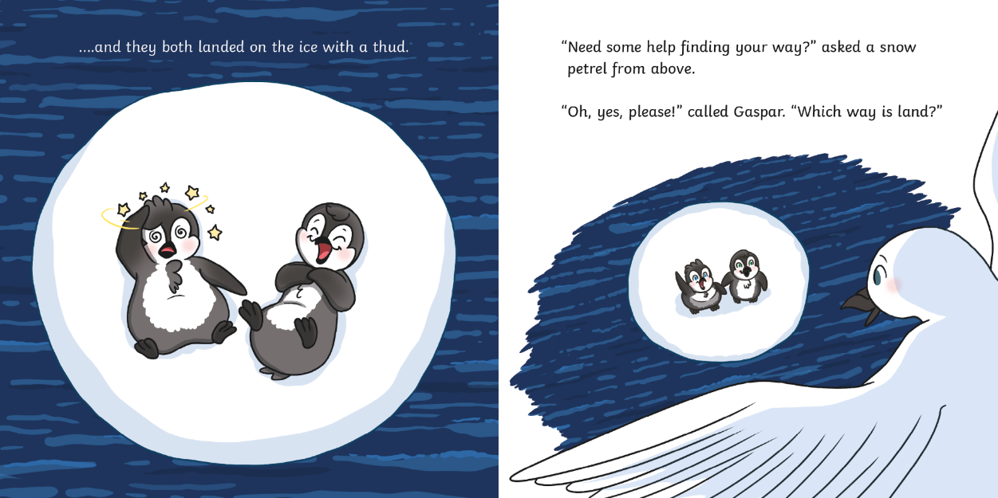
?
Do you think the snow petrel is being kind? Why?

Slide 10
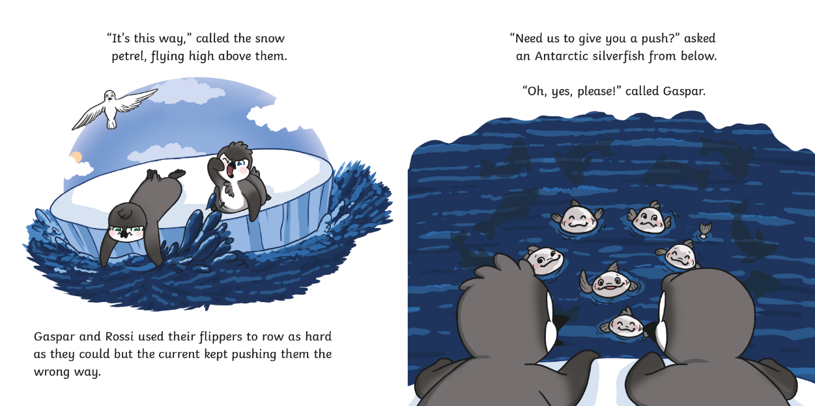
?
What is ‘the current’? What do you think this means?

Slide 11
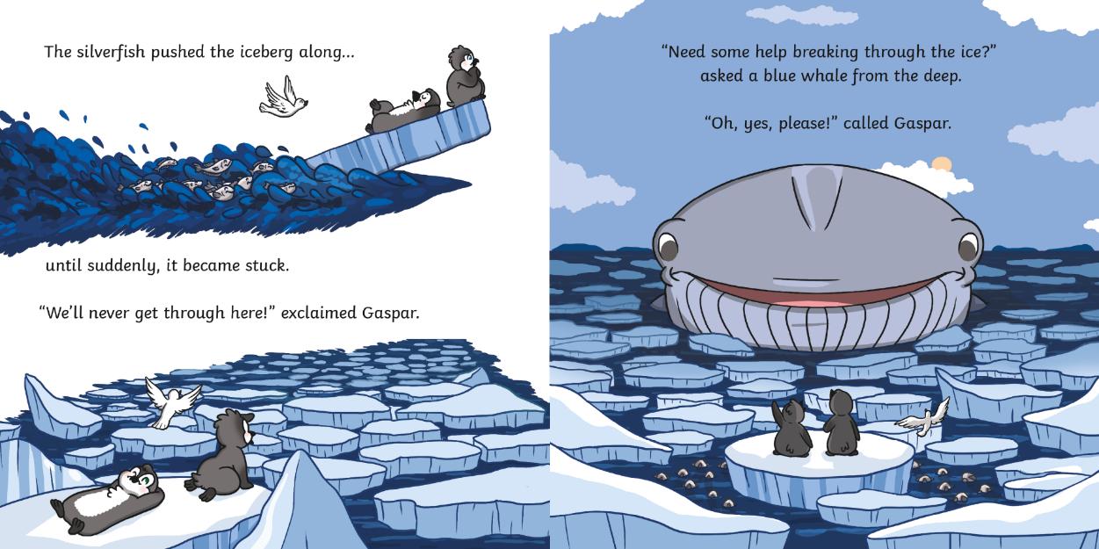
?
How do you think the blue whale will help the penguins break through the ice?

Slide 12
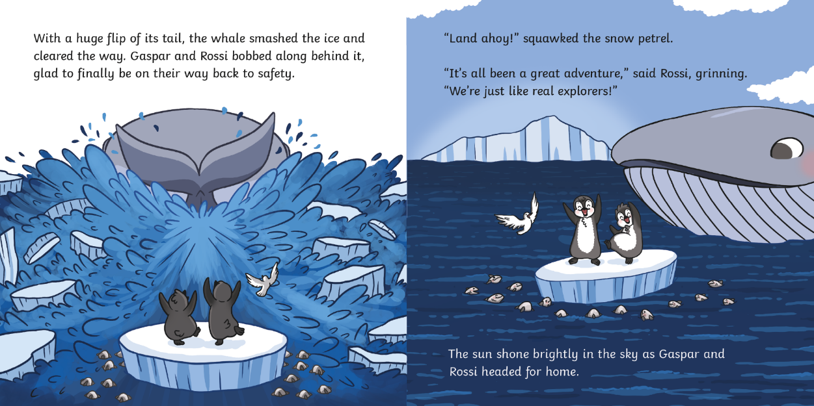
?
Why does Rossi say that she and Gaspar are ‘just like real explorers’?

Slide 13
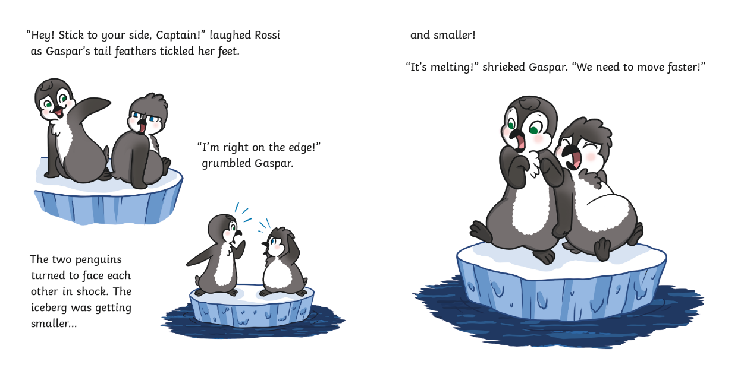
?
What will happen if the iceberg melts?

Slide 14
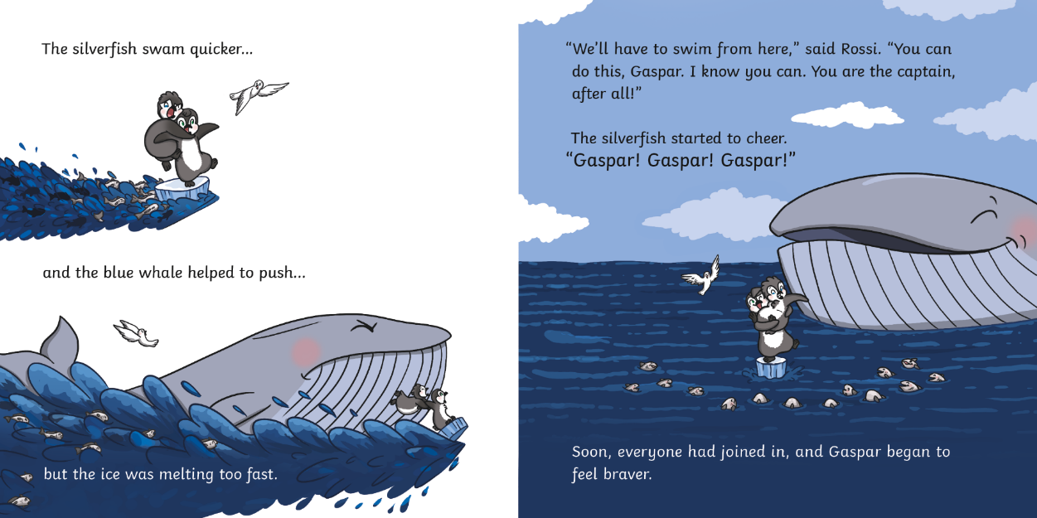
?
Do you think Rossi is a good friend? Why?

Slide 15
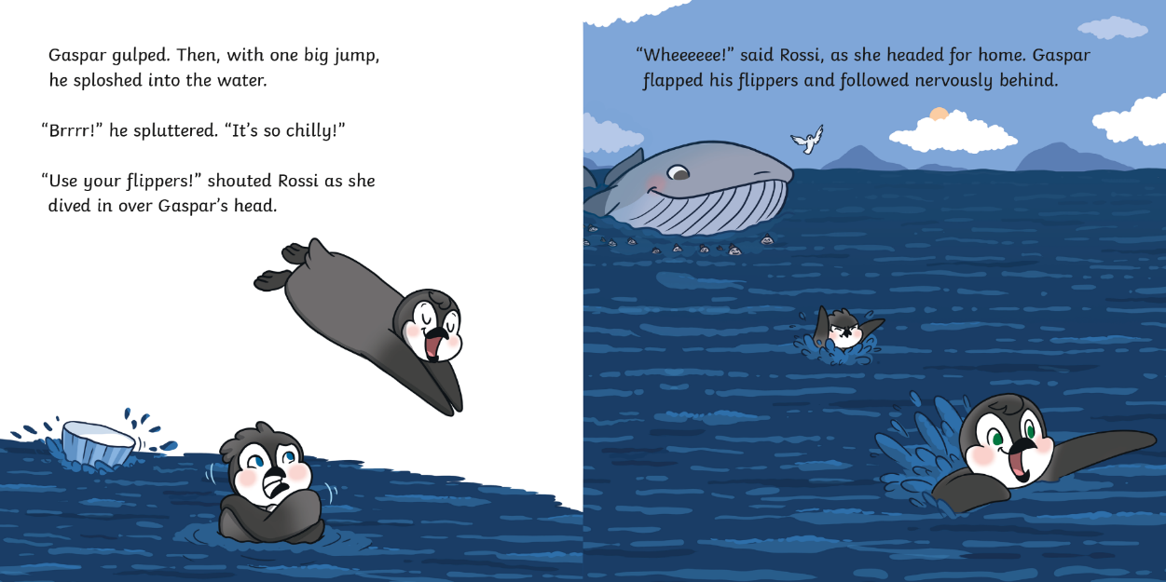
?
Can you find a word that tells you how Gaspar feels about swimming?

Slide 16
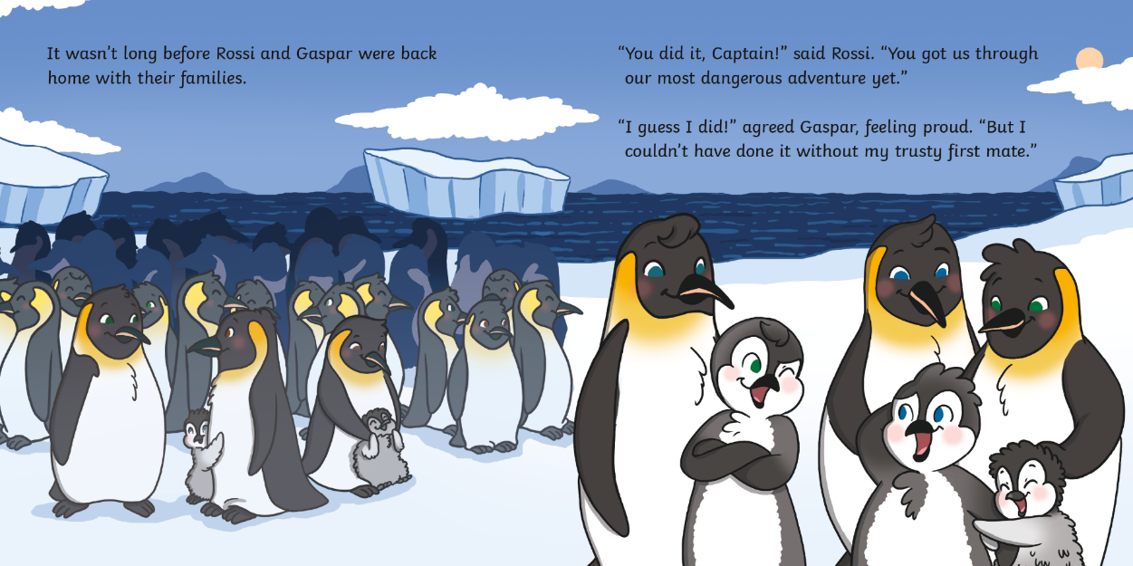
?
Why does Gaspar feel proud?

Slide 17
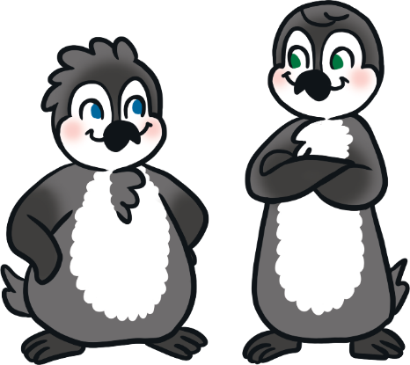
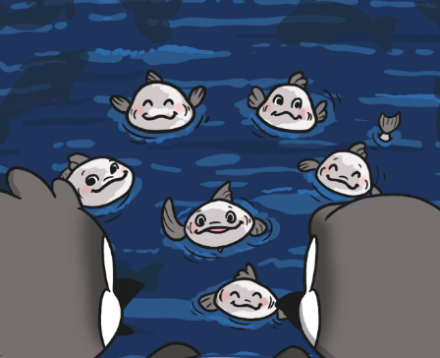
?
Who are the main characters in this story?
the Antarctic silverfish
Gasper and Rossi

Slide 18
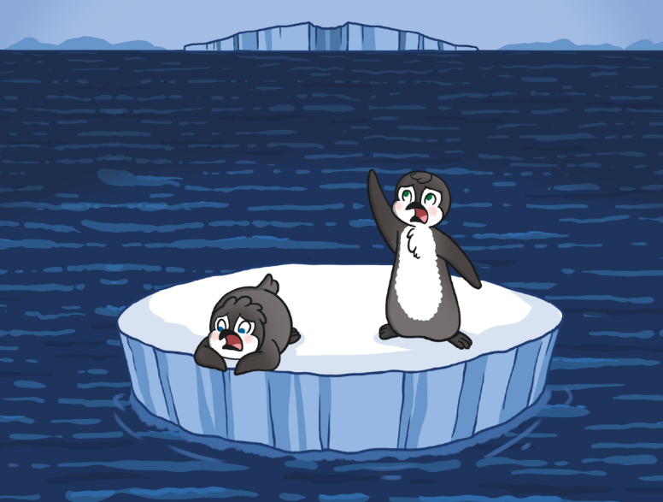
?
What is the problem in the story?
?
How would you feel if this happened to you?

Slide 19
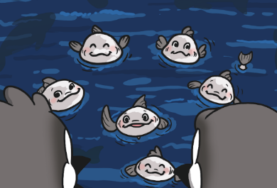
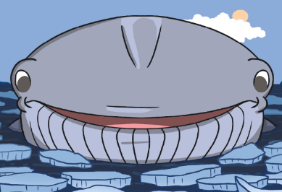
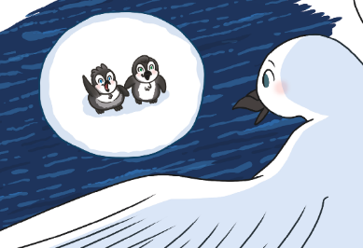
?
Who helps the penguins first?
the Antarctic silverfish
the blue whale
the snow petrel

Slide 20
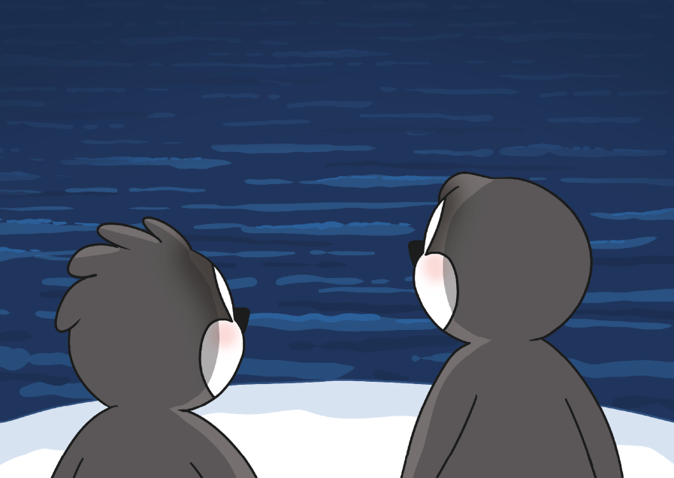
?
Do you think there is a message in this story? What do you think it might be?

Slide 21
?
What is your favourite part of the story?
Why?

