Slide 1
Life skills
Working from home

Slide 2
Life Skills to learn at home
As the roads are getting busy again re-visit you road safety and have a go at completing a COPE module 7.6 on road safety.
Look at the plan, (slide 4) how to learn from home and have a go!
Have a look at the 20 life skills to learn at home (slide 5)
Tick the ones you can do this week, have you learnt a new skill?
Try and learn the skills you are not confident in or can not do

Slide 3
Life skills
Think about the Life skills you have been learning during this time.
Have you learnt anything new?
If so think how good this was and keep going!

Slide 4
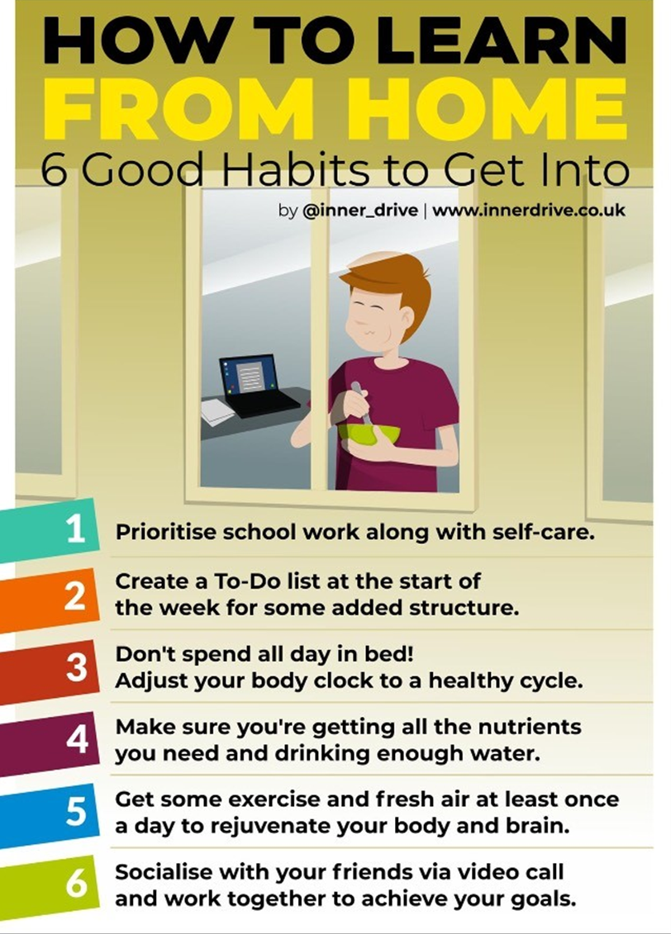

Slide 6
Have you learnt any of the new skills from the previous slide?
What else do you want to learn?
Email with your requests
sarah.jones@abbotsleaschool.co.uk

Slide 7
Life skills
This week you have information on:-
Oak Academy – there is 3 sections each with 6-8 life skills for you to learn and practice.
Oak Academy also add to the link with new skills so you can keep coming back for new skills to learn.
You can also look at the rest of this great resource to help with all other subjects.

Slide 8
Oak Academy
Link to on line learning – independent living
https://www.thenational.academy/online-classroom/specialist/independent-living#subjects
This is split into 3 sections with 3 online lessons each
  Early development
  Building understanding
  Applying learning

