Slide 1
Aiming High (proactivity)
2020
Employability skills

Slide 2
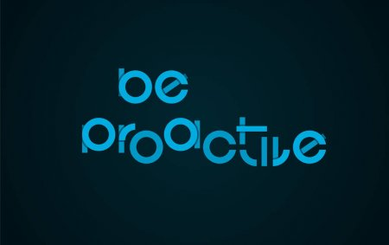
What is aiming high and proactivity?
For you to be able to aim high you need to be ambitious If you want to be successful, you have to aim high.
Proactive behavior involves acting in advance of a future situation, rather than just reacting. It means taking control and making things happen rather than just adjusting to a situation or waiting for something to happen.

Slide 3
A proactive approach to achieving goals Example:

Slide 4
5 Ways to Stop Feeling Helpless and Start Taking the Job Hunt Into Your Own Hands
1. Have More Than One Dream Company
2. Know What Message You’re Sending
3. Present How You’re Uniquely Qualified
4. Refine and Control Your Career Narrative
5. Keep the Conversation Going

Slide 5
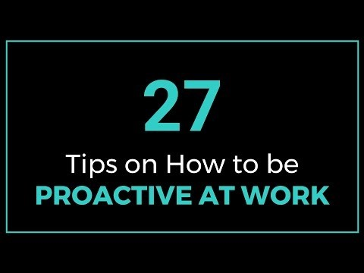
27 Tips on How to be Proactive at Work
Double Click TO Play Video

Slide 6
Thank you!
Have a lovely afternoon

