Slide 1
Creativity
2020
Employability skills

Slide 2
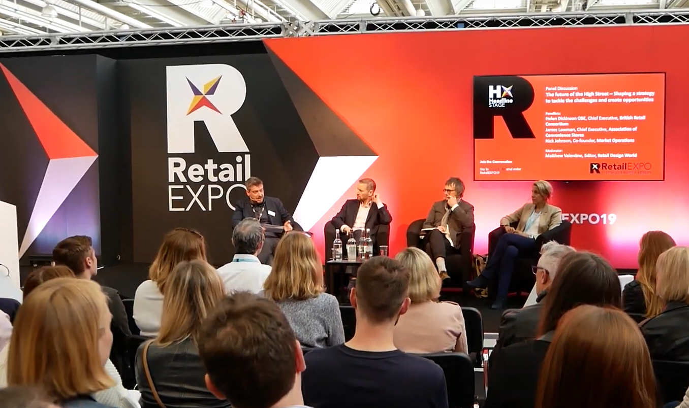
Creating new opportunities challenge: High street retailers
You own an independent clothes shop on a local high street, but the business is struggling, you must think of new ways to use the shop space and boost their income.
What’s the most creative thing you could do to increase income and save the business?
Where can you find inspiration for ideas?

Slide 3
Creative thinking methods

Slide 4
The power of creative constraints - Brandon Rodriguez
Double Click TO Play Video

Slide 5
Thank you!
Have a lovely afternoon

