Slide 1
Exploring personal strengths
2020
Employability skills

Slide 2
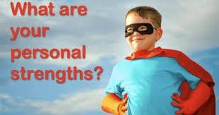
What is personal strength?
Strengths are tasks or actions you can do well. These include knowledge, proficiencies, skills, and talents. People use their traits and abilities to complete work, relate with others, and achieve goals.

Slide 3
Examples of some personal strengths are:
Enthusiasm.
Trustworthiness.
Creativity.
Discipline.
Patience.
Respectfulness.
Determination.
Dedication.

Slide 4
Some ways to take your core strengths and make them even stronger?
Assess Subsets of Your Strengths.
Find People to Cover for Your Weaknesses.
Get Additional Training.
Identify Strength-Enhancing Opportunities.
Deliberately Practice.
Communicate and Blog.
Learn From Others.
Be Open to Change

Slide 5
Personal Mastery - Find Your Strengths
Double Click TO Play Video

Slide 6
Thank you!
Have a lovely afternoon

