Slide 1
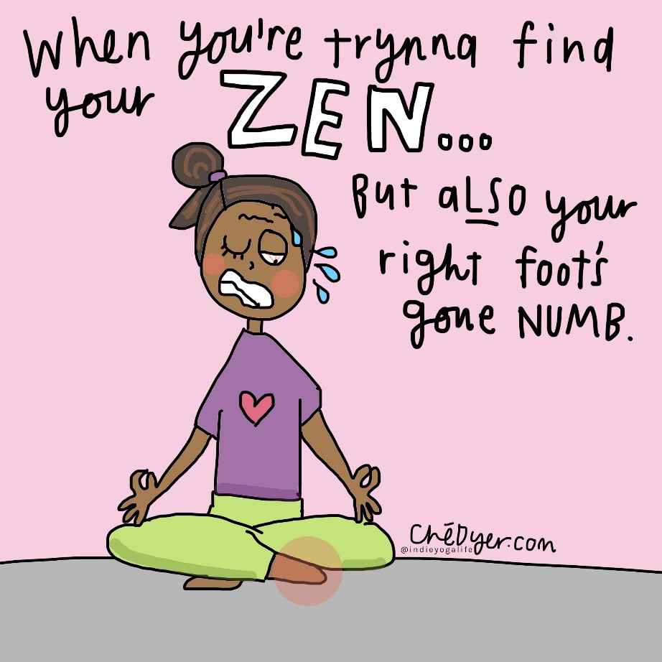
Why take up Yoga?
Yoga can help you get fit for life. It helps you deal with stress, pick up your child, control your dog, carry groceries, or work in your garden. It also can help to prevent or ease back pain and muscle or joint injury

Slide 2
Benefits of yoga
Yoga is a great activity for you if you have diabetes, high blood pressure, high cholesterol, or heart disease. It gives you strength, flexibility, and mind-body awareness. ... Yoga can help you stay flexible and strong without putting added stress on your

Slide 3
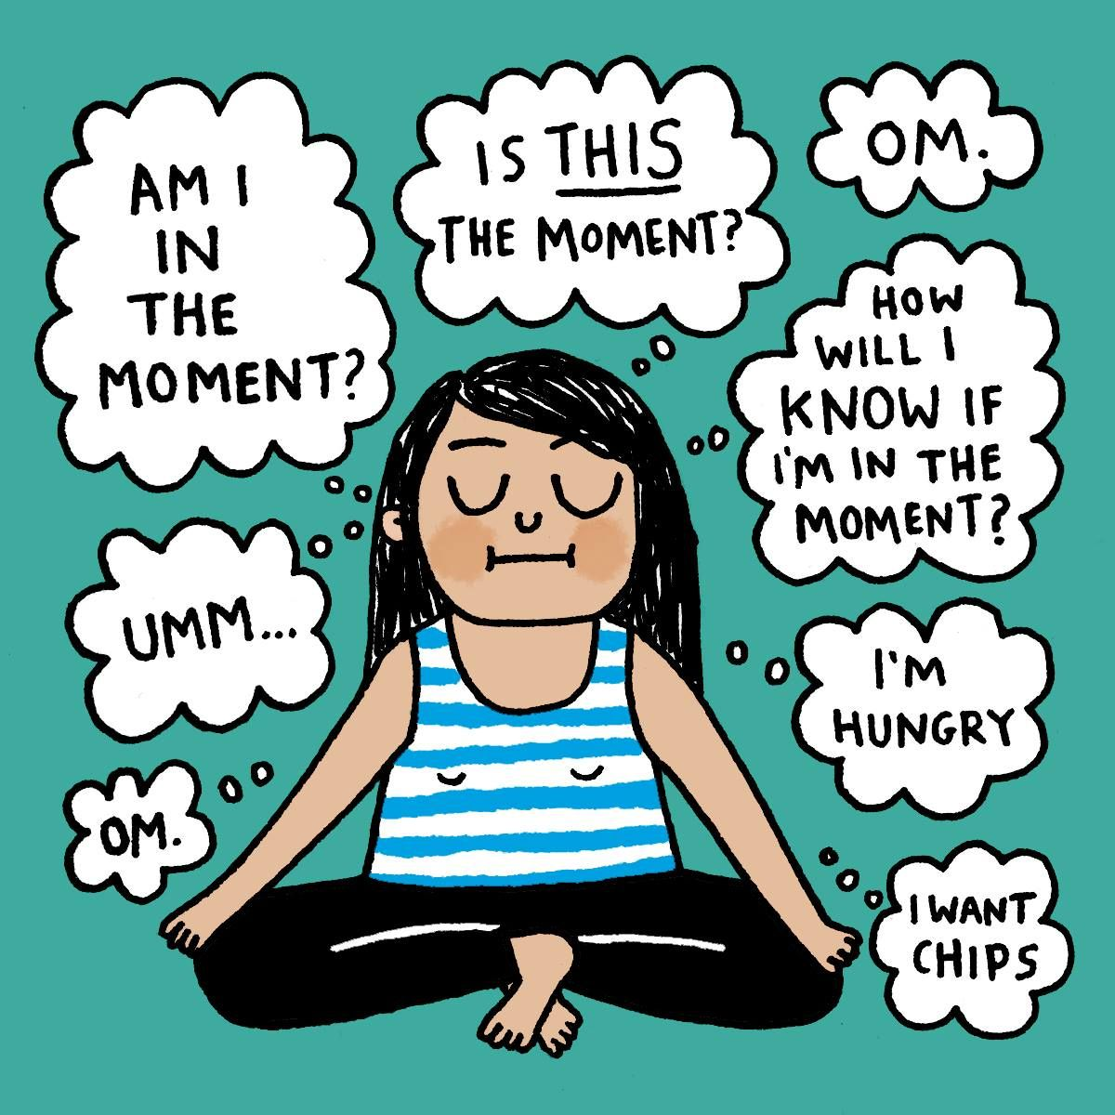
Over time, healthy living has a large impact on life expectancy. Research has shown that the benefits of yoga are tangible and that a consistent yoga practice can aid in longevity and increase life span. ... Enjoy your “post-yoga bliss” and know that it's making your body happy!

Slide 4
Relaxation Yoga calms body and mind, reducing your stress levels. According to research, yoga's stress-busting powers may come from its ability to lessen the activity of proteins that are known to play a role in inflammation. Increased Flexibility. No rocket science: the more you stretch your muscles, the more flexible to

Slide 5
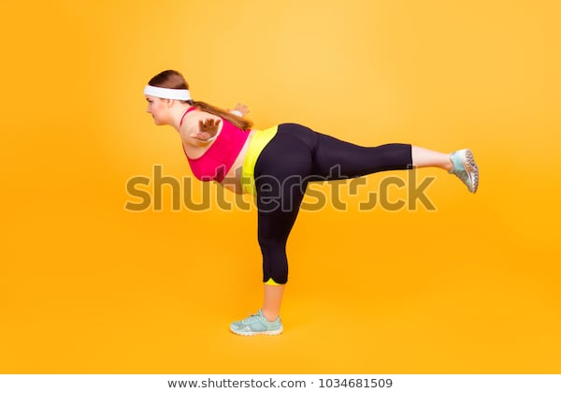
Any one can do it

Slide 6
Meditation it can help you relax

Slide 7
Just a few little stretches

Slide 8
Cool Mum
In this stressful time of lock down working from home why not try to do something relaxing like Yoga. It can be fun, it can be done alone just a quiet spot to meditate and contemplate the meaning of Life.

