Slide 1
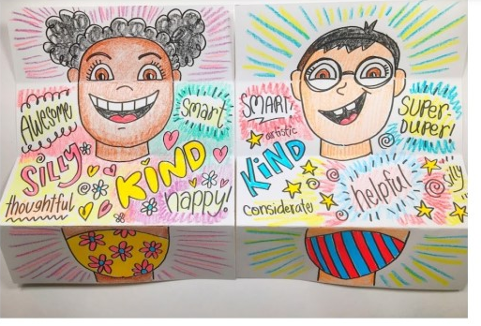
Behind my mask
Fold a piece of paper in half
Draw a self portrait with a colourful mask (be as creative as you like!)
Open the page and draw words which represent you as a person ☺

