Slide 1
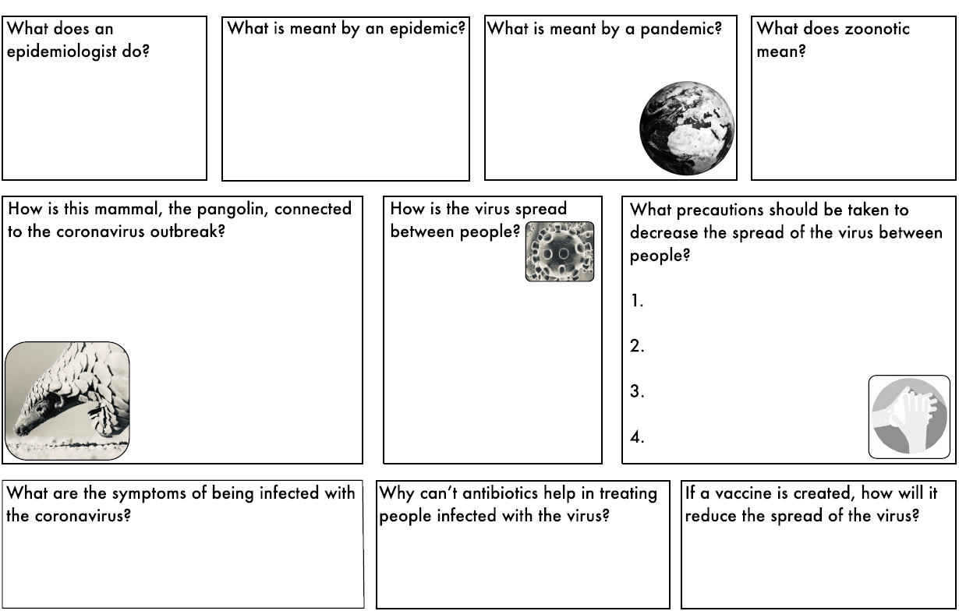
Name:
Covid comprehension
Date:
Watch the videos and listen to the PowerPoint.
Use it to help you answer these questions.
Some of them you might need to research on your own ☺
Answer here
Answer here
Answer here
Answer here
Answer here
Answer here
Answer here
Answer here
Answer here
Answer here
Answer here
Answer here
Answer here
Self assessment

Slide 2
Name:
Covid comprehension
Date:
Watch the videos and listen to the PowerPoint.
Use it to help you answer these questions.
Some of them you might need to research on your own ☺
Self assessment

