Slide 1
CORONA VIRUS

Slide 2
LEARNING GOALS
To help you feel more empowered and informed about Coronavirus.

Slide 3
We are living through an unprecedented moment in history now. Today, tomorrow, and the days that follow will be captured in history books. Someday, you will share stories with your children and grandchildren about living through this time. As these days are historical, it is important not to let these events pass without capturing how they affect you, your family, your school, your community, and the entire world.

Slide 4
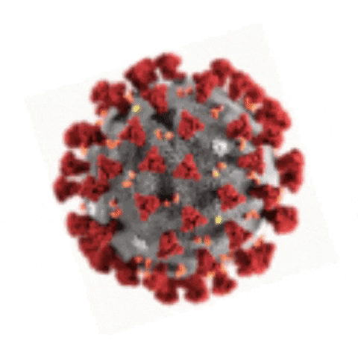
The new Coronavirus is spreading quickly but not as quickly as fear and misinformation about the illness. Social media is being flooded with misinformation about Coronavirus; so, the World Health Organization (WHO) joined TikTok on February 28 in an effort to stop some of it. Let’s watch the videos they posted on TikTok.

Slide 5
HOW TO PROTECT YOURSELF AGAINST CORONAVIRUS

Slide 6
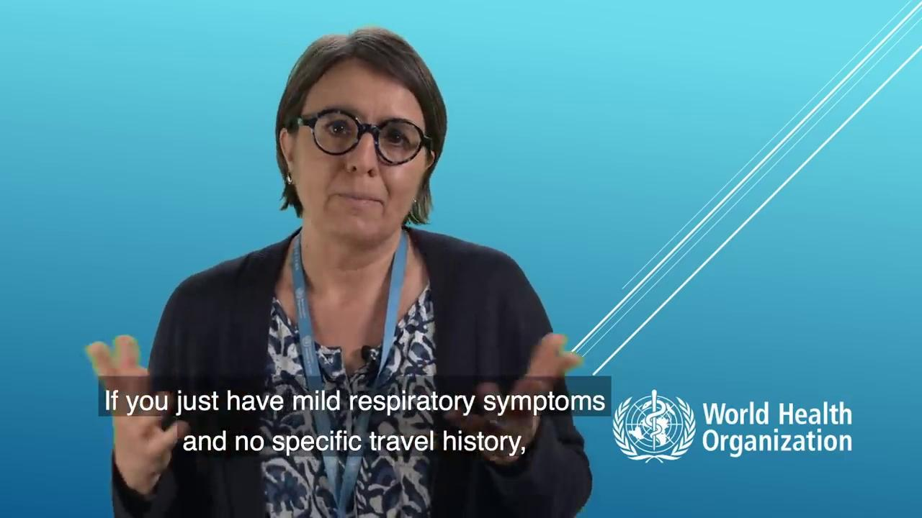
In this video, Benedetta Allegranzi, the organization’s technical lead of infection prevention and control, explains how people can slow down the spread of coronavirus.

Slide 7
7 STEPS TO PREVENT THE SPREAD OF CORONAVIRUS
Please check this infographic after you have watched the video.

