Slide 1
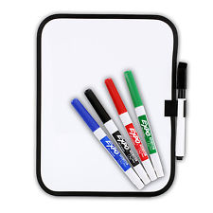
Lesson Objective:
To use spreading and cutting techniques to make a sandwich.
Food Technology
Sandwich
Lesson Activities
1: Method of making a sandwich
2: Activity 1: Making a sandwich
3: Activity 2: Evaluation
4: Choose

Slide 2
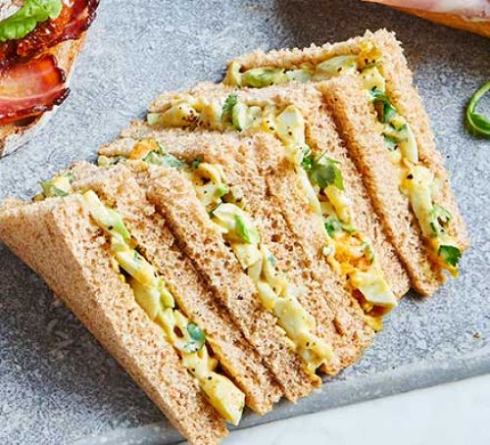
Lesson Objective:
To use spreading and cutting techniques to make a sandwich.
Sandwich
Today we are going to be making a sandwich. We are going to try and do as much of this activity independently, as in the future you will use this skill to make your own meal.

Slide 3
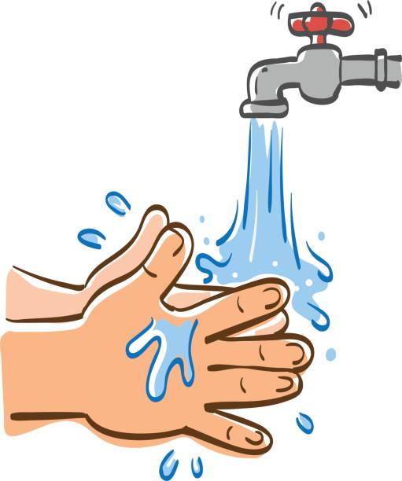
Lesson Objective:
To use spreading and cutting techniques to make a sandwich.
1
Method
Wash your hands using soap and warm water.

Slide 4
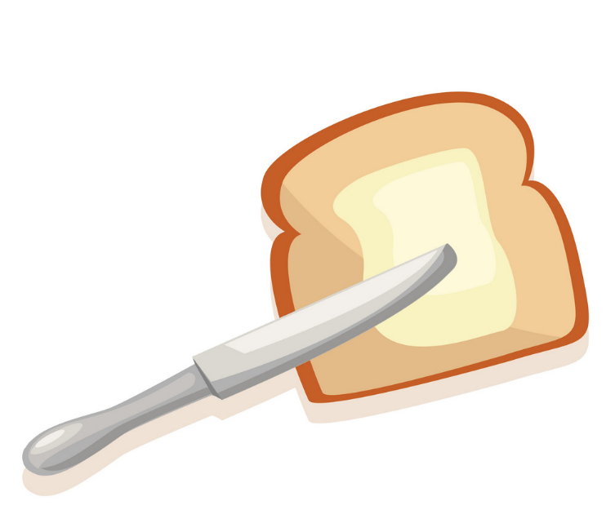
Lesson Objective:
To use spreading and cutting techniques to make a sandwich.
2
Method
Carefully use a knife to spread butter on two pieces of bread.

Slide 5
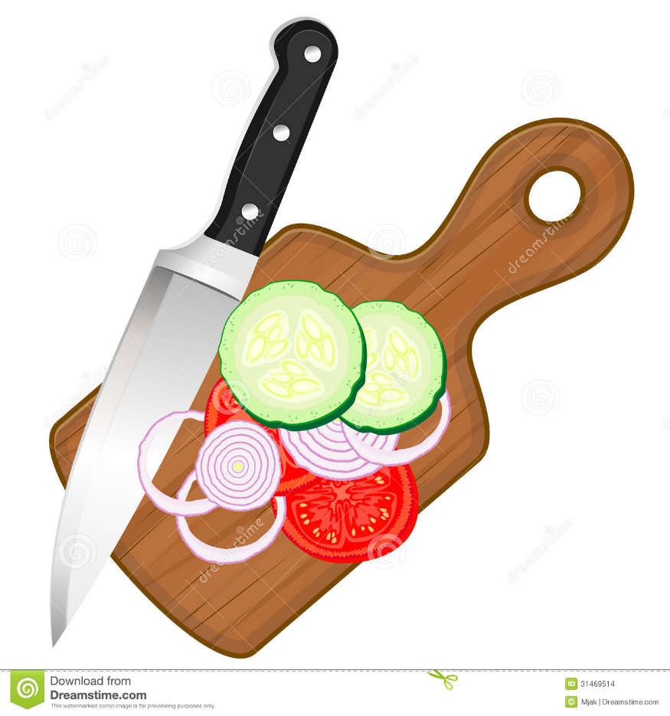
Lesson Objective:
To use spreading and cutting techniques to make a sandwich.
3
Method
Carefully, using appropriate chopping techniques, chop the cucumber and tomato on a chopping board.

Slide 6
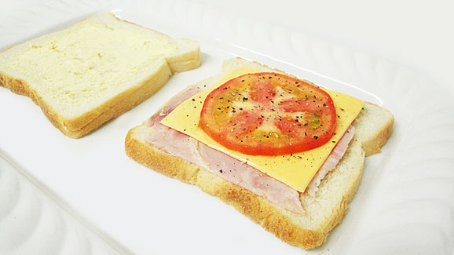
Lesson Objective:
To use spreading and cutting techniques to make a sandwich.
4
Method
Choose what you would like on your sandwich and place it on the buttered side of one piece of bread.

Slide 7
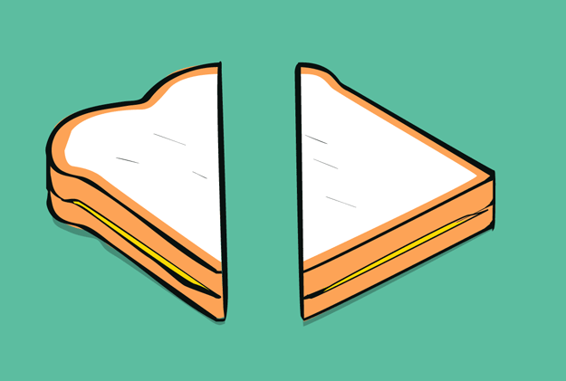
Lesson Objective:
To use spreading and cutting techniques to make a sandwich.
5
Method
Place the other piece of bread on top and cut your sandwich in half.

Slide 8
Lesson Objective:
To use spreading and cutting techniques to make a sandwich.
6
Method
Wash and tidy away all equipment.

Slide 9
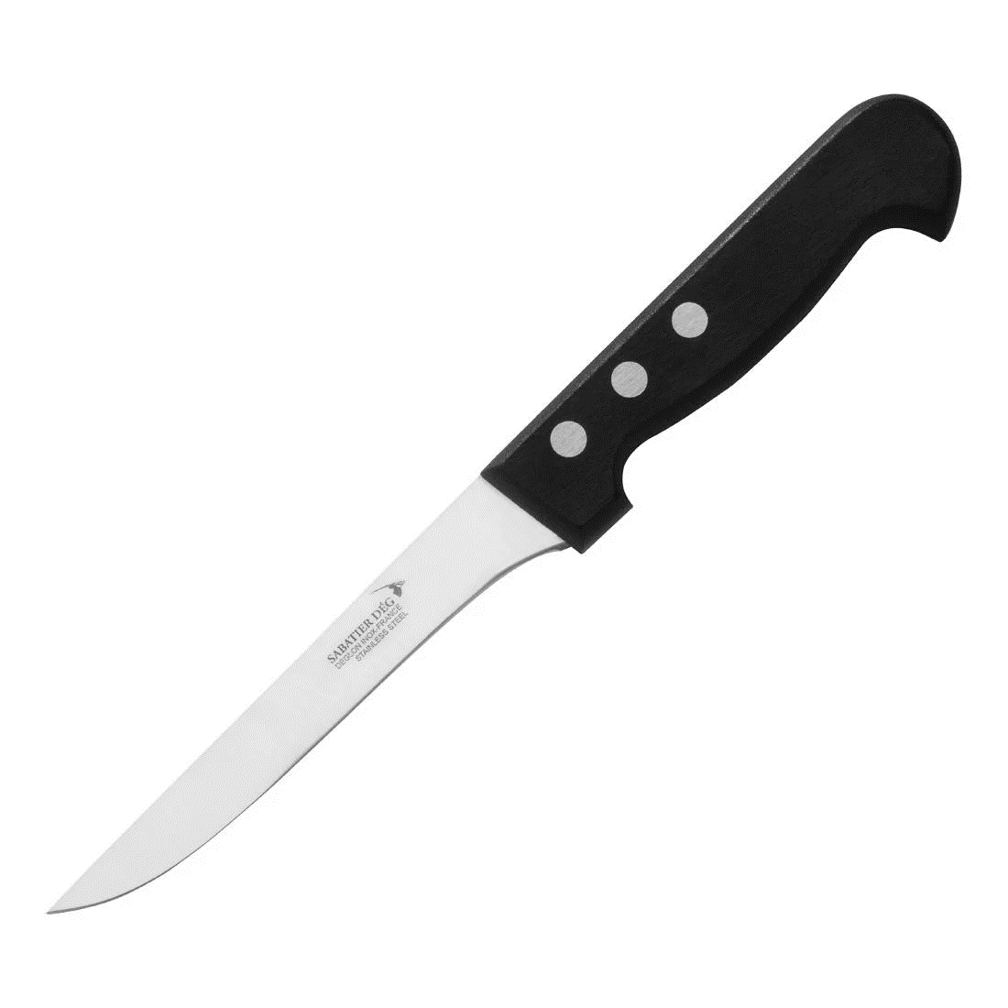
Lesson Objective:
To use spreading and cutting techniques to make a sandwich.
Safety Rules
Today we will be using knives to help us chop some of our ingredients. Knives are very sharp. What rules do we need to remember?
1. Do not walk or run around the room when holding the knife.
2. When cutting fruit, make sure to use safe cutting methods such as the claw or the bridge.
3. When using the knife to cut ALWAYS make sure you are watching what you are doing.

Slide 10
Lesson Objective:
To use spreading and cutting techniques to make a sandwich.
Activity 1
We are now going to make our sandwich.
You are going to work at the group table with Miss Mac.
You are going to work at your workstation with Mr Roach.
You are going to work at your workstation with Miss McDowell.
You are going to work at your workstation with Mr Howarth – Maddison.
You are going to work at your workstation with Mr Terry.
Miss Mac
Aiden
Alfie
JoJo
Mr Roach
Olivia
Tyrone
Conor
Miss McDowell
Noah
Mr Howarth-Maddison
Matthew
Mr Terry
Khaya

Slide 11
Lesson Objective:
To use spreading and cutting techniques to make a sandwich.
Activity 2
You are now going to write an evaluation of making your sandwich. Think about what ingredients and equipment you used today.
Worksheet
Equipment I Will Need

