Slide 1
It is bird watching week.
Make a bird feeder and hang it out for the birds to feed from. Here are some ideas…
Waffle’s Bird Adventure
Monday: Bird Feeders
Hang up an egg box and fill with seeds.
Thread cheerios or berries onto a pipe cleaner or bit of string.
Mix bird seed and lard together and put in yogurt pot. Add a string to hang it up with.

Slide 2
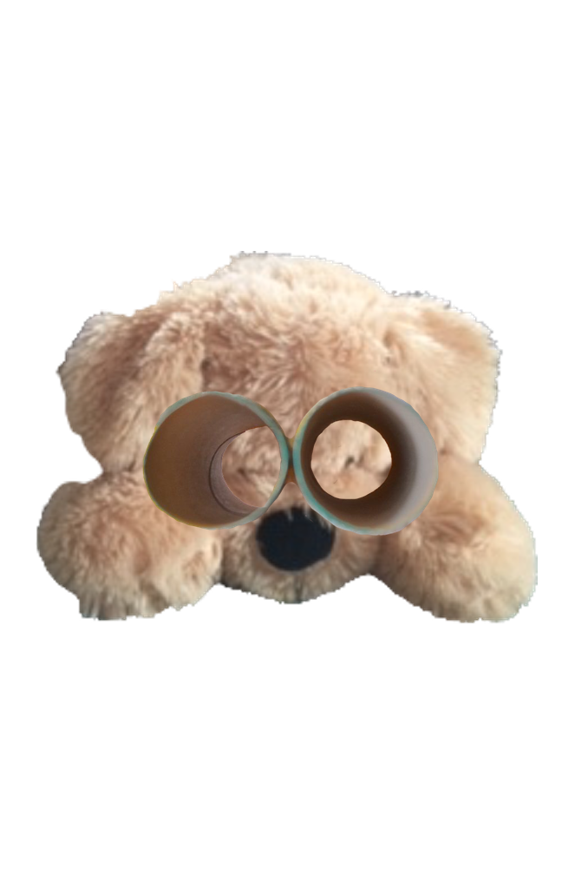
Make a set of tube binoculars.
Waffle’s Bird Adventure
Tuesday: Tube Binoculars

Slide 3
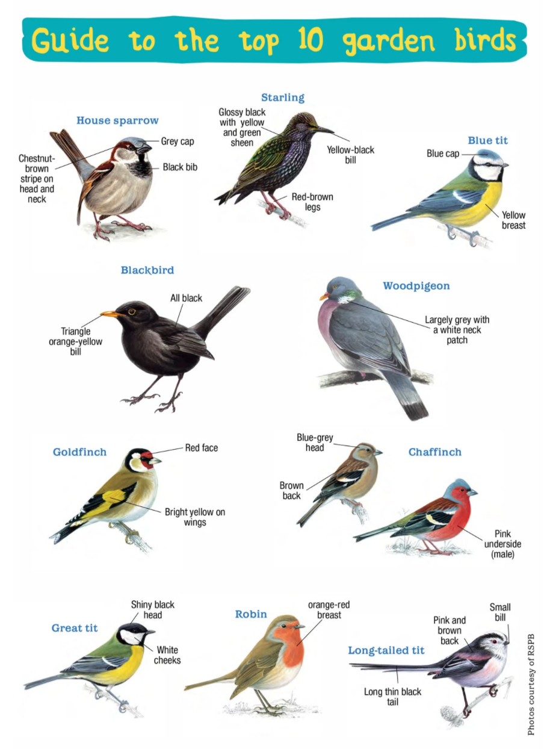
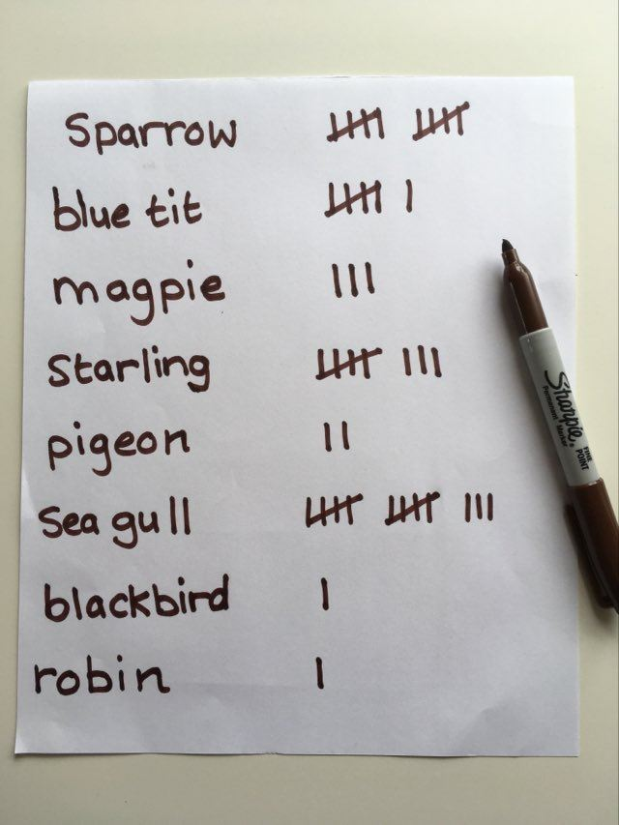
Waffle’s Bird Adventure
Wednesday: Birdwatch
Find somewhere to carry out a bird watch. This can be from a window, a garden, as part of a day trip or visit to a park.
1. Make a tally chart to show how many of each type of bird you see.
2. What is the most common bird you saw?
3. What is the least common bird you saw?
Check out the RSPB website for more information on bird identification.
https://www.rspb.org.uk/get-involved/activities/birdwatch/birds-to-look-out-for/

Slide 4
Draw and label a picture of your favourite bird.
What colour is it?
What features does it have?
Waffle’s Bird Watch Adventure
Thursday: Bird Drawings
Primary and secondary feathers are long and found on the wing.
Tail feathers make up the tail.
Birds have different types of feathers.
Down feathers are short and fluffy and keep the bird’s breast warm.

Slide 5
Waffle’s Bird Adventure Friday: Robin Rhyme
Learn the poem and then recite it to someone from your family.
Little Robin Red Breast
Little Robin Red Breast sat upon the tree,
Up went Pussy Cat and down went he.
Down came Pussy Cat and away Robin ran,
Says little Robin Red Breast, catch me if you can.
Little Robin Red Breast jumped upon the wall,
Pussy cat jumped after him and almost got a fall.
Little Robin chirped and what did pussy cat say?
Pussy cat said “Meeow!” and Robin flew away.

