Slide 1
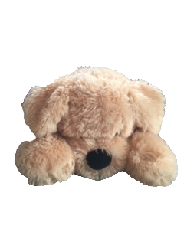
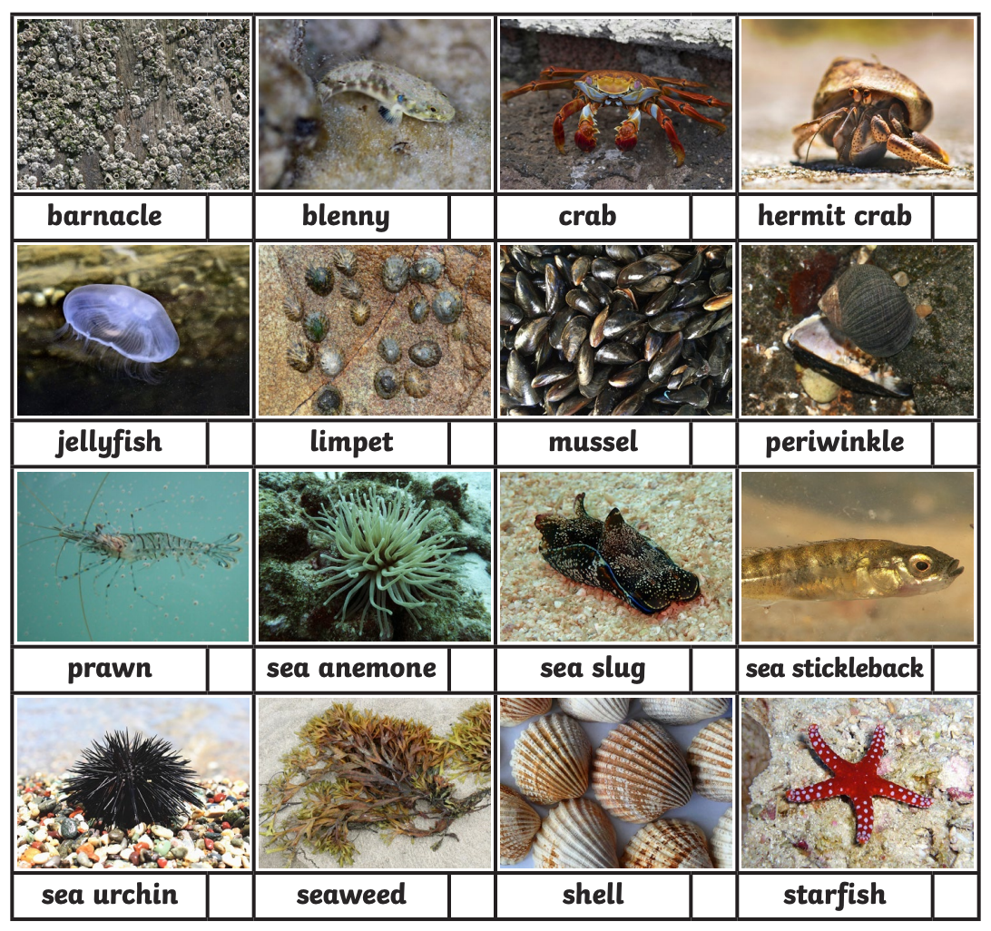
Choose a sea creature to research.
Waffle’s Seaside Adventure
Monday: Sea creature facts
Create a fact sheet about your chosen sea creature.
Remember a fact sheet has:
A title.
A labelled picture of your sea creature.
5 facts about your sea creature.
A “did you know” section.

Slide 2
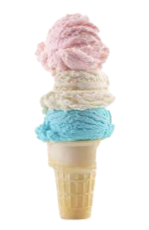
Ice cream Pattern Puzzle
Waffle’s Seaside Adventure
Tuesday: Ice Cream Maths
Waffle has three different
ice cream flavours.
He makes ice creams with three scoops.
How many different ice creams can he create?

Slide 3
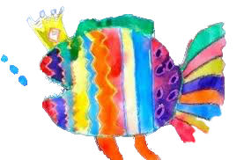
Design a sea creature.
Waffle’s Seaside Adventure
Wednesday: Design a sea creature
Does it have spines?
Does it have a shell?
Does it have a pattern?

Slide 4
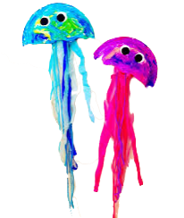
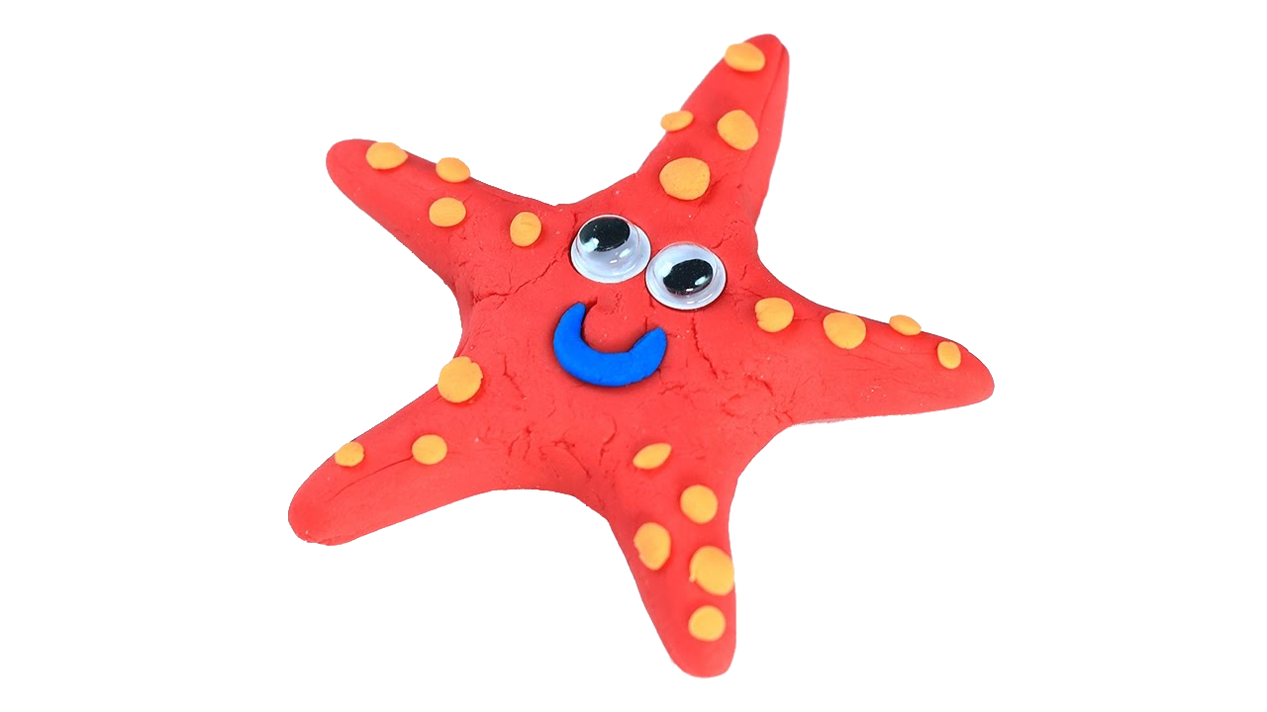
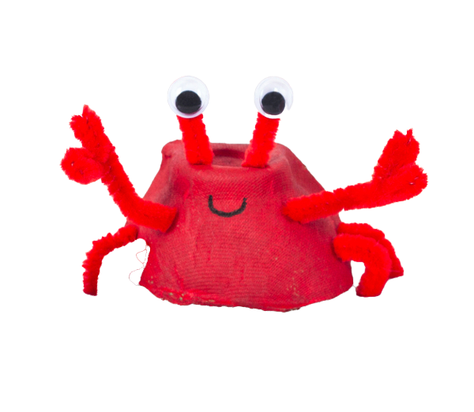
Waffle’s Seaside Adventure
Thursday: Art Attack
Make a sea creature model.

Slide 5
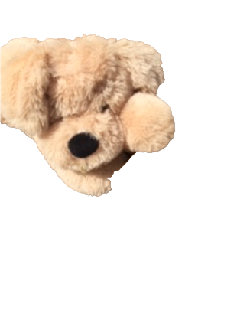
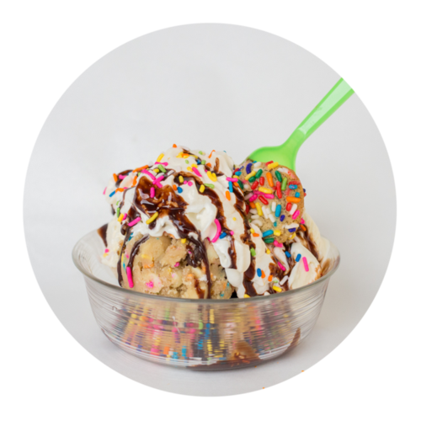
Waffle’s Seaside Adventure
Friday: Ice cream Sundaes
Make an ice cream sundae.
Instructions
Put some scoops of ice cream in a bowl.
Chop up some fruit and add it to the bowl.
Add some toppings.
Eat with a spoon.

