Slide 1
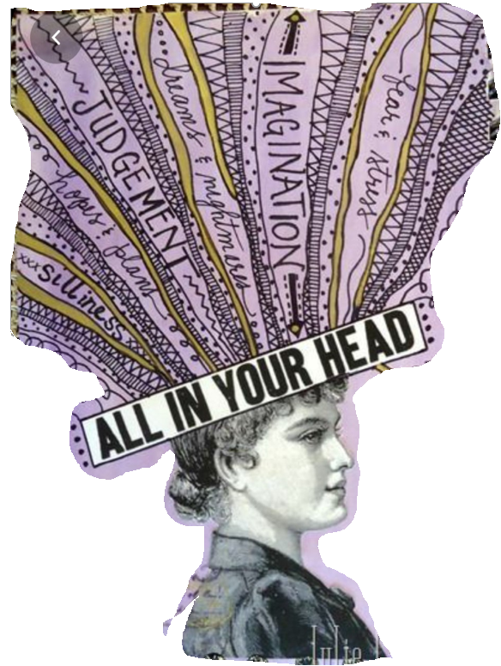
All in my head
Draw a self portrait or print off a picture of student’s head.
Discuss lockdown, how are we feeling, what are we thing about.
Add a hair strand to state activity they liked or feeling they felt during lockdown
Choose different typography (the way words are written) for different feelings

