Slide 1
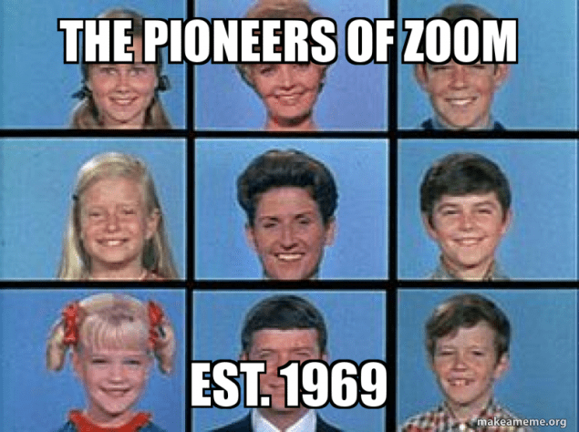
Class Australia and Samoa from Home!
Friday is World Mental Health Day
Wear yellow
6th October 2020

Slide 2
Lesson 1 – Science
All will be able to develop their knowledge of science
Most will be able to show their understanding of how sound can cause reactions
Some will be able to pick their own music to go with clips

Slide 3
Keywords
Biology
Neurologic
physiologic responses
Heartrate

Slide 4
Movie Music
Movies are amazing: a good movie can make you laugh, cry or jump in surprise.
But how do they do it? The music you are listening to plays a big part.
This programme investigates the design and technology that goes into making movies sound good – from understanding how soundtracks can make you feel a particular emotion, to how cinemas are designed to make your movie experience intense.

Slide 6
Questions
What kind of music most often accompanies sad scenes? Action scenes? Scary scenes? Happy scenes?
How does music influence the way we experience a film?

Slide 7
Movie magic
https://www.youtube.com/watch?v=mndDbN60Eiw
https://www.youtube.com/watch?v=SOjsywud-MA
https://www.youtube.com/watch?v=kiV3J_e977Q
https://www.youtube.com/watch?v=7fcS90NHCq0

Slide 8
Taking your heart rate
https://www.youtube.com/watch?v=AHHr8qNU9QY

Slide 9
Challenge
Try this with anyone who is in the house and bring the results at 2pm

