Slide 1
Abbot’s Lea School
2020
Know about the value of giving customers a positive first impression of an organisation.

Slide 2
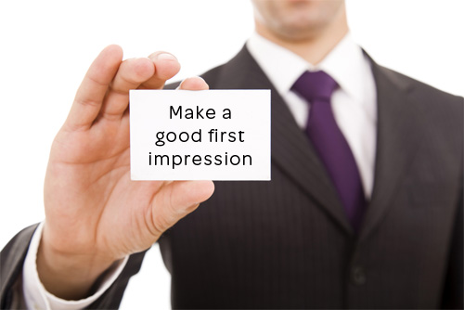
What does first impression mean?
The definition of impression is the way you feel about something, the way that something looks or seems or impression can describe the impact you have on others.
An example of impression is when you meet someone and like them.
An example of impression is when someone acts angry when you first meet them.

Slide 3
Face to Face First Impressions
Double Click TO Play Video

Slide 4
Over The Phone First Impression
Be polite: for an example “I like to answer each call with “Good morning/Good afternoon” as it gives a warm first impression.”
Get your pronunciation right: for an example “In a virtual receptionist business where the company you're answering on behalf changes from call to call, it is key to ensure you have the correct pronunciation of the company name and that you're able to pronounce it clearly.”
Perfect your tone: for an example “Tone of voice is one of the most important things when answering a call. I always try to answer in a cheerful, friendly tone which can help open up the client.”
Speak at the right pace: for example “Never mumble, speak clearly in a pace that is neither too fast nor too slow.”

Slide 5
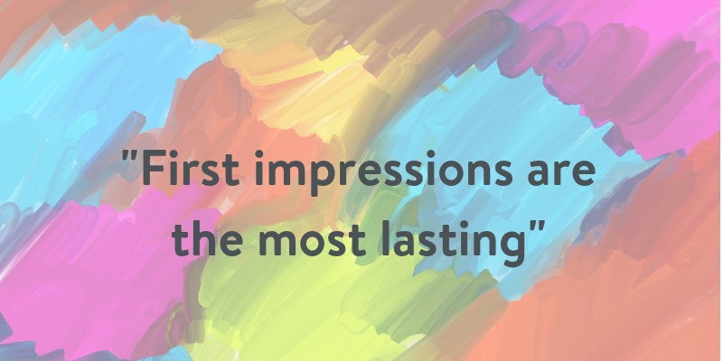
First Impressions
7 seconds based on appearance
55% based on appearance
17% based on the words we use
38% based on your tone of voice

Slide 6
Why first impressions are important. How could they affect the business’s success?
First impressions have the ability to make or break a business, and a positive experience can create long-lasting business relationships.
Your first impression to someone lasts forever.
When it comes to making a good first impression, body language can often speak louder than words. Use your body language to project appropriate confidence and self-assurance. Stand tall, smile (of course), make eye contact, greet with a firm handshake.
A positive first impression is an important start to building a relationship with your customers. Whether the interaction is over the phone or in-person, the initial impression can set the tone for the entire customer experience.

Slide 7
Worksheet
If you are not sure about the question or how to answer it please ask my self or other job coaches.

