Slide 1
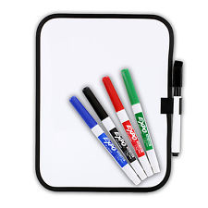
Lesson Objective:
To make a rice crispy cake.
Food Technology
Rice Crispy Cakes
Lesson Activities
1: Method of making cakes
2: Activity 1: Making rice crispy cakes
3: Activity 2: Evaluation
4: Choose

Slide 2
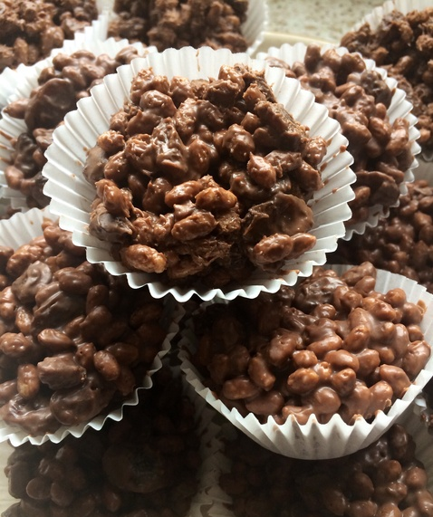
Lesson Objective:
To make a rice crispy cake.
Method
Today we are going to be making rice crispy cakes. We are going to follow this method to make our cakes.

Slide 3
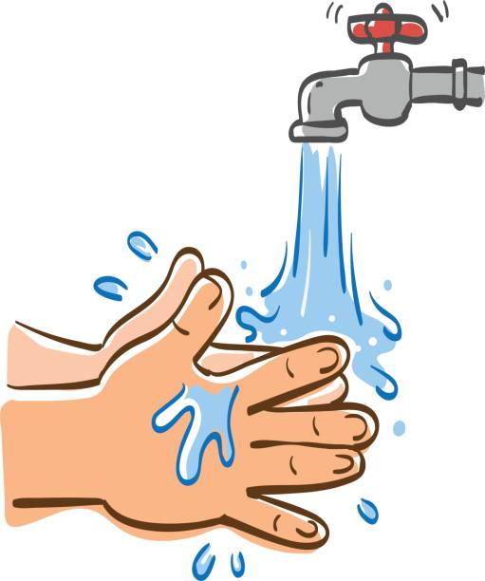
Lesson Objective:
To make a rice crispy cake.
1
Method
Wash your hands using soap and warm water.

Slide 4
Lesson Objective:
To make a rice crispy cake.
2
Method
Safely, melt the chocolate in a mixing bowl in the microwave. Check on it every 20 seconds and stir.

Slide 5
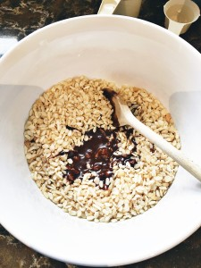
Lesson Objective:
To make a rice crispy cake.
3
Method
Add Rice Krispies into the mixing bowl and use a spoon to mix the melted chocolate and Rice Krispies together.

Slide 6
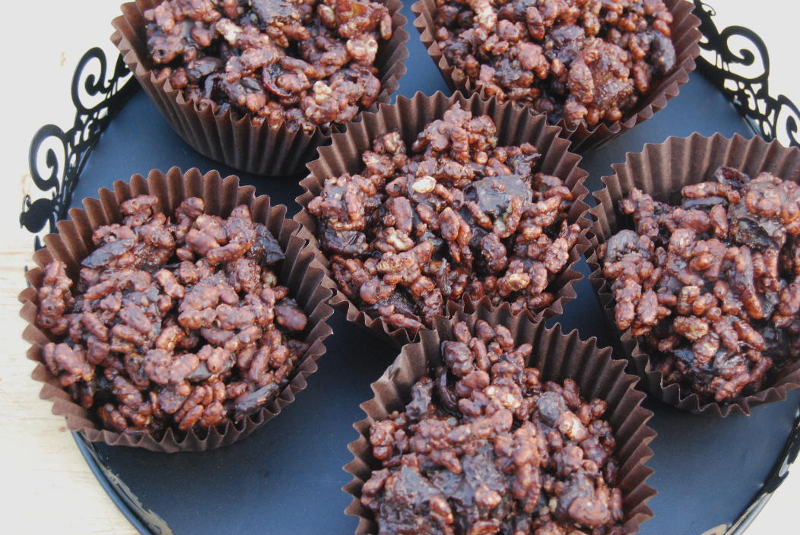
Lesson Objective:
To make a rice crispy cake.
4
Method
Use a spoon to share the mixture into the cake cases.

Slide 7
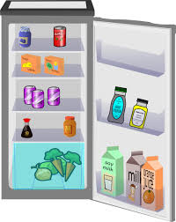
Lesson Objective:
To make a rice crispy cake.
5
Method
Decorate the cakes with decorations and place them into the fridge to cool.

Slide 8
Lesson Objective:
To make a rice crispy cake.
6
Method
Wash and tidy away all equipment.

Slide 9
Lesson Objective:
To make a rice crispy cake.
Activity 1
We are now going to make our rice crispy cakes.
You are going to work at the group table with Miss Mac.
You are going to work at your workstation with Mr Roach.
You are going to work at your workstation with Miss McDowell.
You are going to work at your workstation with Mr Howarth – Maddison.
You are going to work at your workstation with Mr Terry.
Miss Mac
Aiden
Alfie
JoJo
Mr Roach
Olivia
Tyrone
Conor
Miss McDowell
Noah
Mr Howarth-Maddison
Matthew
Mr Terry
Khaya

Slide 10
Lesson Objective:
To make a rice crispy cake.
Activity 2
Worksheet
You are now going to write an evaluation of making rice crispy cakes. Think about what ingredients and equipment you used today.
Equipment I Will Need

