Slide 1
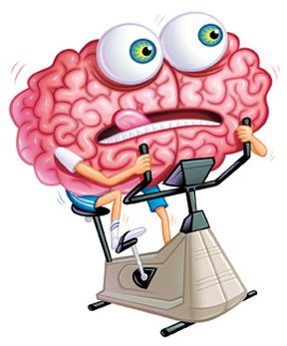
Exercise your brain!
Name:_____________________
Class_________________
Teacher:___________________

Slide 3
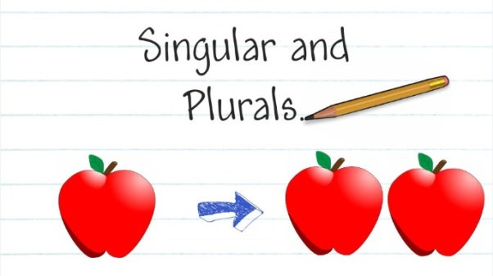
Section one: Singular and plural
To be completed by:
______________________________
What do I need to complete?
Spelling test 1
Read the singular to plural rules
Complete single to plural worksheet
Read page on irregular plurals
Complete sheet on irregular plurals
New vocabulary G and H
Reading comprehension: The Pickwick Papers
Self Assessment: What do I still need to practise from this section?

Slide 4
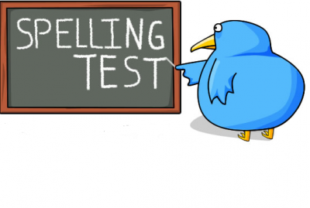
Spelling test 1
You will be tested on your spellings in every
literacy lesson.
You are expected to get at least 17/20 right each time. If you do not manage this you will need to re-take the test at another time.
 | Read | Write | Cover and write
Commonly misspelt words | Committed
 | Conscience
 | Conscientious
 | Conscious
 | Definite
 | Definitely
 | Disappear
 | Discipline
 | Embarrass
 | Equipment
 | Exhilarate
 | Exceed
 | Existence
 | Experience
 | Fiery
Topic specific words

Slide 5
When writing it is very important to make sure we are using singular and plural nouns or our work won’t make sense!
Unfortunately the rules for making a singular word into a plural word is not as easy us just adding an ‘S’ to the end, there are a few rules to look out for.
Some rules for you
Just add an S!
The general rule is just add an S (but)
Sometimes you need to add an es
Change the y to an i and add es
Words that end in ey add an s
Change an F to a V and add an es
Cat › cats
Boss › bosses
Lorry › lorries
Monkey › monkeys
Leaf › leaves
1 - 4 are called regular plurals
5 are called near-regular plurals
There are, of course, exceptions to all these rules.

Slide 6
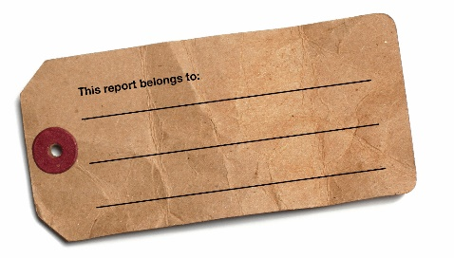
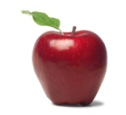
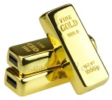
Task
Change these words from single to plural or plural to single.
Gold task: Use the word in an ambitious language technique, e.g. Simile, metaphor, personification.
Singular | Plural | Language technique
Planet
Puppy
Dwarf
 | Dominoes
 | Halves
Baby
Hero
Knife
Find an extra word for each rule and add it to the list below.

Slide 7
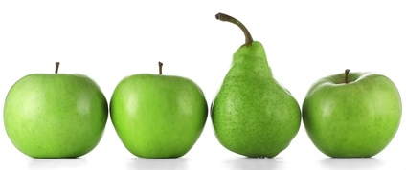
What are the exceptions to the rules?
What does that even mean?
For example, this pear is the exception to the rule, it is green and it is a fruit but it doesn’t come in the same shape – it abides by different rules to the apples.
Words are the same. Some just have different rules to our five basic ones when changing from singular to plural. These are called irregular plurals.
Task: change these commonly used words from single to plural form, or the other way round – we like to keep you on your toes!
Singular | Plural | Language technique
Child
Sheep
Mouse
 | People
 | Feet
Man
 | Women
Penny
 | Teeth

Slide 8
Letter
Word
G
Definition
Sentence (using your word):
Synonyms
Antonyms
Letter
Word
H
Definition
Sentence (using your word):
Synonyms
Antonyms

Slide 9
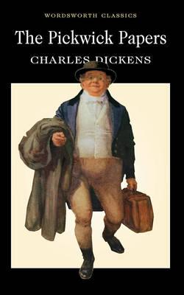
The Pickwick Papers by Charles Dickens
Reading comprehension : Read the extract and answer the questions in as much detail as possible.
Old Wardle led the way to a pretty large sheet of ice; and the fat boy and Mr. Weller, having shovelled and swept away the snow which had fallen on it during the night, Mr. Bob Sawyer adjusted his skates with a dexterity which to Mr. Winkle was perfectly marvellous, and described circles with his left leg, and cut figures of eight, and inscribed upon the ice, without once stopping for breath, a great many other pleasant and astonishing devices, to the excessive satisfaction of Mr. Pickwick, Mr. Tupman, and the ladies; which reached a pitch of positive enthusiasm, when old Wardle and Benjamin Allen, assisted by the aforesaid Bob Sawyer, performed some mystic evolutions, which they called a reel.
All this time, Mr. Winkle, with his face and hands blue with the cold, had been forcing a gimlet into the sole of his feet, and putting his skates on, with the points behind, and getting the straps into a very complicated and entangled state, with the assistance of Mr. Snodgrass, who knew rather less about skates than a Hindoo. At length, however, with the assistance of Mr. Weller, the unfortunate skates were firmly screwed and buckled on, and Mr. Winkle was raised to his feet.
'Now, then, Sir,' said Sam, in an encouraging tone; 'off with you, and show 'em how to do it.'
'Stop, Sam, stop!' said Mr. Winkle, trembling violently, and clutching hold of Sam's arms with the grasp of a drowning man. 'How slippery it is, Sam!'
'Not an uncommon thing upon ice, Sir,' replied Mr. Weller. 'Hold up, Sir!'
This last observation of Mr. Weller's bore reference to a demonstration Mr. Winkle made at the instant, of a frantic desire to throw his feet in the air, and dash the back of his head on the ice.
'These--these--are very awkward skates; ain't they, Sam?' inquired Mr. Winkle, staggering.
'I'm afeerd there's a orkard gen'l'm'n in 'em, Sir,' replied Sam.
'Now, Winkle,' cried Mr. Pickwick, quite unconscious that there was anything the matter. 'Come; the ladies are all anxiety.'

Slide 10
'Yes, yes,' replied Mr. Winkle, with a ghastly smile. 'I'm coming.'
'Just a-goin' to begin,' said Sam, endeavouring to disengage himself.
'Now, Sir, start off!'
'Stop an instant, Sam,' gasped Mr. Winkle, clinging most affectionately to Mr. Weller. 'I find I've got a couple of coats at home that I don't want, Sam. You may have them, Sam.‘
‘Thank'ee, Sir,' replied Mr. Weller.
'Never mind touching your hat, Sam,' said Mr. Winkle hastily. 'You needn't take your hand away to do that. I meant to have given you five shillings this morning for a Christmas box, Sam. I'll give it you this afternoon, Sam.'
'You're wery good, sir,' replied Mr. Weller.
'Just hold me at first, Sam; will you?' said Mr. Winkle. 'There--that's right. I shall soon get in the way of it, Sam. Not too fast, Sam; not too fast.'
Mr. Winkle, stooping forward, with his body half doubled up, was being assisted over the ice by Mr. Weller, in a very singular and un-swan-like manner, when Mr. Pickwick most innocently shouted from the opposite bank—
'Sam!'
'Sir?'
'Here. I want you.'
'Let go, Sir,' said Sam. 'Don't you hear the governor a-callin'? Let go, sir.'
With a violent effort, Mr. Weller disengaged himself from the grasp of the agonised Pickwickian, and, in so doing, administered a considerable impetus to the unhappy Mr. Winkle. With an accuracy which no degree of dexterity or practice could have insured, that unfortunate gentleman bore swiftly down into the centre of the reel, at the very moment when Mr. Bob Sawyer was performing a flourish of unparalleled beauty. Mr. Winkle struck wildly against him, and with a loud crash they both fell heavily down. Mr. Pickwick ran to the spot. Bob Sawyer had risen to his feet, but Mr. Winkle was far too wise to do anything of the kind, in skates. He was seated on the ice, making spasmodic efforts to smile; but anguish was depicted on every lineament of his countenance.
'Are you hurt?' inquired Mr. Benjamin Allen, with great anxiety.
'Not much,' said Mr. Winkle, rubbing his back very hard.

Slide 11
uestions
What shows that Mr Sawyer was an experienced skater?
2. Write down five sentences that show Mr Winkle was new to skating.
3. Why does Dickens use the phrase ‘knew rather less about skates than a Hindoo’ to show Mr Snodgrass’ unfamiliarity with skating?
4. Why did Mr Winkle offer Sam two coats and five shillings?
5. Why did Mr Winkle not want Sam to touch his hat?
6. Write out in correct modern English the four phrases underlined.
7. Write in your words an account of what happened in the paragraph
beginning: ‘With a violent effort’.
8. What is the meaning of these words?
9. Was Mr Winkle hurt by the fall? How do we know?
10.Describe Mr Winkle in your own words. What sort of a man do you think
he was?
a. Dexterity | b. inscribed | c. mystic | d. gimlet
e. singular | f. impetus | g. spasmodic

Slide 12
Answer your questions in detail here:

Slide 15
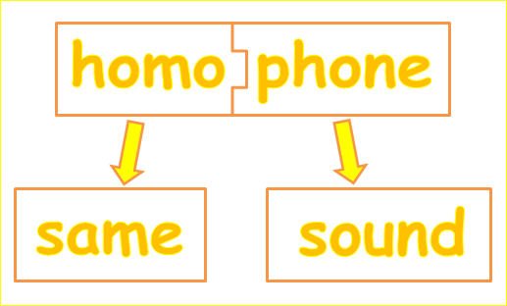
Section two: Homophones
To be completed by:
______________________________
What do I need to complete over the next two weeks?
Spelling test 2
What is a homophone? – read
Homophone tasks (x4)
Extended writing task
New vocabulary I and J
Reading comprehension: Frankenstein
Self Assessment: What do I still need to practise from this section?

Slide 16
Spelling test 2
You will be tested on your spellings in every
literacy lesson.
You are expected to get at least 17/20 right each time. If you do not manage this you will need to re-take the test at another time.
 | Read | Write | Cover and write
Commonly misspelt words | Foreign
 | Fourth
 | Gauge
 | Generally
 | Grammar
 | Grateful
 | Guarantee
 | Harass
 | Height
 | Hierarchy
 | Ignorance
 | Immediate
 | Independent
 | Indispensible
 | Intelligence
Topic specific words

Slide 17
What is a homophone?
Homophones are words that sound the same but have different
meanings. If we get these words wrong it can create a
completely different meaning to our writing and understanding.
Why is it important? Moving forward there will be a larger emphasis on SPaG in your GCSE exams. Across literature and language it will now be worth 20% of the grade, so let’s start practising now!
The basics and most frequent
There | Use there when referring to a place, whether concrete ("over there by the building") or more abstract ("it must be difficult to live there"). Also use there with the verb BE (is, am, are, was, were) to indicate the existence of something, or to mention something for the first time. If you wrote there, will the sentence still make sense if you replace it with here? If so, you're using it correctly.
They’re | A contraction of they and are where you simply add an apostrophe to omit (add in the place of a letter) the letter a in the are. If you used they're, will the sentence still make sense if you replace it with they are? If so, you're on the right track!
Their | When you are talking bout something that someone owns. If you chose their, will the sentence still make sense if you replace it with our? If so, you've chosen the correct word.
Task
Fill in the blanks using the correct their / they’re / there.
____________ going to the funfair but _______ not sure what rides to go on yet.
___________ house was amazingly beautiful but _________ incredibly rude!
She couldn’t collect her boots from the cupboard as _________ was a gigantic spider in _________.
This is __________ ball of green string and __________ going to build a helicopter with it.
Please go over _______ and speak to Mr. Smith about the topic. When you have finished ask group two if you can borrow _______ pencils.

Slide 18
Here | Use here when referring to a place, whether concrete (“please come over here by the entrance") or more abstract ("it must be difficult to live here"). Also use here with the verb BE (is, am, are, was, were) to indicate the existence of something, or to mention something for the first time. If you wrote here, will the sentence still make sense if you replace it with there? If so, you're using it correctly. (Did you notice – this was very similar to there?)
Hear | One of your five senses. The noises that go into your ear. Is there reference to a sound or noise in the sentence, then you are using the right homophone!
You need to wait _________ patiently until the bus comes.
Can you _______ the bells in the distance?
“What is this over _________? Have you drawn on the wall?”
She rang the reception bell impatiently and eventually ended up yelling, “Hello, I am here!”
I feel ancient, I can barely _________ myself think of this racket they call music.
To | Use to as a preposition before a noun or as an infinitive before a verb.
Too | Use too as a synonym for also or to indicate excessiveness (a lot of something!) Can you replace too with also, you are probably using the right one!
Two | Simply the number after one.
I ate _______ much cake and now I think I am going ______ explode.
Annoyingly, when I opened my Skittles , I only had ______ red ones. I am going ______ complain.
This time he has gone ______ far.
Atticus talks _______ much. I need him to understand that I only have _______ minutes before my curfew runs out.
Meet me at ________ O’clock to catch the train to Upminster

Slide 19
Where | Where is one of our 5 Ws for asking questions. Like there and here, it is also a place.
Wear | Used when referring to an item that you, or somebody else, have on their body.
We’re | The same as you’re, a contraction for we and are. If you can replace it with we are then you have the right one!
Were | The past tense of was.
“________ are we going? Is it some_______ fun?” Lucy squealed.
_________ going to go crazy if we sit here any longer.
I thought I was going to ________ a woolly hat but by the time I was ready it was sunny outside.
They ________ going to the gym but then they passed the ice cream parlour, _______ they spent the next hour.
_________ going to have to resort to plan B _________ we use the dancing crocodile instead of the gymnastic elephant.
Imagine you are secret agent trying to stop the mastermind of the criminal world from stealing the crown jewels.
Describe your plan in detail using all the homophone words we have looked at today.
Extended writing task

Slide 21
Letter
Word
I
Definition
Sentence (using your word):
Synonyms
Antonyms
Letter
Word
J
Definition
Sentence (using your word):
Synonyms
Antonyms

Slide 22
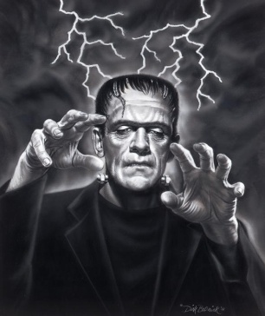
Frankenstein by Mary Shelley
Reading comprehension : Read the extract and answer the questions in as much detail as possible.
Chapter 5
It was on a dreary night of November that I beheld the accomplishment of my toils. With an anxiety that almost amounted to agony, collected the instruments of life around me, that I might infuse a spark of being into the lifeless thing that lay at my feet. It was already one in the morning; the rain pattered dismally against the panes, and my candle was nearly burnt out, when, by the glimmer of the half-extinguished light, I saw the dull yellow eye of the creature open; it breathed hard, and a convulsive motion agitated its limbs.
How can I describe my emotions at this catastrophe, or how delineate the wretch whom with such infinite pains and care I had endeavoured to form? His limbs were in proportion, and I had selected his features as beautiful. Beautiful! -- Great God! His yellow skin scarcely covered the work of muscles and arteries beneath; his hair was of a lustrous black, and flowing; his teeth of a pearly whiteness; but these luxuriances only formed a more horrid contrast with his watery eyes, that seemed almost of the same colour as the dun white sockets in which they were set, his shrivelled complexion and straight black lips.
The different accidents of life are not so changeable as the feelings of human nature. I had worked hard for nearly two years, for the sole purpose of infusing life into an inanimate body. For this I had deprived myself of rest and health. I had desired it with an ardour that far exceeded moderation; but now that I had finished, the beauty of the dream vanished, and breathless horror and disgust filled my heart. Unable to endure the aspect of the being I had created, I rushed out of the room, continued a long time traversing my bed chamber, unable to compose my mind to sleep. At length lassitude succeeded to the tumult I had before endured; and I threw myself on the bed in my clothes, endeavouring to seek a few moments of forgetfulness. But it was in vain: I slept, indeed, but I was disturbed by the wildest dreams. I thought I saw Elizabeth, in the bloom of health, walking in the streets of Ingolstadt. Delighted and surprised, I embraced her; but as I imprinted the first kiss on her lips, they became livid with the hue of death; her features appeared to change, and I thought that I held the corpse of my dead mother in my arms; a shroud enveloped her form, and I saw the grave-worms crawling in the folds of the flannel. I started from my sleep with horror; a cold dew covered my forehead, my teeth chattered, and every limb became convulsed: when, by the dim and yellow light of the moon, as it forced its way through the window shutters, I beheld the wretch -- the miserable monster whom I had created. He held up the curtain of the bed and his eyes, if eyes they may be called, were fixed on me.

Slide 23
His jaws opened, and he muttered some inarticulate sounds, while a grin wrinkled his cheeks. He might have spoken, but I did not hear; one hand was stretched out, seemingly to detain me, but I escaped, and rushed down stairs. I took refuge in the courtyard belonging to the house which I inhabited; where I remained during the rest of the night, walking up and down in the greatest agitation, listening attentively, catching and fearing each sound as if it were to announce the approach of the demoniacal corpse to which I had so miserably given life.
Oh! no mortal could support the horror of that countenance. A mummy again endued with animation could not be so hideous as that wretch. I had gazed on him while unfinished he was ugly then; but when those muscles and joints were rendered capable of motion, it became a thing such as even Dante could not have conceived.
I passed the night wretchedly. Sometimes my pulse beat so quickly and hardly that I felt the palpitation of every artery; at others, I nearly sank to the ground through languor and extreme weakness. Mingled with this horror, I felt the bitterness of disappointment; dreams that had been my food and pleasant rest for so long a space were now become a hell to me; and the change was so rapid, the overthrow so complete!
uestions
Summarise in 50 – 100 words what has happened in the passage you have read.
How does Dr Frankenstein feel about the monster he has created? How do you know this?
How does the author describe the monster? What effect does this create?
Find 3 quotes that tell you Dr Frankenstein is afraid.
Extended writing
Create a diary entry as if you are Dr Frankenstein and you have just created your monster. Include thoughts and feelings. Also, include lots of description so that the reader can imagine what you are seeing and doing.

Slide 24
Answer your questions in detail here:

Slide 29
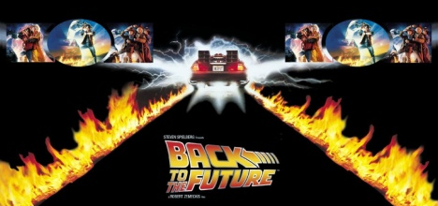
Section three: Past, present, future
To be completed by:
______________________________
What do I need to complete over the next two weeks?
Spelling test 3
What are the rules?– read
Which present tense?
Recap verbs
Complete the tenses grid
Extended writing
New vocabulary K and L
Reading comprehension: Mo Farah
Self Assessment: What do I still need to practise from this section?

Slide 30
Spelling test 3
You will be tested on your spellings in every
literacy lesson.
You are expected to get at least 17/20 right each time. If you do not manage this you will need to re-take the test at another time.
 | Read | Write | Cover and write
Commonly misspelt words | Judgement
 | Knowledge
 | Leisure
 | Library
 | Lightning
 | Maintenance
 | Manoeuvre
 | Memento
 | Millennium
 | Miniature
 | Mischievous
 | Noticeable
 | Occasion
 | Occasionally
 | Occur
Topic specific words

Slide 31
Past tense
We use the past tense to talk about things that have already happened.
Present tense
We use the present tense to talk about things that are happening now.
Future tense
We use the future tense to talk about things that are going to happen.
What are the rules?
These are the basic ones, but like with all rules, there are exceptions.
Key: | Past tense | Present tense | Future tense
Present to past
When changing a verb (a doing word) into the past tense you need to add an –ed on the end.
Want + ed = wanted
Present with subjects
In the present tense verbs can also change with different subjects (the person or thing in the sentence).
We add an s to the word when the subject is he, she or it or a single noun (person, place or thing).
For example; I love chocolate. We love chocolate. They love chocolate but, Sara loves chocolate.
Exceptions, or more formally – irregular verbs
Is | Are
Eat | Ate
Do | Did
Go | Went
Have | had

Slide 32
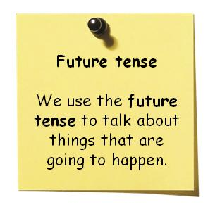
There are three different ways to write in the future tense.
Future tense = Will or shall + verb
Present continuous = where plans about the future are being discussed. (Verb + ing)
‘going to’ + verb = when you are talking about making a decision
Examples
I will go to the cinema tomorrow.
What time are you leaving tomorrow? I am leaving at 7am.
I’m going to watch a film on TV.
Task
Which version of the future am I?
Underline the key part of the sentence that tells me this.
Example, Tomorrow I shall eat a whole chicken at Nandos. | 1
I am going to have a bath and go to bed.
She will run a marathon next week.
She is getting married in 2 months time at 3pm.
They’re determined to eat carrots every day until they can see in the dark.
I shall dance at the ball until my feet can’t take anymore.

Slide 33
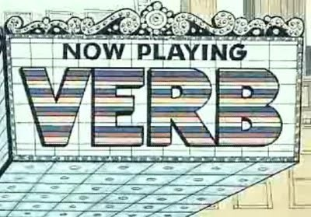
Recap: In term 1 we looked at what a verb is. Explain here what you can remember about them: ________________________________________________________________________________
________________________________________________________________________________
Task 1: highlight all the verbs in the sentences below.
Task 2: convert these sentences into past / present /future tense.
Past tense | Present tense | Future tense
 | 1. The gate creaks in the wind.
2. We went to the fish and chip shop and it was delicious.
 | 3. Jo is wearing jeans.
 |  | 4. James will be playing in a band. .
 |  | 5. Cassandra will be walking to school tomorrow .
6. Barbara went shopping.
 | 7. I am very hungry.
8. They ate lunch very quickly.

Slide 34
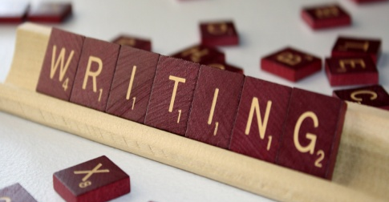
Let’s get these skills and ideas in writing.
(What tense? _____________________)
Task:
Write three paragraphs to show your understanding of tenses we have been studying.
1: What did you do last weekend? (Past)
2: What are you doing today? (Present)
3. What are you doing next weekend? (Future)
Remember: Try to use a variety of sentence structures and vocabulary choices – you need all your skills!

Slide 36
Letter
Word
K
Definition
Sentence (using your word):
Synonyms
Antonyms
Letter
Word
L
Definition
Sentence (using your word):
Synonyms
Antonyms

Slide 37
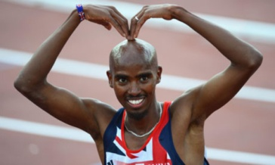
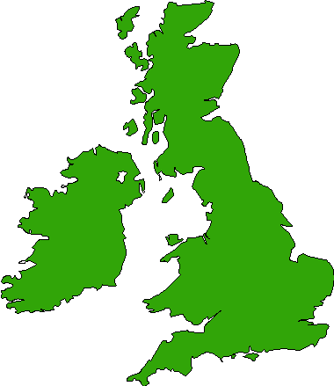
Mo Farah an interview
Reading comprehension : Read the extract and answer the questions in as much detail as possible.
The Weather
“There was still so much I had to get used to when it came to life in Britain. Like the weather, for example. I’d never seen snow before. That first winter it snowed so heavily I couldn’t believe what I was seeing. The whole town was blanketed in thick white. Then there was the cold. Djibouti stayed hot all year round. In December and January the temperature might drop to around 29˚C. That’s about as cold as it ever got. My first winter in England, I remember my fingers and toes turning numb from the freezing cold. I wore gloves but I could never warm up my hands. I’m fine with the rain , but I can’t be dealing with the cold. I’ll probably never get used to it.
1. What happened Mo’s first winter in England?
2. Had he ever seen snow before?
3. What was the weather like in his home town?
4. What does he think about the cold now?
5. What do you think about the weather in this country?
English
“My biggest struggle in those days was with my English. I could speak a few words but I couldn’t read or write, and sometimes I had to communicate with people using hand gestures because I didn’t know the word for certain things. To help improve my English, the school placed in an English as an Additional Language (EAL) group. I still struggled............ Instead, I found myself sitting in this EAL class and finding it difficult to concentrate. There was a Ukrainian kid in the group called Sergiy. We used to fight all the time. It was like Frazier-Ali between Sergiy and me. I learnt more about fighting than I did about English in that class.
1. What problems did Mo have with English?
2. How did he communicate when he didn’t know a word?
3. What did the school do to help him?
4. Why do you think he found it difficult to concentrate?
5. Why do you think he got involved in teaching?

Slide 38
Being Different
“I got into a fair few fights in my early days at Feltham. It was never anything serious, just the odd scrap here and there. Because I usually have a smile on my face and try to be nice to people my kindness often gets mistaken for weakness. I suppose I stood out at school. I was slightly different from the other kids. I came from another continent, I was a Muslim, I spoke another language. Some kids probably looked at me and thought, ‘Yeah, here’s someone we can push around.’ They didn’t know me. I’ve never been afraid to stick up for myself. I’d had a tough childhood- a lot tougher than a lot of kids. From a young age I had to learn to be a fighter. I never backed down from a fight”
1. Why did people think Mo was weak?
2. Was Mo afraid of other people?
3. What did he mean when he said “I’d had a tough childhood”?
4. What did he learn from a young age?
Extended writing task:
Compare your thoughts on British weather with Mo’s
How do people in this country/ class/ college treat you? Explain why you think that is so

Slide 39
Answer your questions in detail here:

Slide 43
Spelling test time
 | Test 1 | Test 2 | Test 3
Connective
Commonly misspelt words
English subject words
Topic specific words
 | Total: /20 | Total: /20 | Total: /20

Slide 44
Choose your words wisely!
Relevant | Interesting | Ambitious

