Slide 1
Leadership
2020
Employability skills

Slide 2
What is leadership skills?
Leadership skills are skills you use when organizing other people to reach a shared goal. Whether you're in a management position or leading a project, leadership skills require you to motivate others to complete a series of tasks, often according to a schedule.

Slide 3
Leadership Skills
Management
Vision
Goal
Teamwork
Strategy
Challenges
Motivation
Honest and integrity
Relationship building

Slide 4
Motivation and Challenges
If you have good ideas and a desire to implement them, you'll want to be a leader. Enjoying your job, being highly motivated and committed to your work, and feeling passionate about making a more significant contribution are all factors that can motivate you to be a leader. This will challenge you or others you work with to aim higher and do things you may think you can not do.

Slide 5
Goal and Vision
Set clear goals for completing a project so that your team knows what is expected of them. Ensure that your team agrees with goals and deadlines you have set, and can identify with them on a personal level. This way they can be motivated to work harder and achieve those goals, boosting productivity levels in turn. Making sure that your team are in agreement and happy with goals and deadlines you have set will help them feel more involved in their work.

Slide 6
Teamwork and Relationship building
One of the keys to having great leadership skill is all about being able to work as part of a team. So it is important that you get to know your team well and start building those relationships with them.

Slide 7
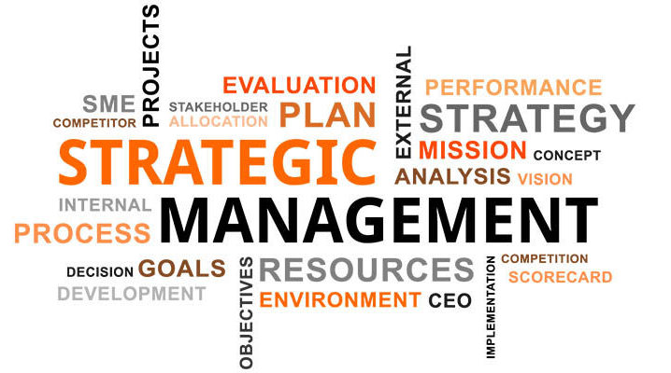
Strategy and Management
Strategic management is the ongoing planning, monitoring, analysis and assessment of all necessities an organization needs to meet its goals and objectives. Changes in business environments will require organizations to constantly assess their strategies for success.

Slide 8
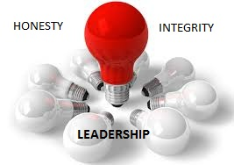
Integrity and Honesty
Integrity is the practice of being honest and showing a consistent and uncompromising adherence to strong moral and ethical principles and values. In ethics, integrity is regarded as the honesty and truthfulness or accuracy of one's actions. Having honesty and integrity in the workplace is one of the most important qualities of great leadership skills.

Slide 9
Skills that make you a leader.
Double Click TO Play Video

Slide 10
Thank you!
Have a lovely afternoon

