Slide 1
Listening and presenting
2020
Employability skills

Slide 2
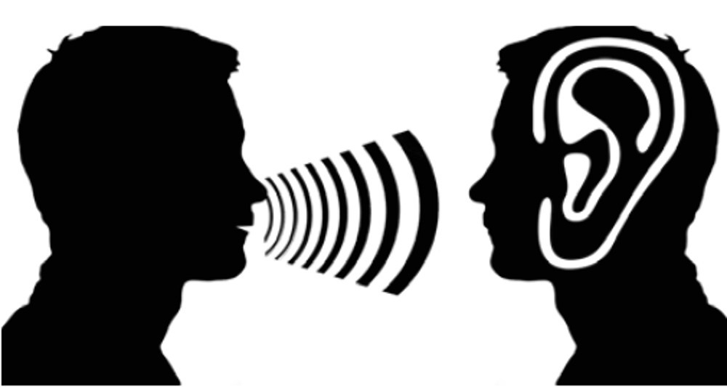
What is listening?
According to Oxford Living Dictionaries, to listen is to give attention to sound or action. When listening, one is hearing what others are saying, and trying to understand what it means. The act of listening involves complex affective, cognitive, and behavioral processes.

Slide 3
Presenting Skills
Presentation skills are the skills you need in delivering effective and engaging presentations to a variety of audiences. These skills cover a variety of areas such as the structure of your presentation, the design of your slides, the tone of your voice and the body language you convey.

Slide 5
Improving your presenting skills
Practice! Naturally, you'll want to rehearse your presentation multiple times.
Transform Nervous Energy Into Enthusiasm.
Attend Other Presentations.
Arrive Early.
Adjust to Your Surroundings.

Slide 6
Improving your listening skills
Put Yourself In Their Shoes. Whether you agree with the speaker or even have an interest in what they have to say, what they are saying is important to them.
Pick Up Key Points And Let The Speaker Know You Did.
Practice Active Listening.
Develop Curiosity, An Open Mind, And A Desire For Continuous Growth.
Develop curiosity, a open mind and desire for continuous growth.

Slide 7
Thank you!
Have a lovely afternoon

