Slide 1
Road Signs
Why are road signs there?
Road signs are there to tell you what you ARE allowed to do and what you MUST NOT do
What do we need to know about road signs?
We need to understand road signs and do what they say

Slide 2
What different road signs mean…
Click to find out more about Circular
Signs
Click to find out more about Triangular
Signs
Click to find out more about Rectangular
Signs
Afterwards, click here to continue slide show…

Slide 3
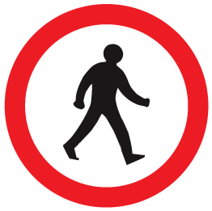
Circular Signs Give Orders…
Blue circular signs usually tell you what you must do
Turn left
ahead
Mini
roundabout
Keep left
Ahead only
Red circular signs usually tell you what you must not do.
No entry for
vehicles
No
pedestrians
No cycling
Can you guess what these road signs mean?
Click on the sign to check…
Back

Slide 4
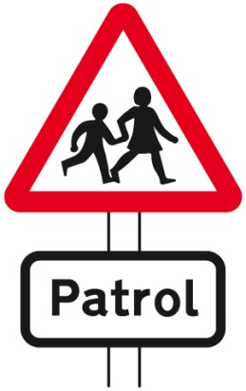
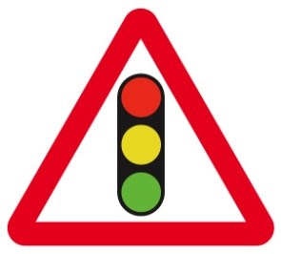
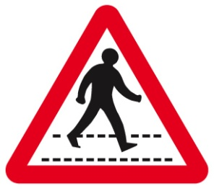
Triangular Signs Give Warnings…
Children
Going to
Or from
school
Crossroads
Traffic signals
ahead
Pedestrian
crossing ahead
Cycle route
ahead
Danger
Can you guess what these road signs mean?
Click on the sign to check…
Back

Slide 5
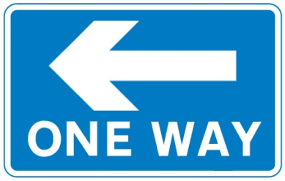
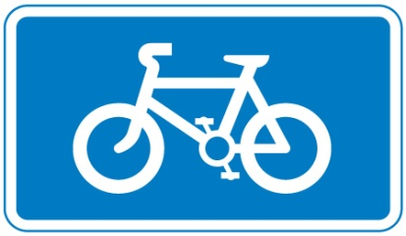
Rectangular Signs Give Information…
Route for
pedestrians
Tourist
attraction
Recommended
For pedal
cycles
One way
street
Can you guess what these road signs mean?
Click on the sign to check…
Back

Slide 6
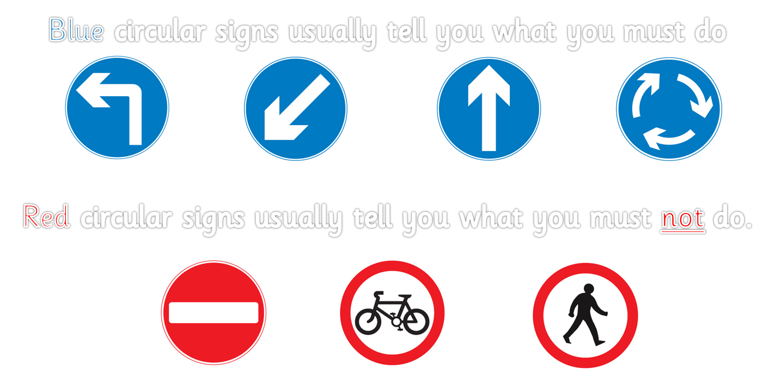
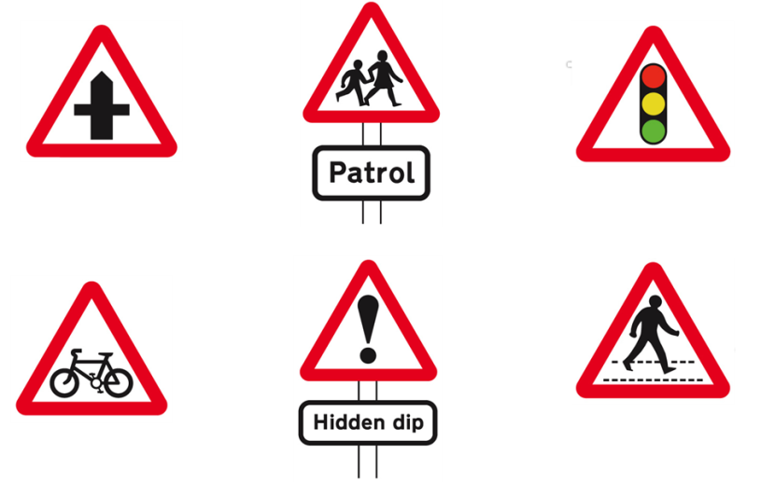
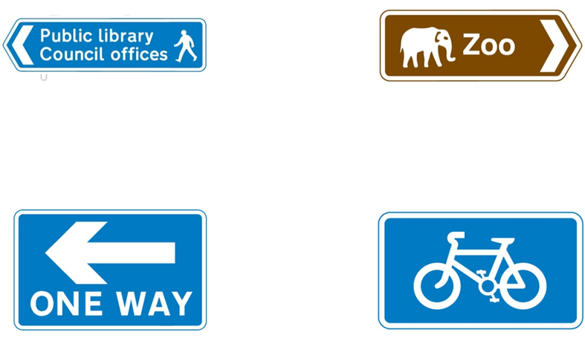
Click the links below for…
Remember…
Signs that give warnings:
Signs that give information:
Stop Look Listen Think song
Road Safety Run game

