Slide 1
Safety in the Community
Abbot’s Lea School
KS5

Slide 2
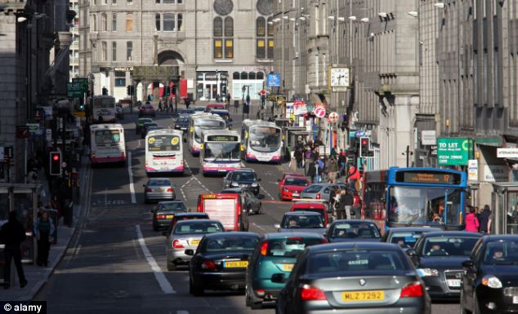
L.O: We are learning about safety in the community
When we are in the community, there are a lot of hazards we need to consider.
How many dangers can you name in these pictures?

Slide 3
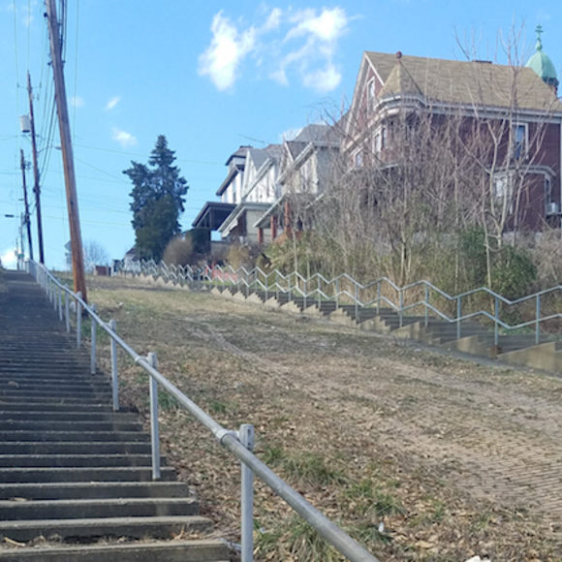
L.O: We are learning about safety in the community

Slide 4
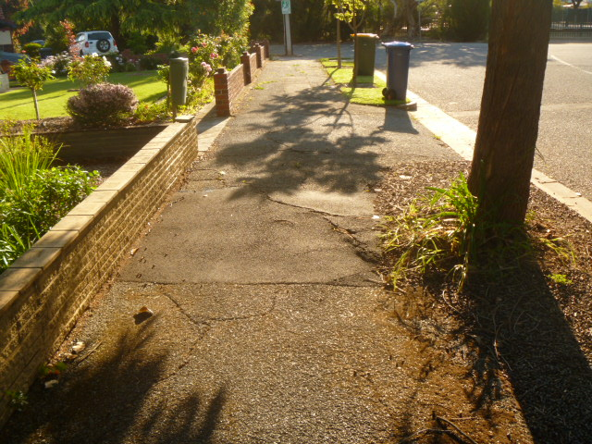
L.O: We are learning about safety in the community

Slide 5
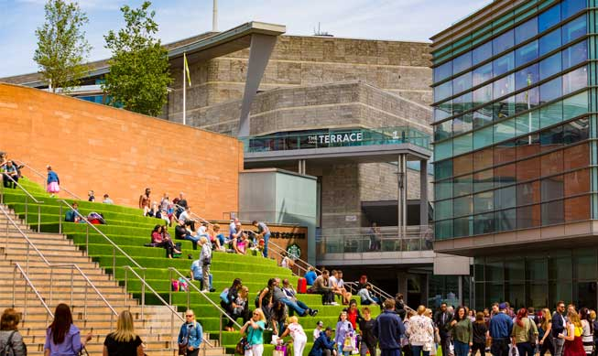
L.O: We are learning about safety in the community

Slide 6
L.O: We are learning about safety in the community

Slide 7
L.O: We are learning about safety in the community
Planning Ahead
When planning a journey, we can consider the possible dangers and be prepared.
Think about this scenario;
You are going to college. You are travelling from home. You are travelling alone. You need to walk to the bus stop 15 minutes away from your home. The bus leaves you in town. You know it is close to College but not exactly sure where.
Complete the worksheet; Travel Scenario!

Slide 8
L.O: We are learning about safety in the community
Looking for help
In the community, there are people who can help us.
Have a look at the table below.
Have a discussion on what information we could include
Think about the different people you could find;
At college?
On the street?
Train station?
Bus Depot?
Who can help us? | Where can we find them? | What can they do?

Slide 9
L.O: We are learning about safety in the community
Speaking to Strangers
Even though we are a lot older, it does not mean it is wise to speak to people we do not know.
A strange person could appear very pleasant and kind, but that does not mean they aren’t dangerous!
Discussion;
What do you think could happen if we speak to people we do not know?

Slide 10
L.O: We are learning about safety in the community
Speaking to Strangers
There is some information that we should never share with people that we do not know and trust.
Can you think what that information might be?
What do you think could happen if we share this information?

Slide 11
L.O: We are learning about safety in the community
TASK
In groups of 4, create a role play scenario highlighting the dangers of speaking to someone we do not know or trust.
Create your story together and take time to practice, once we are all ready, you will act out your role play to the class!

