Slide 1


Slide 2

Welcome to learning at Abbot’s Lea Intern programme

Slide 3
What can you expect?
• Well qualified Job Coaches
Friendliness and professionalism
To be treated fairly and with respect
To have access to printed and electronic resources
Responsiveness to your ideas, opinions and suggestions
Full support for your learning

Slide 4
What do we expect from you?
• To take the programme seriously and work to the best of your ability
To attend all sessions – aim for 100% attendance
Be prepared and take an active part in sessions
To treat staff and other students with respect
Follow our rules and guidance

Slide 5
British Values
We promote British Values
Democracy
Individual liberty
Rule of law
Respect and tolerance

Slide 6

RESPECT
DO NOT USE ‘ISMS’ eg racism, sexism
DO NOT BULLY OR HARRASS
RESPECT PROPERTY
NEVER RESORT TO AGGRESSION

Slide 7


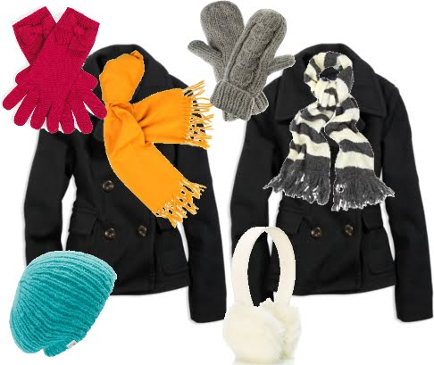

To help to maintain a safe and productive learning space we have a few rules
.

Slide 8

Strengths and Weaknesses
Developing own interpersonal Skills Know own strengths and weaknesses CC | Class discussion and reflections of our strengths and weaknesses within our roles in the workplace and our own personal strengths and weaknesses. Gatsby: 3 | Written work Class discussion Self - analysis and awareness. | Work sheet Class discussion

Slide 9
Learning intention
I will learn about my strengths and weaknesses personally and within the workplace.
Success criteria
I can describe my strengths
I can use my strengths to make decisions
I can explore jobs related to my strengths

Slide 10
What is a Strength?
What is a Weakness?

Slide 11
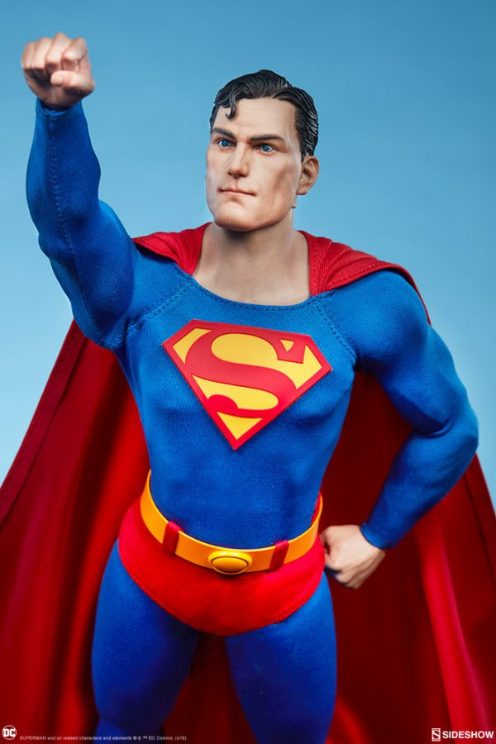
The Strengths and Weaknesses of Superman

Slide 12
Superman has 4 basic weaknesses that affect him physically. These are high gravity, a red sun, magic and Kryptonite. High gravity is a weakness for Superman in that it will cause him to lose his super strength, speed and other powers that come from Earth having a lower gravity than Krypton had.
Superman/s strengths are: the powers of flight, superhuman strength, x-ray vision, heat vision, cold breath, super-speed, enhanced hearing, and nigh-invulnerability.

Slide 13
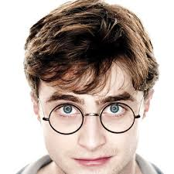
Strengths and Weakness in Harry Potter

Slide 14
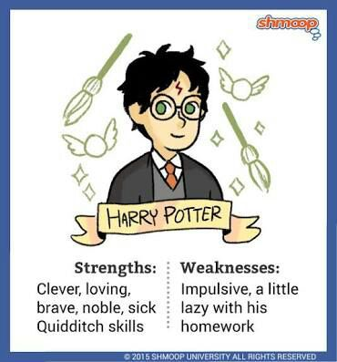

Slide 15
Some other Strengths and Weaknesses

Slide 16
What Strengths are desirable to an employer?
Discuss

Slide 17
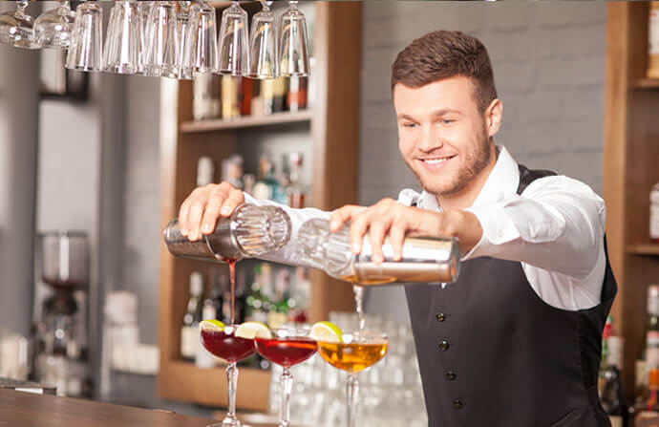
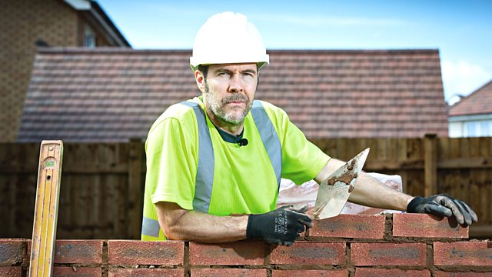
What Specific Strengths might be good if your Job was working behind a Bar?
What Specific Strengths might be good if your Job was working as a Builder?

Slide 18
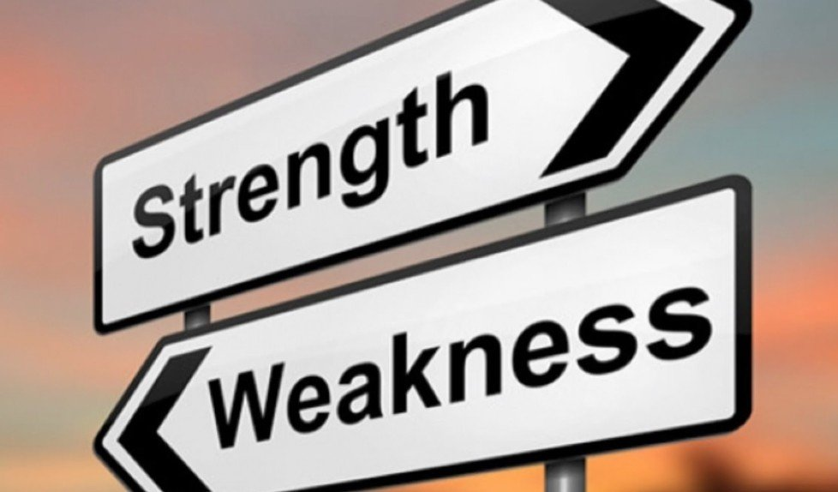

Slide 19
Name: Claire Caddick
Strengths Weaknesses
Confident Not a great listener
Motivated Likes to be in Control
Good Public Speaker Can over-explain

Slide 20
Repeat for ‘ JOB RELATED STRENGTHS AND WEAKNESSES
Work with your Job Coaches to now add what you can personally do to address your weaknesses.
Write this down on your paper.

Slide 27


