Slide 1
The different types of communication
2020
communication skills

Slide 2
What is effective communication?
Effective communication is a process of exchanging ideas, thoughts, knowledge and information such that the purpose or intention is fulfilled in the best possible manner. In simple words, it is nothing but the presentation of views by the sender in a way best understood by the receiver.

Slide 3
Types of Communication
Communication can be categorized into three basic types:
Verbal communication, in which you listen to a person to understand their meaning;
Written communication, in which you read their meaning; and
Nonverbal communication, in which you observe a person and infer meaning.

Slide 4
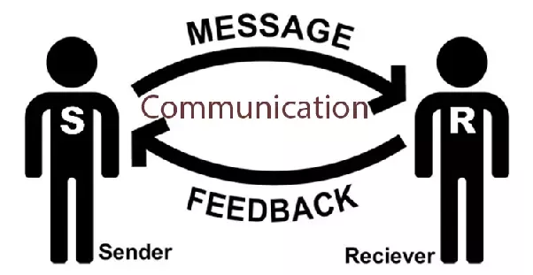
What is verbal communication?
Effective verbal communication skills include more than just talking. Verbal communication encompasses both how you deliver messages and how you receive them. Communication is a soft skill, and it’s one that is important to every employer. Workers who can convey information clearly and effectively are highly valued by employers. Employees who can interpret messages and act appropriately on the information that they receive have a better chance of excelling on the job.

Slide 5
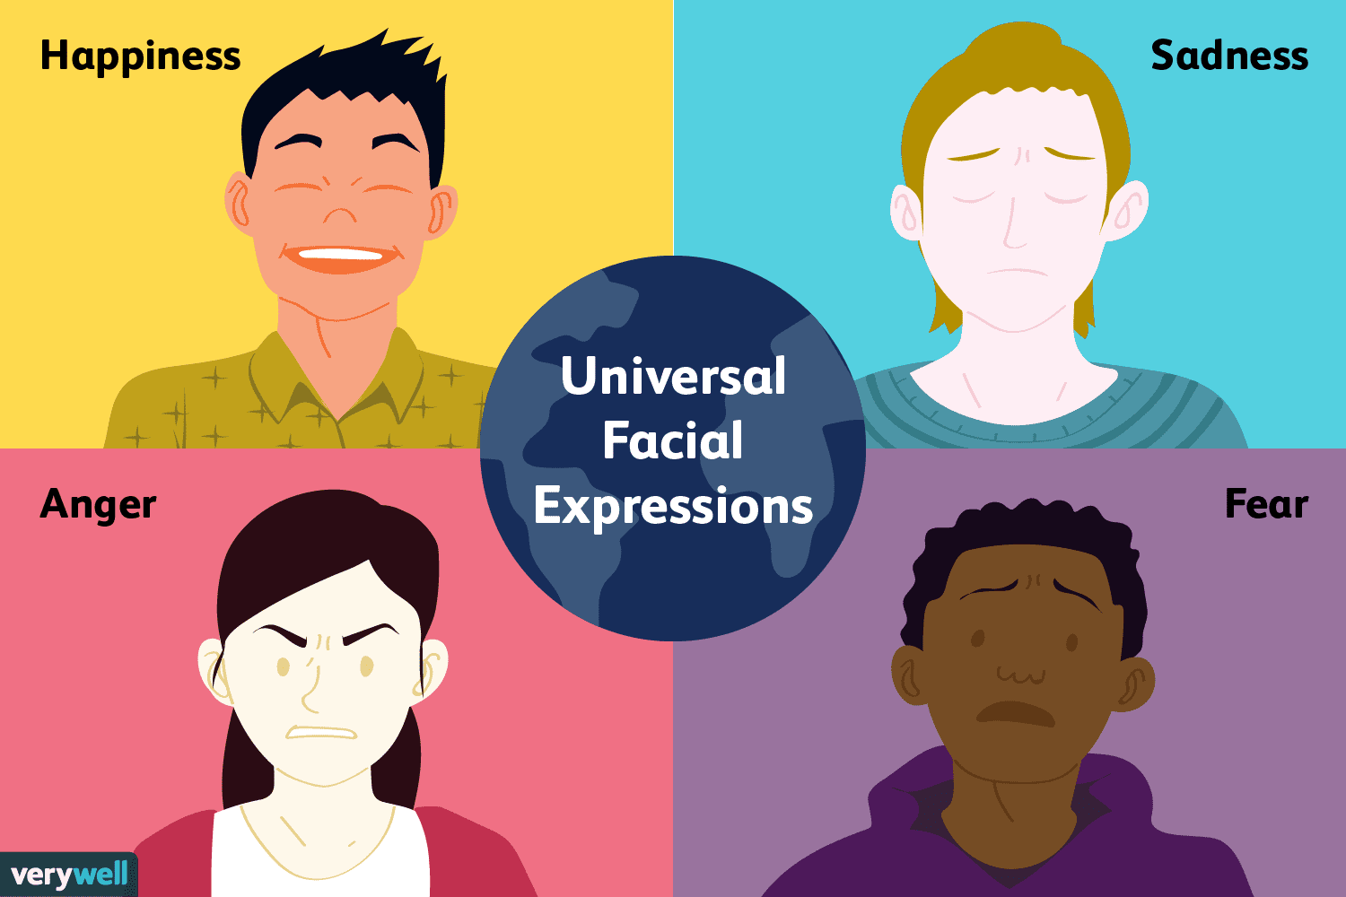
What is non-verbal communication?
Nonverbal communication is the transmission of messages or signals through a nonverbal platform such as eye contact, facial expressions, gestures, posture, and the distance between two individuals.

Slide 6
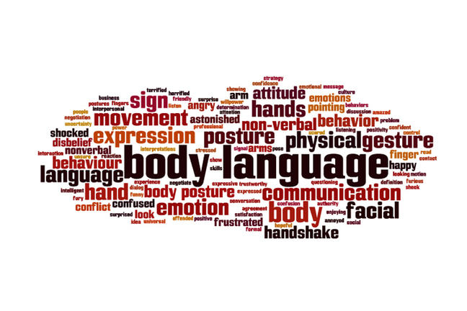
Non-verbal communication:
Facial expressions
Body language
Eye contact
Gestures
Touch

Slide 7
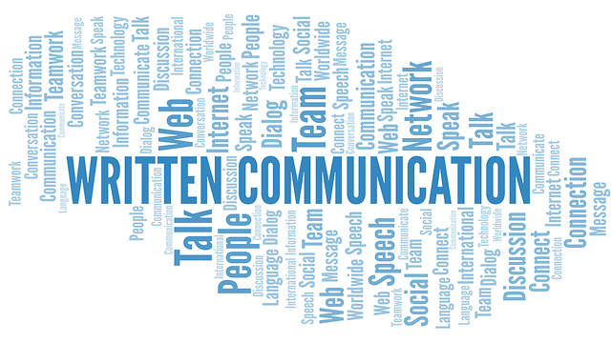
Written communication skills.
A 'Written Communication' means the sending of messages, orders or instructions in writing through letters, manuals, reports, emails, memos, bulletins, etc.

Slide 8
Effective Communication Skills for Youth
Double Click TO Play Video

Slide 9
Thank you!
Have a lovely afternoon

