Slide 1
Assembly

Slide 2
Aim
To understand who Martin Luther King was and why he is remembered through the celebration of a national holiday in America.

Slide 3
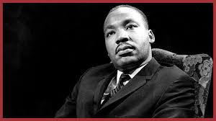
Martin Luther King Day
Martin Luther King, Jr. Day is an American national holiday marking the birthday of Martin Luther King, Jr.
Martin Luther King was born on January 15th, 1929.
Photo courtesy of “Caveman Chuck” Coker (@flickr.com) - granted under creative commons licence - attribution

Slide 4
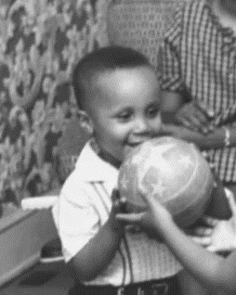
Who Was Martin Luther King?
Martin Luther King was born in Atlanta in the USA. As a child he enjoyed doing all the sorts of things that you enjoy doing.
He enjoyed playing sports, he learned to play the piano and enjoyed going to school.
But life was sometimes difficult for Martin Luther King …because he was African-American.

Slide 5
America in the 1950s & 1960s
In the 1960s, life was particularly unfair for African Americans. They weren’t allowed to use the same facilities as the white people in the United States of America.
There were separate areas for African Americans and white people on public transport like buses and trains.
African Americans had to use separate areas of parks and restaurants and even separate toilets to those used by white people.
In some states in the USA, African-American children weren’t allowed to go to school. Or they had to go to separate schools – these usually weren’t given a lot of money and didn’t have many resources.
Is this fair?

Slide 6
What is fair?

Slide 7
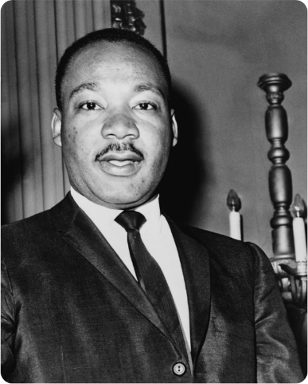
Why Is Martin Luther King Famous?
Martin Luther King was a Christian. He wanted to make sure that all Americans had the same rights, regardless of their race.
He became a civil rights activist. This means he campaigned for improved rights for people – to try to make all people equal.

Slide 8
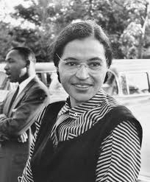
The 1955 Bus Boycott
In 1955, Rosa Parks, an African-American woman, was travelling on a bus when a white man got on. In the 1950s, African Americans would have to give up their seats to white people. Rosa Parks refused to give up her seat and she was arrested by the police.
When this happened, Martin Luther King asked African Americans to protest peacefully by not travelling on the buses in the city where Rosa had been travelling.
They boycotted (that means did not use) the buses for 385 days ...That’s more than a year!
The boycott ended when a court ruled that the segregation of people (the separate areas for people with different coloured skin) on the buses should be stopped.

Slide 9
How old was Rosa when she realised things were different for black people and white people?
What things did she notice were different for black and white people?
3) What was the date in 1955 when Rosa decided to not give up her seat?
4) What do we mean by a “bus boycott?”
5) How much money was Rosa fined?
6) What new rule did the government make?

Slide 10
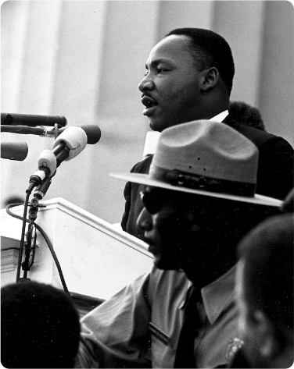
“I have a dream…”
In 1963, Martin Luther King led a huge march on Washington, D.C., the US capital.
Here, in front of a huge crowd, Martin Luther King made his famous “I have a dream” speech. Here is a short extract:
“I have a dream that one day little black boys and black girls will be able to join hands with little white boys and white girls as brothers and sisters.”

Slide 12
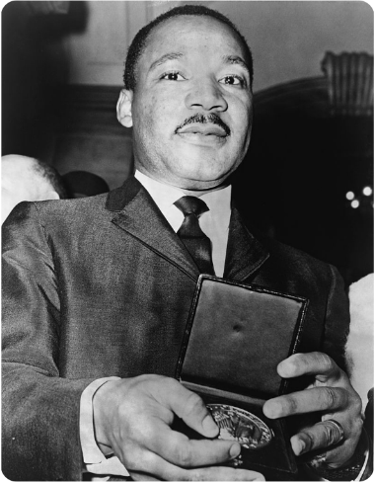
Amazing Achievements
In 1964 Martin Luther King received the Nobel Peace Prize for his work to end racial prejudice in the United States.
The law was changed so that everyone could vote.
It is because of Martin Luther King, and others like him, that people in the United States have equal rights today, although there is still a long way to go.

Slide 13
Write your own “I have a dream speech”
"I Have a Dream Too!" I have a dream that one day this nation will ____________________________________
I have a dream that one day __________________________
I have a dream today.
I have a dream that one day __________________
I have a dream today.
This is my hope and faith.
With this faith we will be able to _______________________ This will be the day when ___________________________

Slide 14
These dates and events are all muddled up!
Can you use the internet to research and put the correct date next to the correct event?
December 1, 1955 | Martin Luther King Jr. is born.
September, 1935 | Martin Luther King begins school at the all-black Yonge Street Elementary School in Atlanta.
December, 1964 | Martin Luther King is ordained as a Baptist minister.
January 15, 1929 | Mrs. Rosa Parks refuses to give up her bus seat to a white man in Montgomery, Alabama.
February, 1948 | The Southern Christian Leadership Conference is founded. Dr. King is chosen president.
January, 1960 | The King family moves to Atlanta, where Martin Luther King becomes co-pastor of the Ebenezer Baptist Church with his father, Martin Luther King, Sr.
January, 1957 | Martin Luther King receives the Nobel Peace Prize.

Slide 15
Can you create a portrait of Martin Luther King Junior?
Can you create a portrait of Rosa Parks?

Slide 16
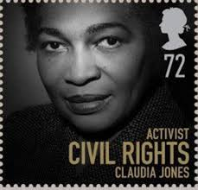
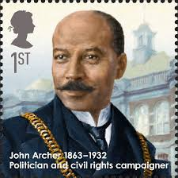
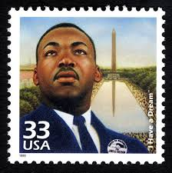
Lots of stamps have been produced to help us remember famous people who fought for fairness.
Could you create your own stamp?
You could Google “famous civil rights activists” to learn about someone who might be on your stamp.

Slide 17
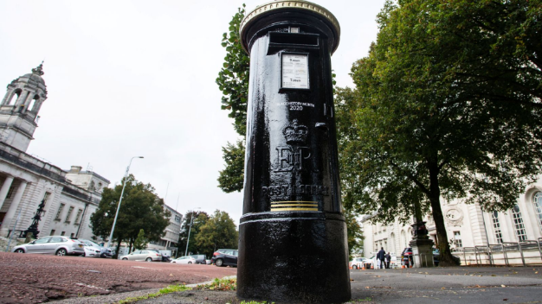
Royal Mail's way of marking Black History Month in October.
Each of the special edition postboxes have been painted black with a gold trim, and feature a social media link and a significant figure in the British black community.
Could you draw a picture of something that is normally a bright colour, but colour it in black instead?

Slide 18
Primary Department:
Ethan 15 January
Secondary Department:
Lexie 17 January
Matthew 19 January
We wish you all a Wonderful Birthday and have fun!

