Slide 2
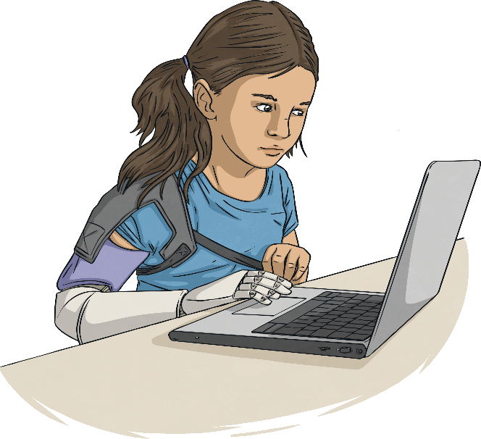
Aims
To know the purpose of the annual Safer Internet Day
To understand the theme, ‘An Internet we trust: exploring reliability in the online world’
To understand my online identity and how to keep safe online

Slide 3
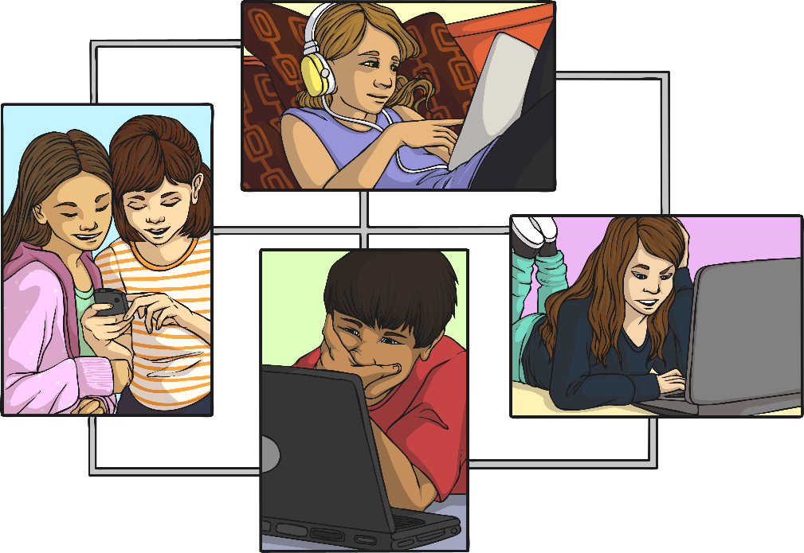
What Is Safer Internet Day?
Safer Internet Day is celebrated in over one hundred countries across the world on Tuesday 9th February 2021.

Slide 4
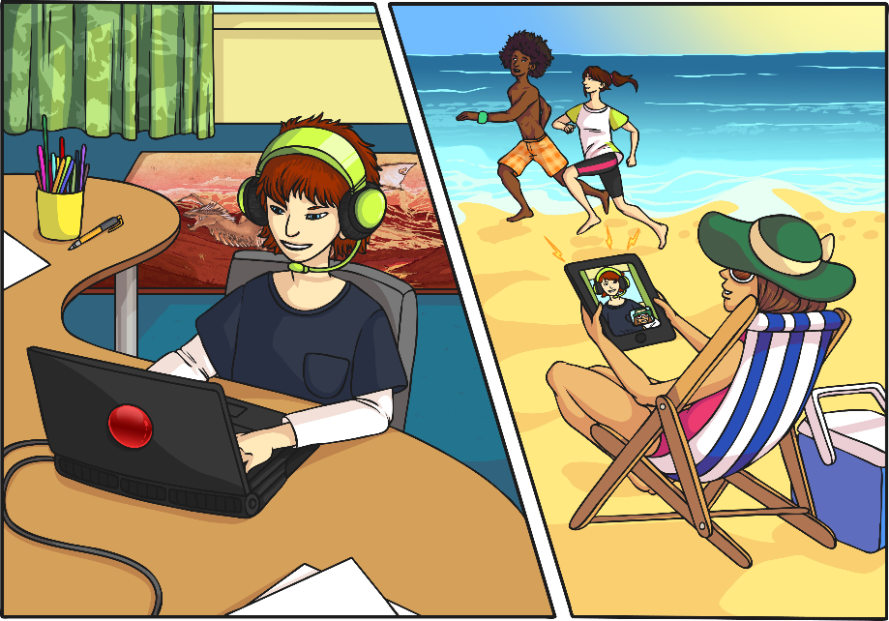
What Do You Use the Internet For?
The Internet is an amazing place!
In our real lives, it provides us with entertainment, allows us to communicate and helps us learn new things.

Slide 5
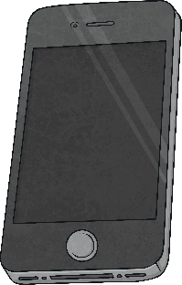
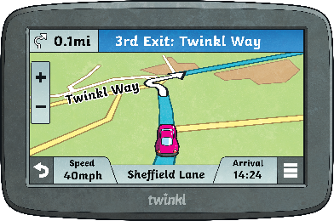
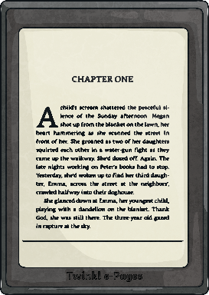
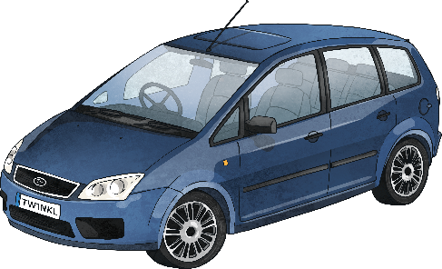
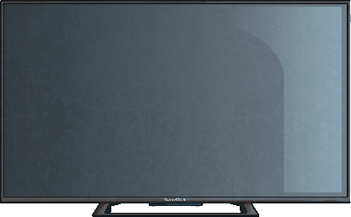
How Do We Access the Internet?
We can use lots of different devices to access the Internet. How many can you think of?
Did you think of all these?

Slide 6
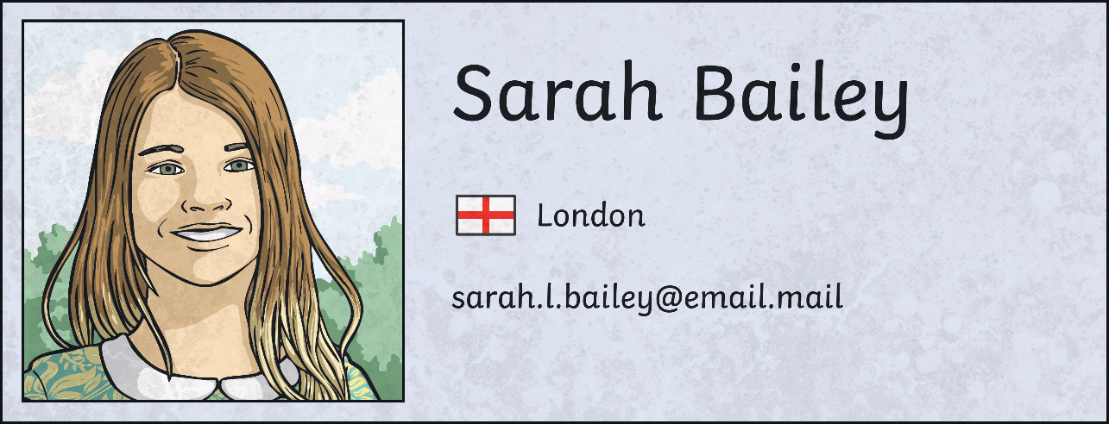
What Is Your Online Identity?
When we go online, we have an online identity.
This is information about ourselves, our likes, what we share and how we talk to others.
On some apps, we can make an avatar or a profile that other people online can see.

Slide 7
An Internet We Trust
The theme this year asks us to think about how we can know what to trust online.
We need to learn how we separate fact from fiction.
How do we know if we can trust something online?

Slide 8
News or Fake News?
There are ways we can investigate if the information we read is fact or fiction.
The online world can influence, persuade and manipulate our decisions and opinions. It’s important we find out what is fact and what is fiction. Sometimes fake news can even be harmful.
What can I do?
Ask myself who wrote this?
Investigate why is was written.
Support my friends if fake news upsets them.
Only share things I have checked are true.

Slide 9
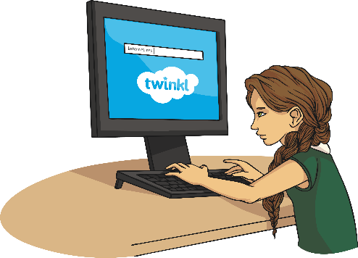
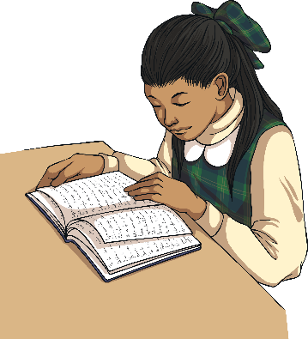
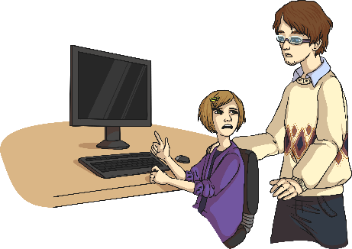
An Internet We Trust
There are ways we can investigate if the information we read is fact or fiction.
question what you see
check other sources online
check sources offline
ask for help

Slide 10
What Would You Do If…
A friend sees an advert pop up saying they have won a prize?
A friend saw a link for a video to an amazing new football trick?
Someone your friend plays games with online asks to meet them person?

Slide 11
What Would You Do If…
A friend sees an advert pop up saying they have won a prize?
A friend saw a link for a video to an amazing new football trick?
Someone your friend plays games with online asks to meet them person?

Slide 12
An Internet We Trust
Remember
question
check
ask

Slide 13
Follow up work
Can you design some “helpful tips” bookmarks, like the ones your teachers can give you?
Can you design a “helpful tips” mouse mat?
Could you create a video clip with your top tips for staying safe online?
Could you create a poster, that we can publish on our website to advise people about how to tell fake news from real news online?
Could you interview someone in your house or class about how they stay safe online?

Slide 14
Secondary Department:
Madeleine for 6 February
Paul 6 February
Primary Department
Jack 5 February
Stephen 8 February

