Slide 1
Australia from Home
Wednesday 14th July

Slide 2
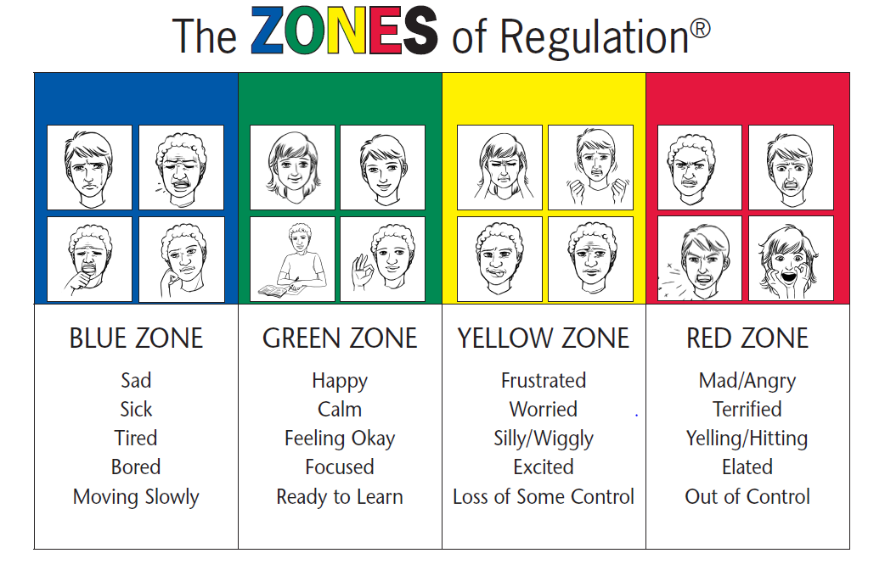
Zones How do you feel?

Slide 3
Lesson 1 – Problem Solving
We are learning about problem solving
The knowledge and skills are how to work in a team and think creatively
This is through taking part in various tasks

Slide 4
Dice-breakers
https://freeonlinedice.com/

Slide 5
Would you rather?
1. Would you rather be a detective or a pilot?
2. Would you rather go skiing or go to a water park?
3. Would you rather fly a kite or swing on a swing?
4. Would you rather dance or sing?
5. Would you rather play hide and seek or dodgeball?
6. Would you rather be incredibly funny or incredibly smart?
7. Would you rather become five years older or two years younger?
8. Would you rather have a full suit of armour or a horse?
9. Would you rather be a master at drawing or be an amazing singer?
10. Would you rather be a wizard or a superhero?

Slide 6
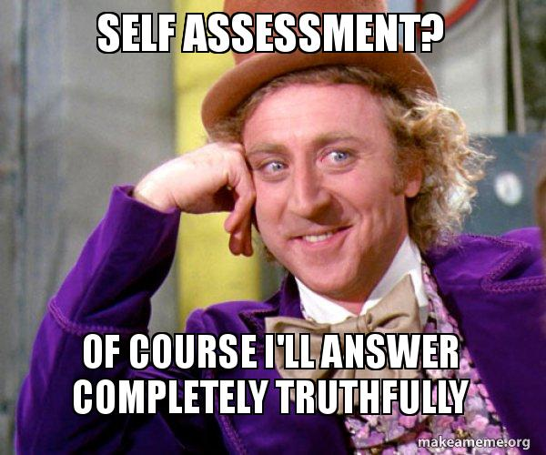
WWW and EBI
What has gone well in this lesson?
What have you learnt?
What could be better?

Slide 7
Zones How do you feel?

Slide 8
Lesson 4 – Drop everything and read
We are learning about reading for meaning
The knowledge and skills are how to read for meaning and actively listening to others
This is through taking part in a debate/discussion

Slide 9
Keywords
Detail
Clarity
Stimulus
Expression

Slide 10
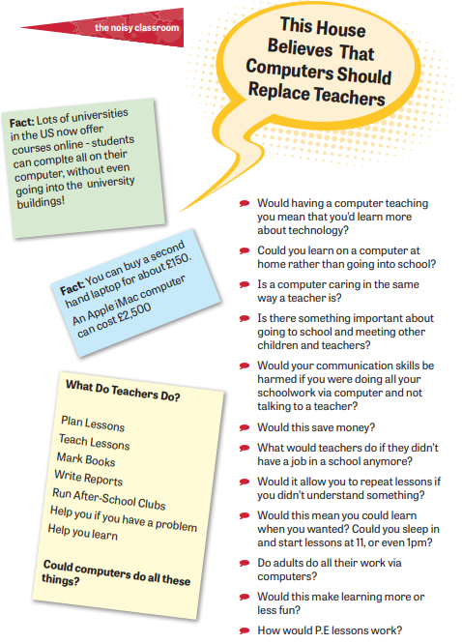
This House believes that computers should replace teachers

Slide 11
Task
Share your opinion
Listen to others
You can disagree but don’t take it personally

Slide 12
Discussion
Keep teachers
Replace with computers

Slide 13
Task
Use flipgrid to record your thoughts: -
https://flipgrid.com/646e2a2b

Slide 14
WWW and EBI
What has gone well in this lesson?
What have you learnt?
What could be better?

