Slide 1
Daily Positive Affirmations
Staff Wellbeing | Resilience Toolkit | Personal Wellbeing | Daily Positive Affirmations

Slide 3
It is important to start each day with a positive thought, as this thought can stay with you for the rest of the day.
Focussing on a positive thought can help you to feel happier and calmer. You can also share this positive thought with others, helping to make their day a little brighter too!

Slide 4
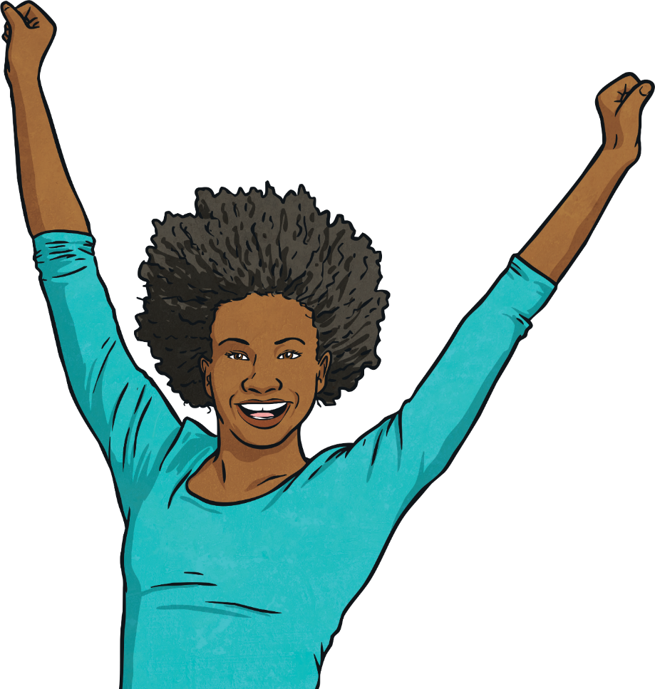
Positivity is a choice and I choose to be positive.

Slide 5
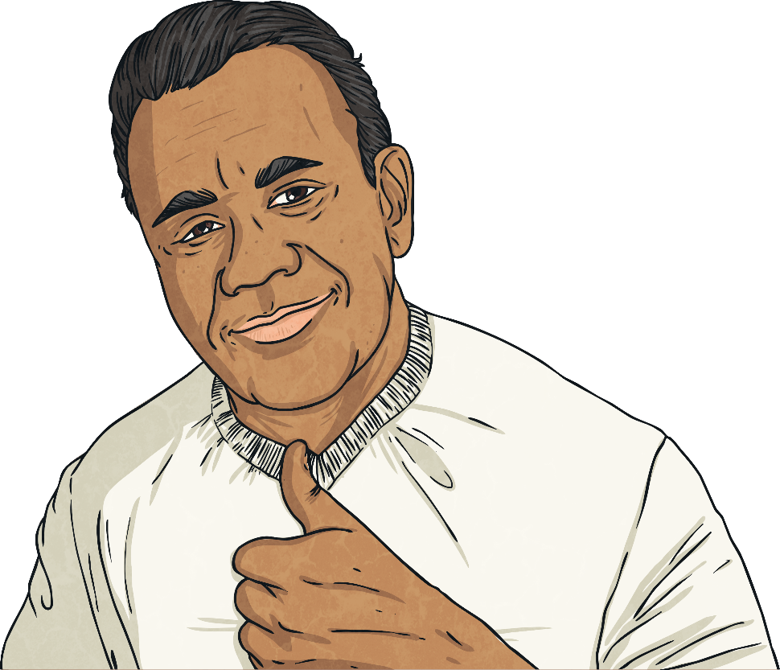
My best is good enough.

Slide 6
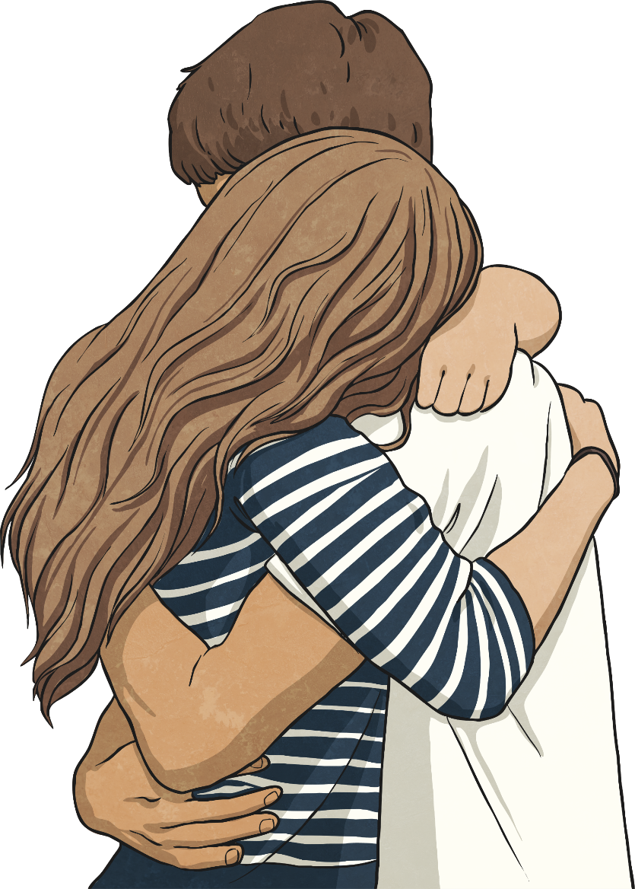
I am good enough.

Slide 7
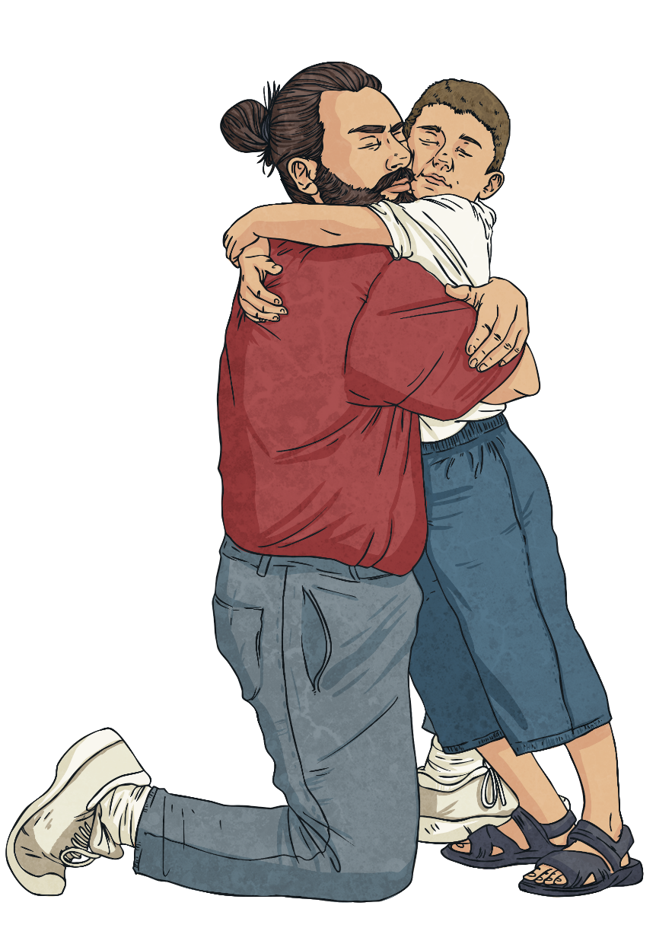
I am compassionate.

Slide 8
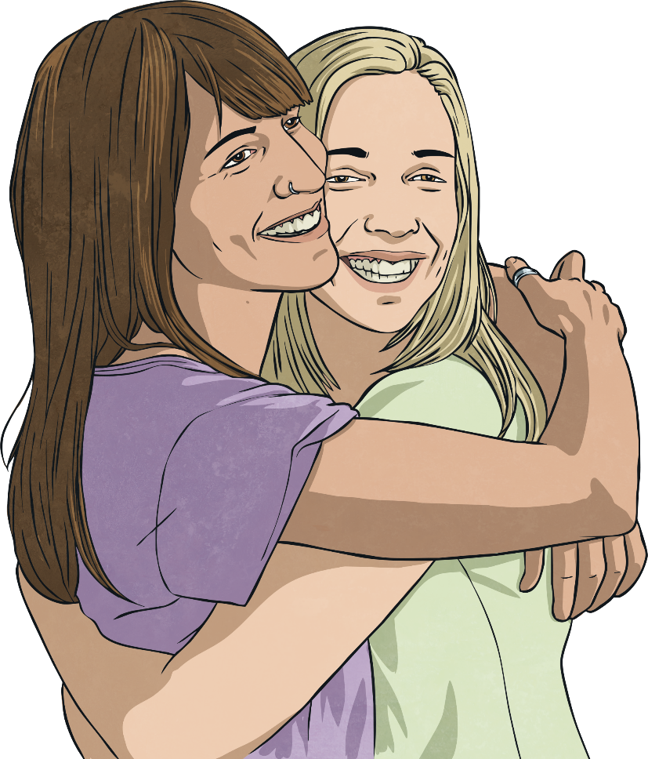
I am a good friend.

Slide 9
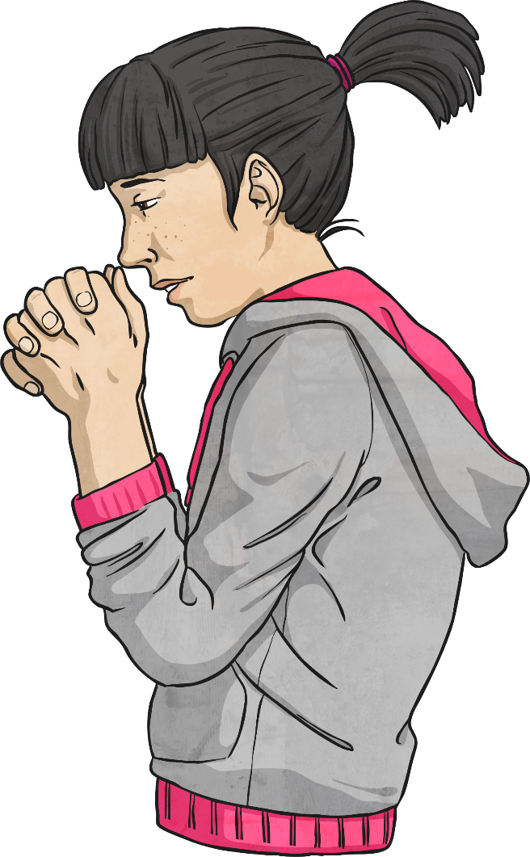
No one is perfect. I forgive myself for my mistakes.

Slide 10
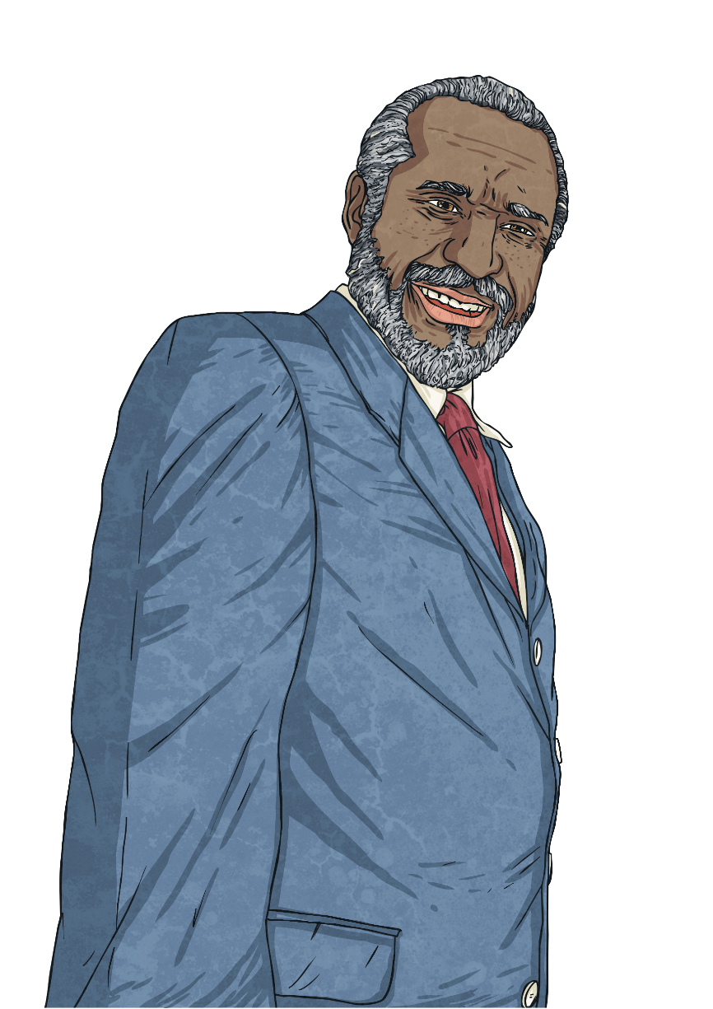
I am great, just the way I am.

Slide 11
I am unique.

Slide 12
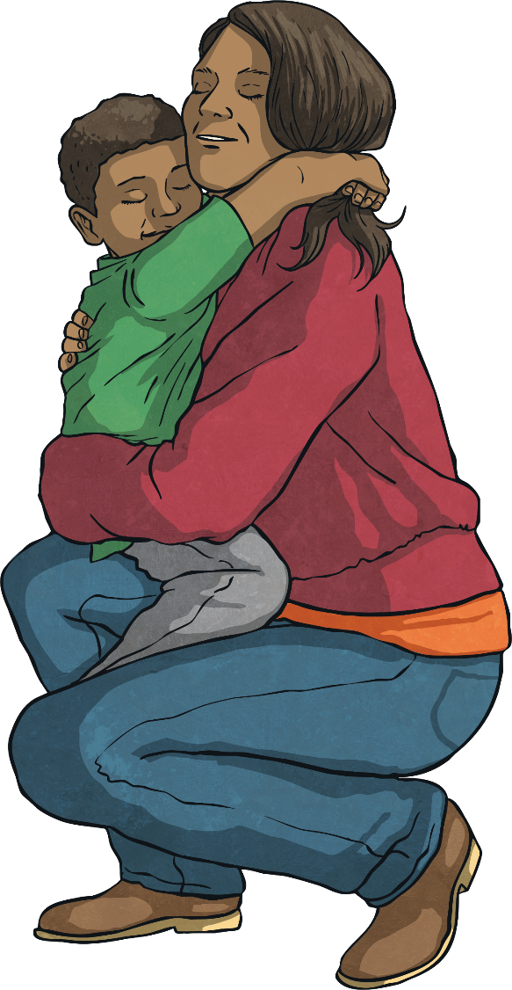
I show empathy to others.

Slide 13
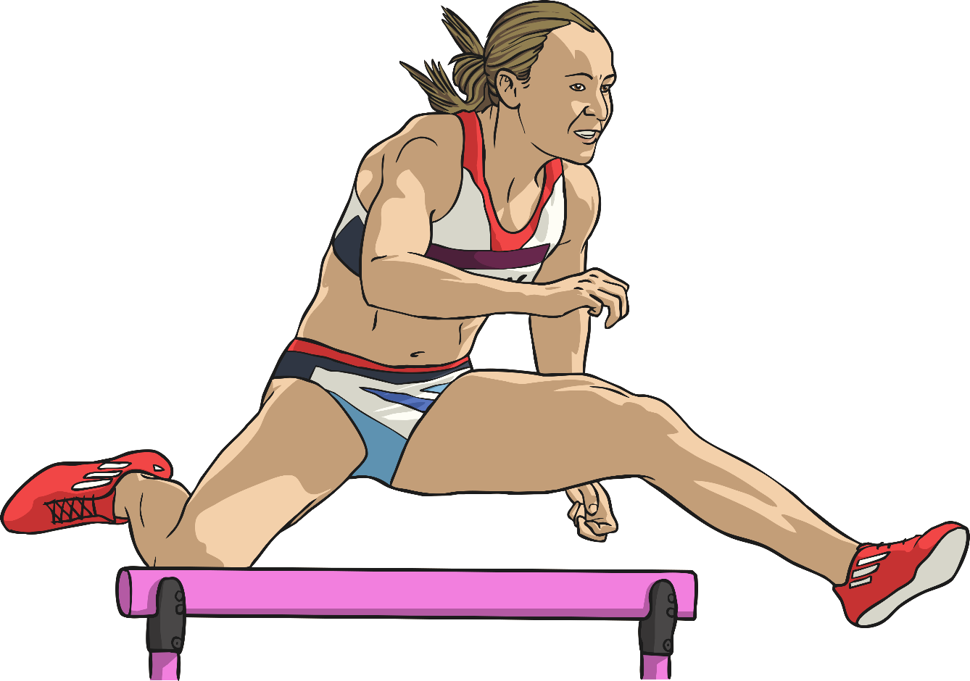
I can conquer all that is thrown at me today.

Slide 14
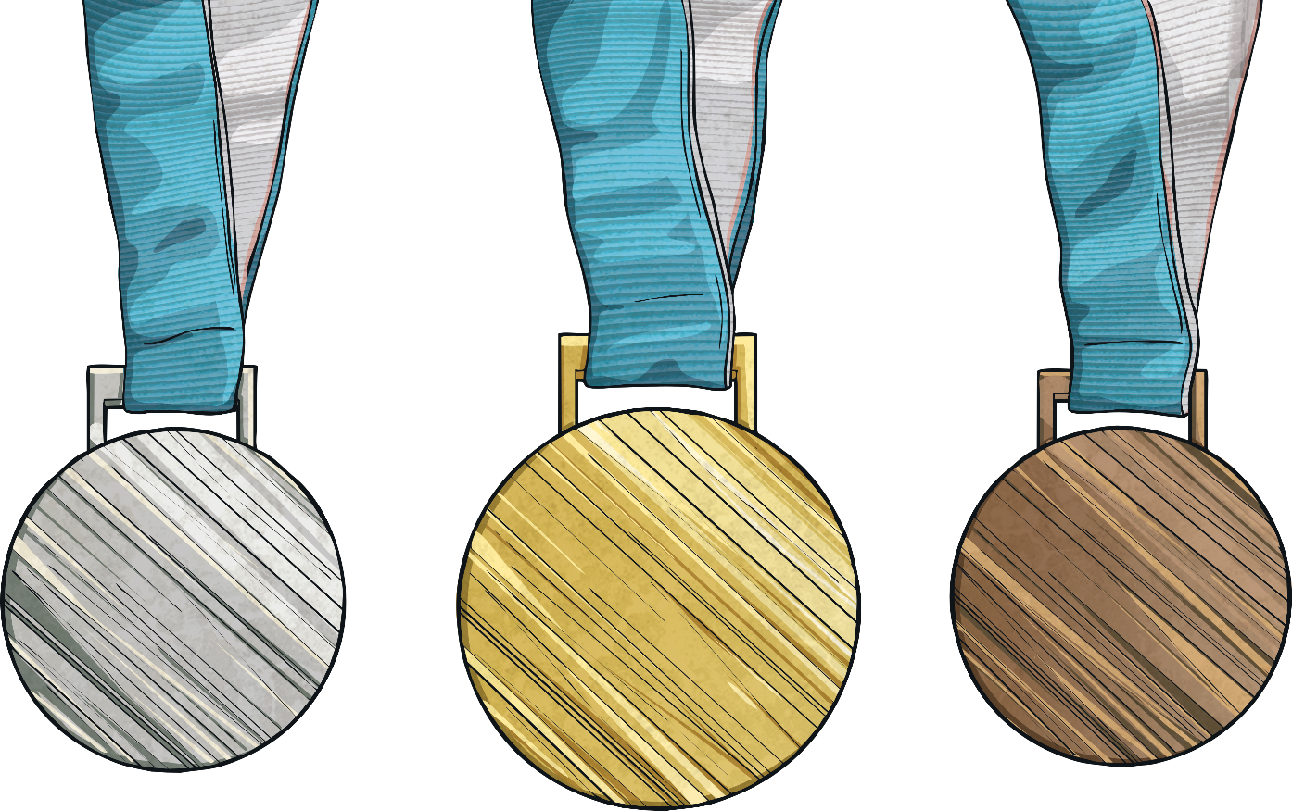
I am brave.

Slide 15
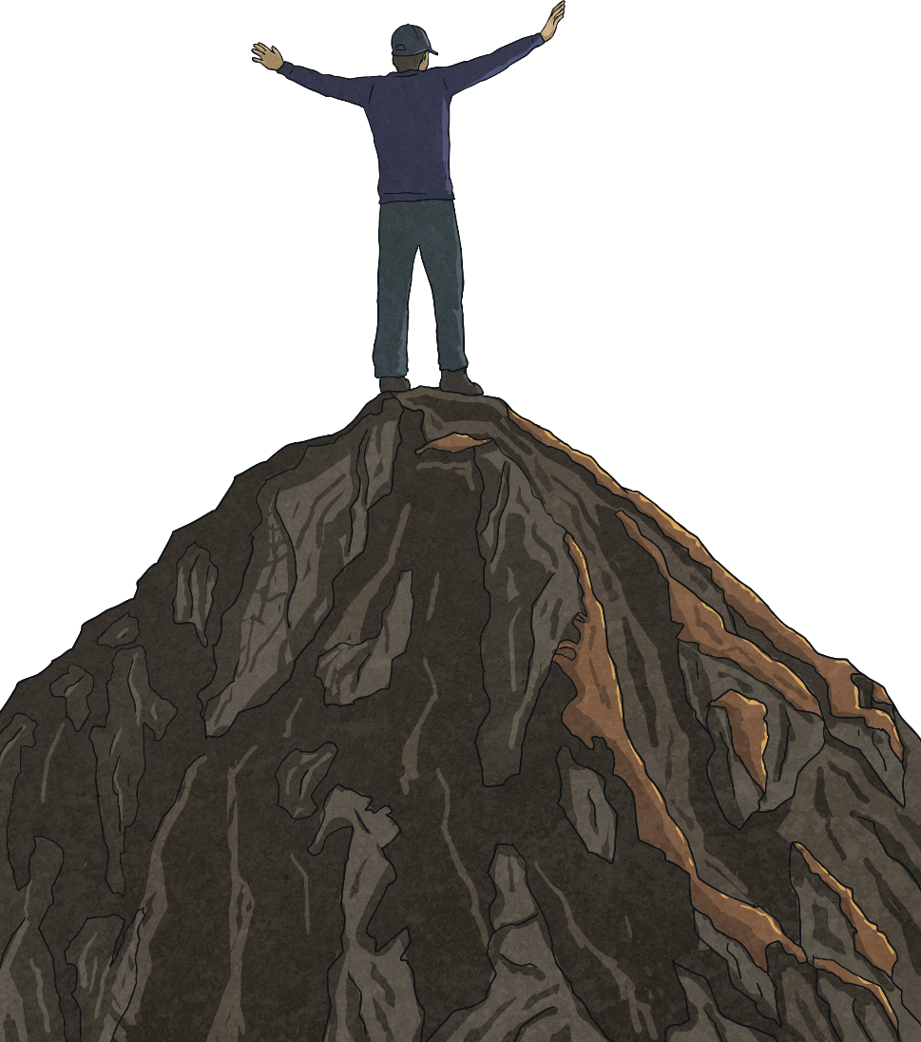
However big the mountain is, I can climb it.

Slide 16
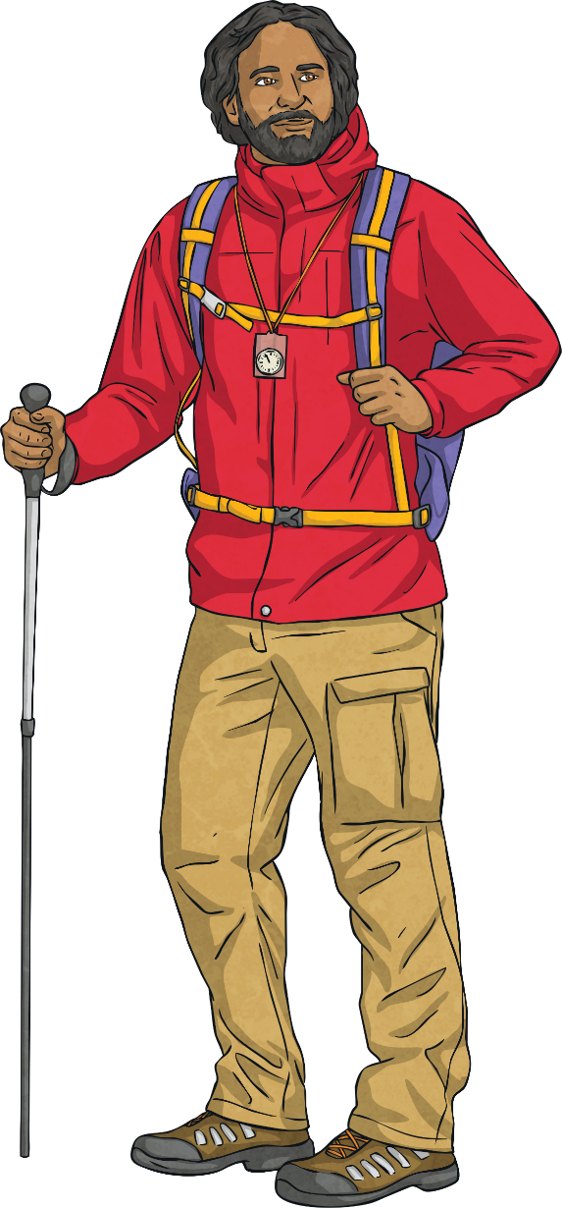
I am resilient.

Slide 17
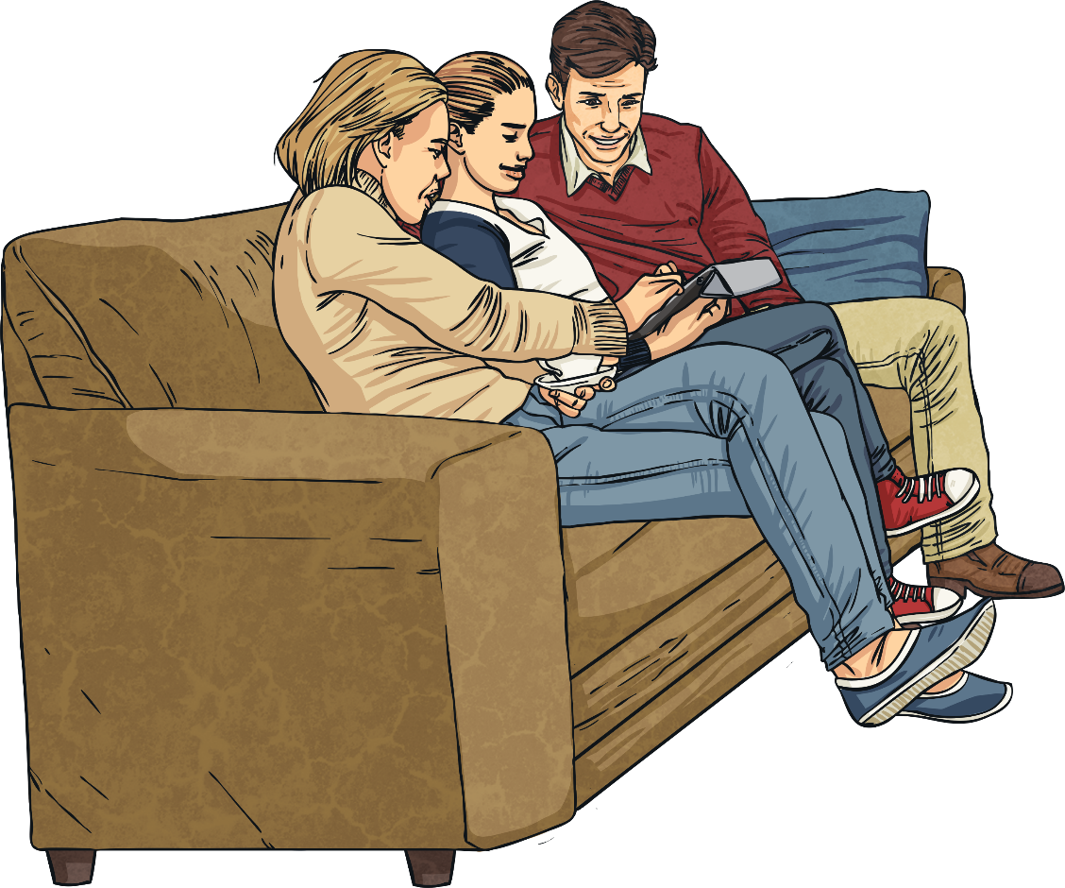
I am helpful.

Slide 18
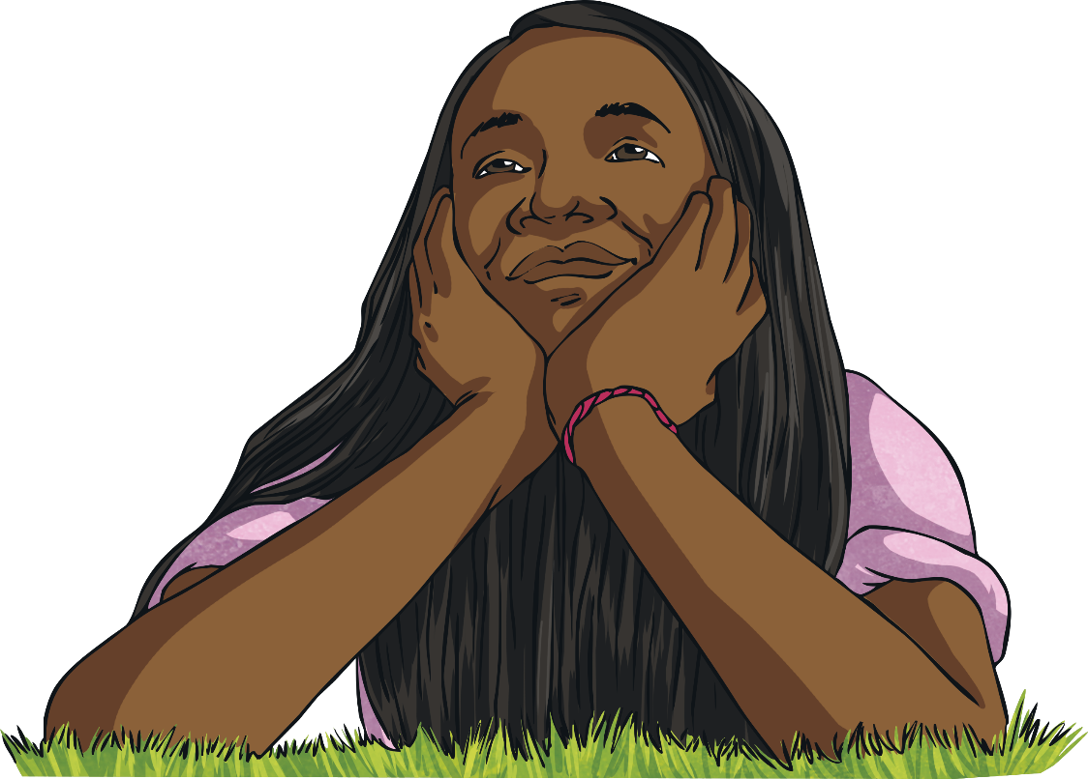
I have a positive attitude.

Slide 19
My mistakes help me learn and grow.

Slide 20
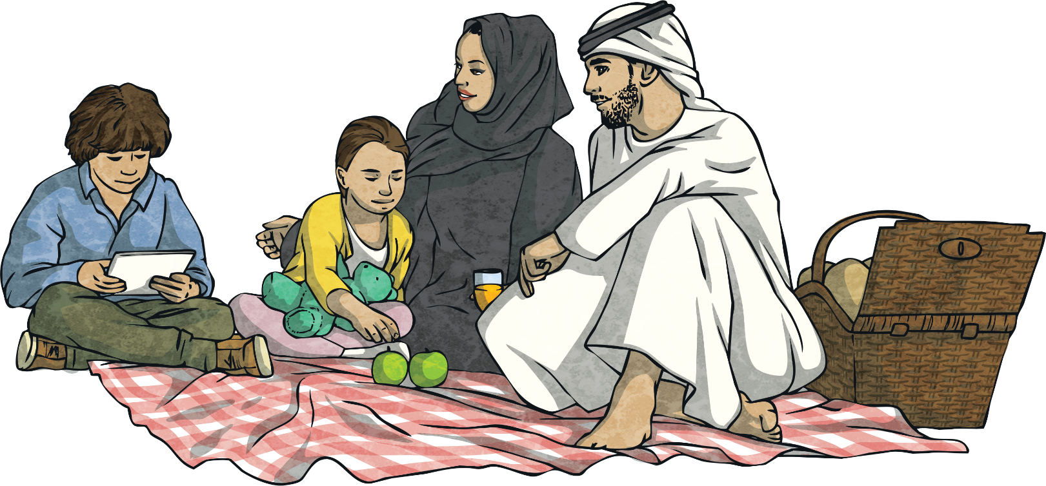
I am loved.

Slide 21
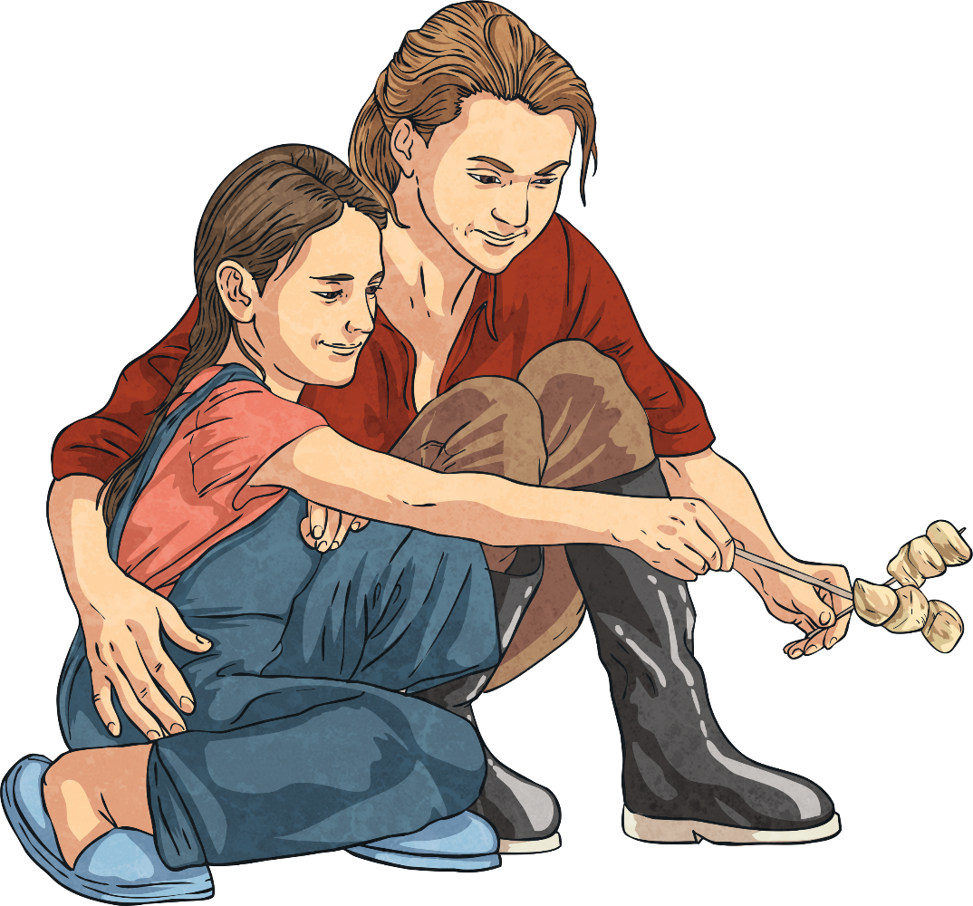
I appreciate the good in my life.

Slide 22
I am beautiful inside and out.

Slide 23
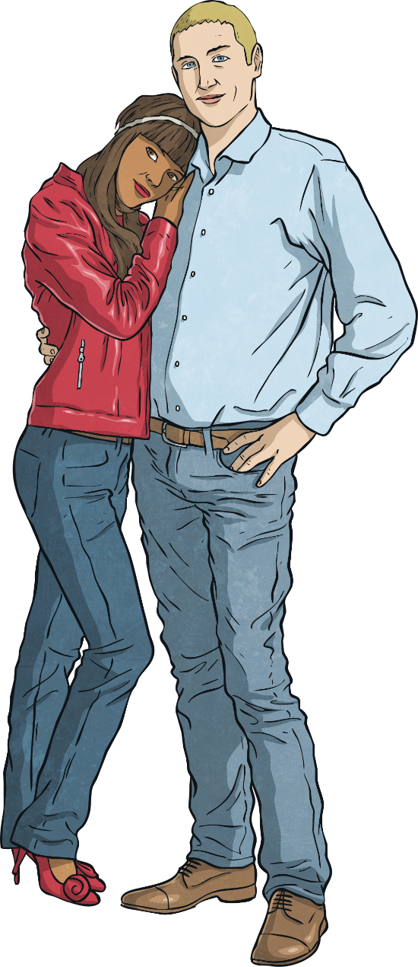
I am worthy of being loved.

Slide 24
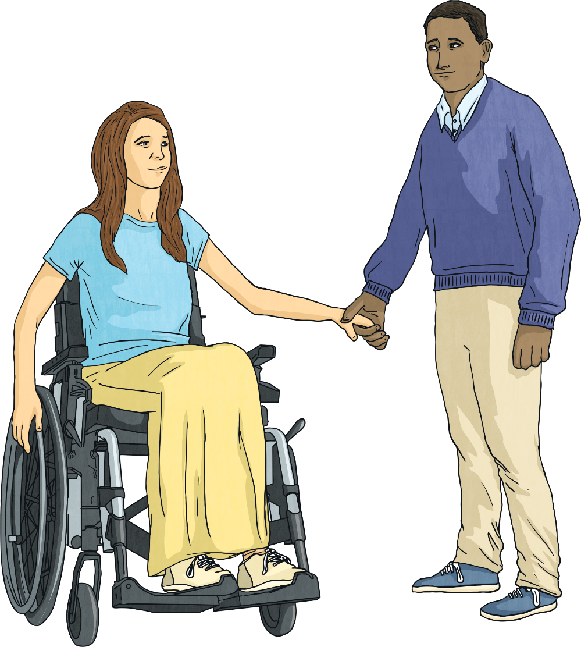
I am important and worthy of being valued.

Slide 25
I am talented.

Slide 26
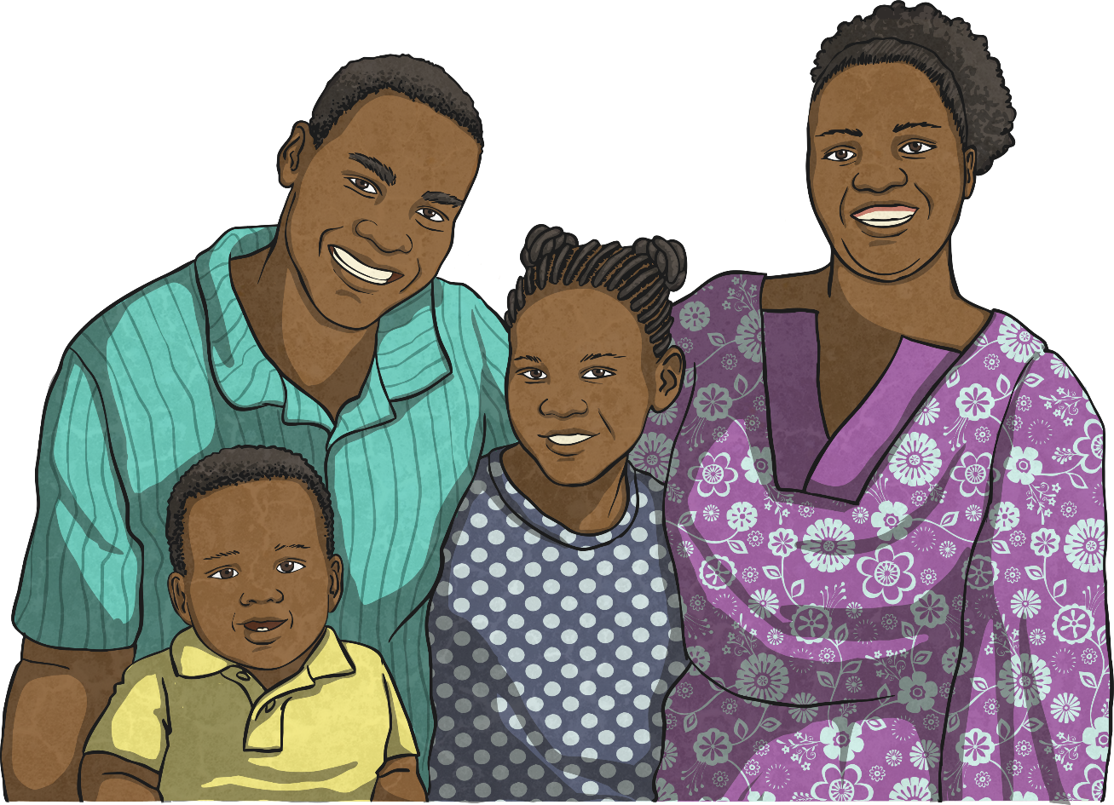
I am blessed.

Slide 27
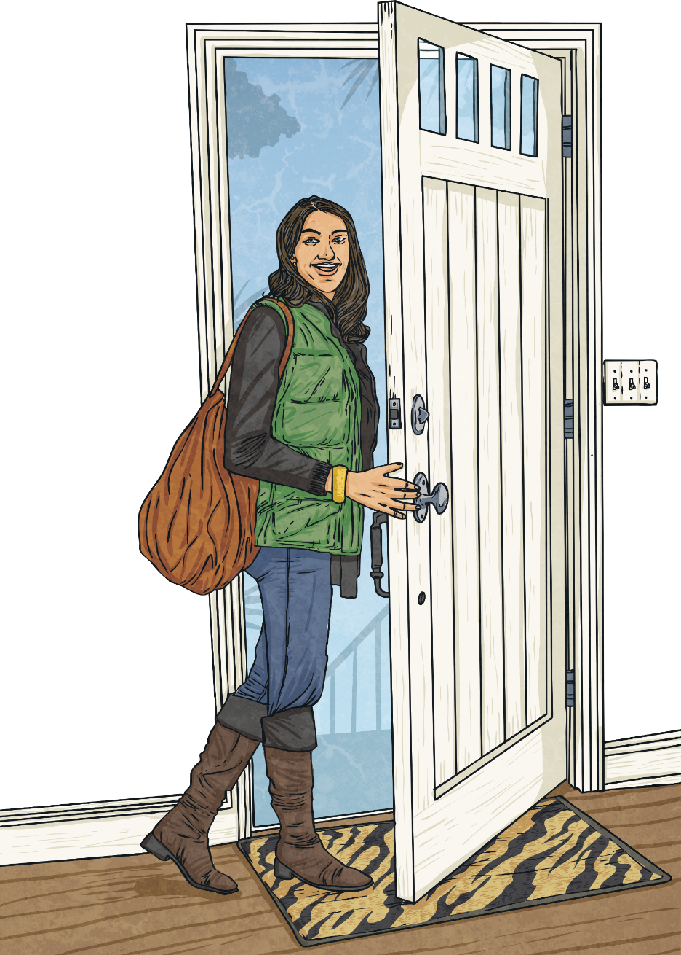
Today is going to be a great day.

Slide 28
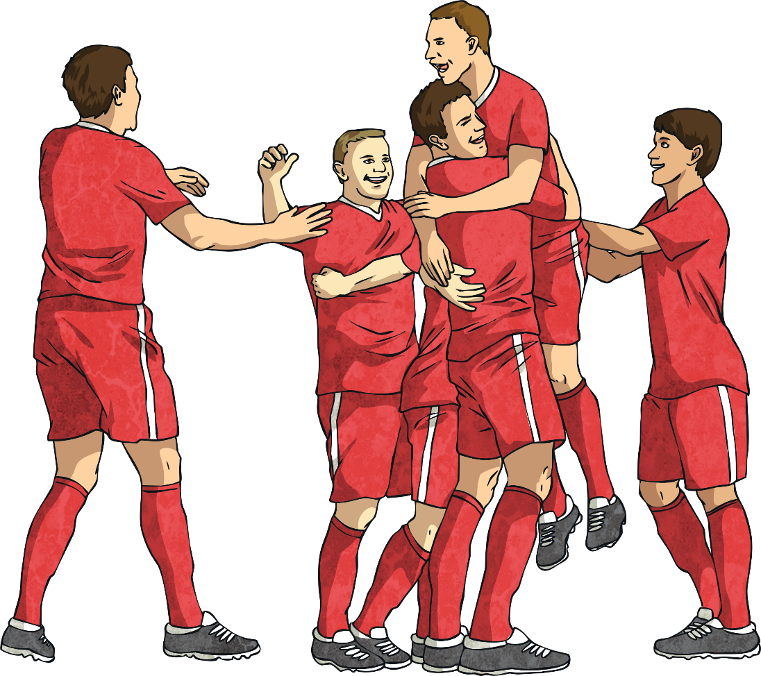
I can achieve my dreams and goals.

Slide 29
I can do anything I put my mind to.

Slide 30
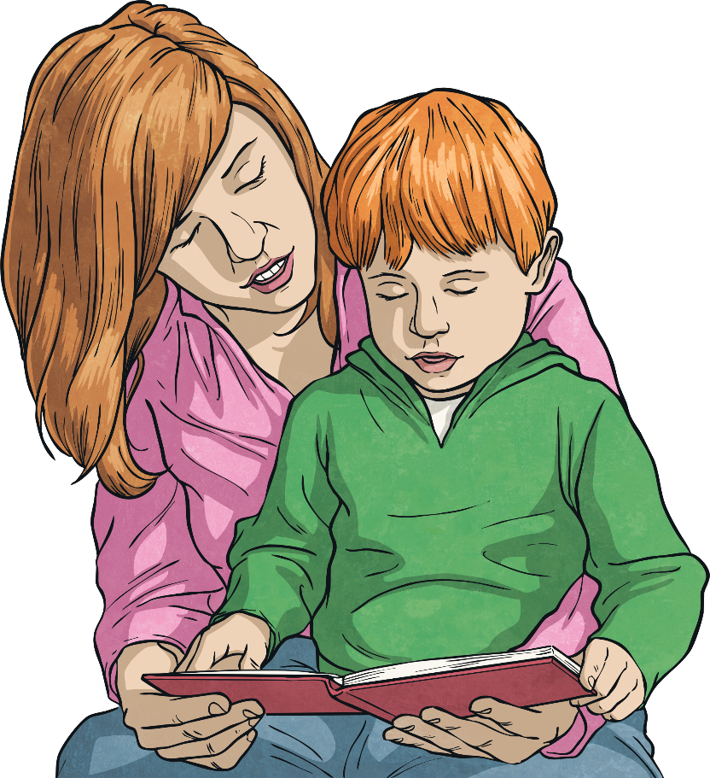
I am always learning and improving.

Slide 31
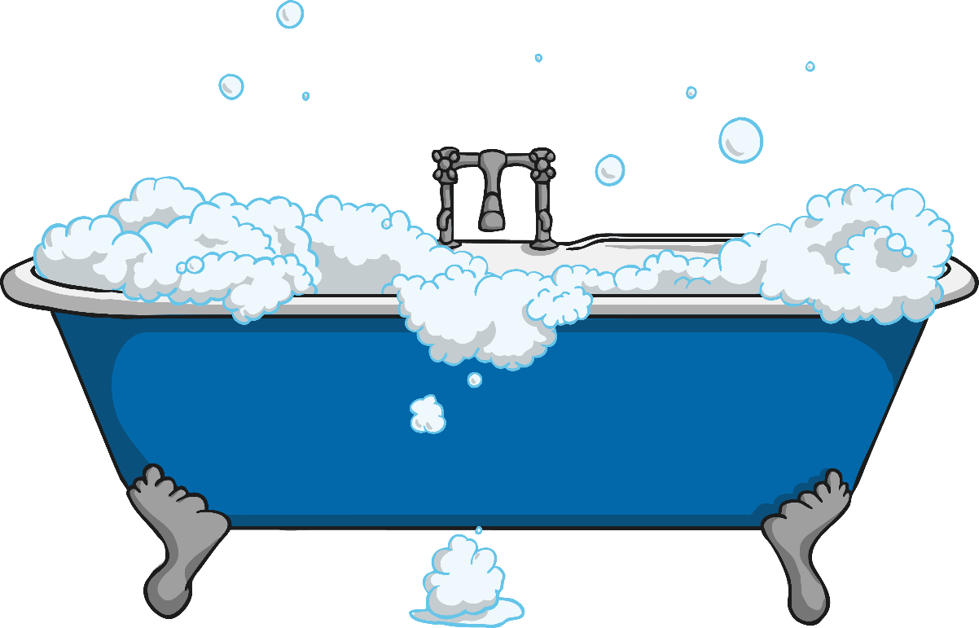
I matter, I am allowed to say ‘no’ to others and ‘yes’ to myself.

