Slide 1
The next six weeks…
During the current ‘Covid -19 Lockdown’ as you know MFRS Fire Cadets has been suspended.
We have not forgotten about you and would very much like to stay in touch.
Each week we will send out a task along with a worksheet for you to complete. We are aware that a lot of cadets will not have access to a printer and therefore any answers can be emailed back to your Unit Leaders:
Email to: DianeDunne@merseyfire.gov.uk
Email to: AnthonyDunn@merseyfire.go.uk
The weekly task will be uploaded to Abbot’s lea website for you to complete during the week.
This will start Monday 11th May 2020
______________________________________________________
Please let us know of any supportive activities you have been involved in during lockdown, along with any photos and videos.
Please also share any good news stories you may have, so we can promote the good work you have been doing with our colleagues and other Fire & Rescue Service’s
Stay safe and well

Slide 2
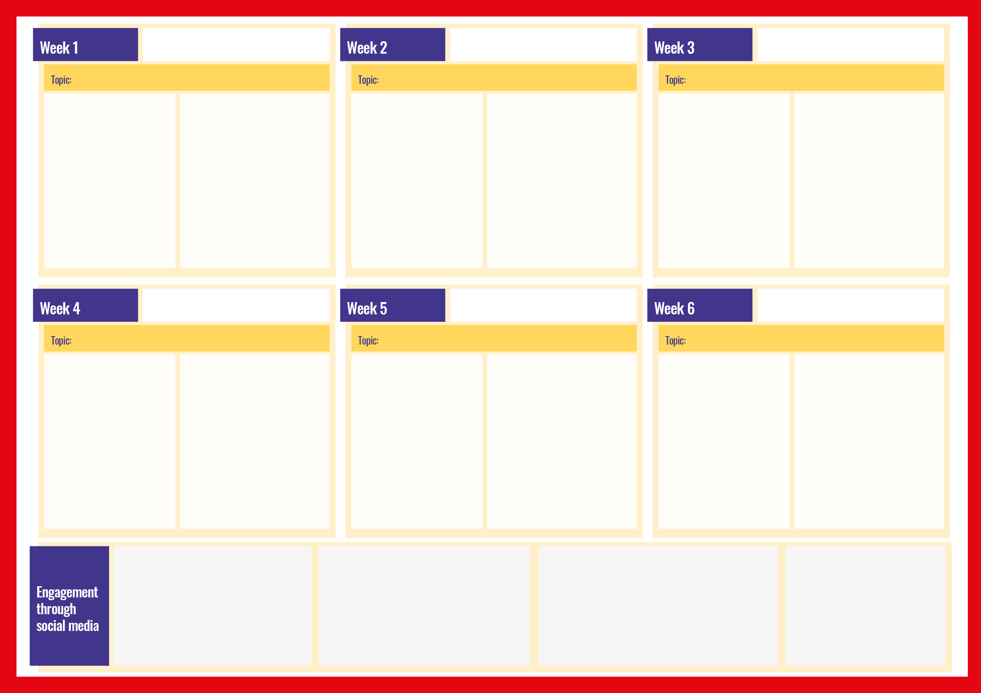
Commencing Monday 4th May 2020
Commencing Monday 11th May 2020
Commencing Monday 18th May 2020
Health & Wellbeing
Learning Outcome:
Fire Cadets will be asked to support a National Fire Service Campaign called
l#Ready/Willing/Able
This task will promote well being and encourage giving back to others.
Activities:
Fire Cadets will be asked to promote activities they are currently doing or would like to do once lockdown is lifted to support their community
Fire Cadet Quiz
Learning Outcome:
A quiz to challenge the Cadets to think about what they’ve learnt since joining the Fire Cadets.
This task will confirm previous learning
Activities:
Fire Cadets will be given 15 questions to answer - they will be based on the knowledge they have gained since joining the Fire Cadets.
Communication
Learning Outcome:
Fire Cadets will be asked to re look at the phonetic alphabet.
This task will promote communication skills and confirm previous learning
Activities:
Fire Cadets will be given the phonetic alphabet and will be asked to spell their name in the phonetic alphabet
Commencing Monday 25th May 2020
Commencing Monday 1st June 2020
Commencing Monday 8th June 2020
My Good Deed
Learning Outcome:
Fire cadets will be asked to complete a good deed around the house for parents /careers/ or siblings.
This task will give the cadets a sense of achievement and may boost moral in the family home.
Activities:
Fire Cadets will take part in activities around the home. Examples of activities may include::-
Wash Dishes
Make a Cup of Tea
Wash The Car
Clean Up
Tidy your Bedroom
Fire Equipment
Learning Outcome:
Fire Cadets will be asked to name Fire Equipment.
This task will confirm previous learning
Activities:
Fire Cadets will be sent a worksheet of photographs of equipment used and will be asked to name the pieces of equipment
Fire Safety
Learning Outcome:
Fire Cadets will be asked to hi-light possible fire safety dangers in their home.
This task will confirm previous learning
Activities:
Fire Cadets will be sent a worksheet of a room in their house and will be asked to circle any dangers
.

