Slide 1
Global Scouse Day
Global Scouse Day is an annual celebration of the city of Liverpool which is held every year on February 28th.

Slide 2
What is “Scouse”?
Scouse is a type of stew, typically made from chunks of meat, usually beef or lamb, potatoes and onion. It is particularly associated with the port of Liverpool.

Slide 3
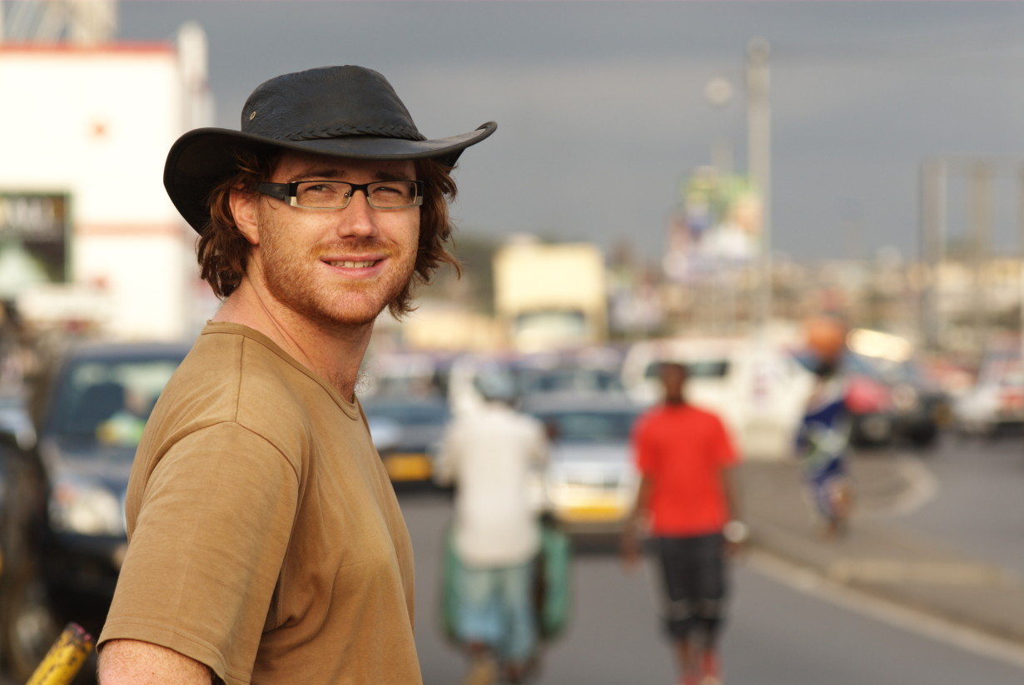
Global Scouse Day began with a “scouse supper” with friends held every year on Liverpudlian adventurer Graham Hughes’s birthday.
He is considered the founder of Global Scouse Day

Slide 4
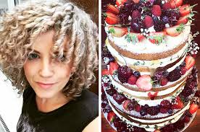
When he left the country in December 2008, Laura Worthington (of Laura’s Little Bakery fame) thought it would be fun to continue the tradition in his absence.

Slide 5
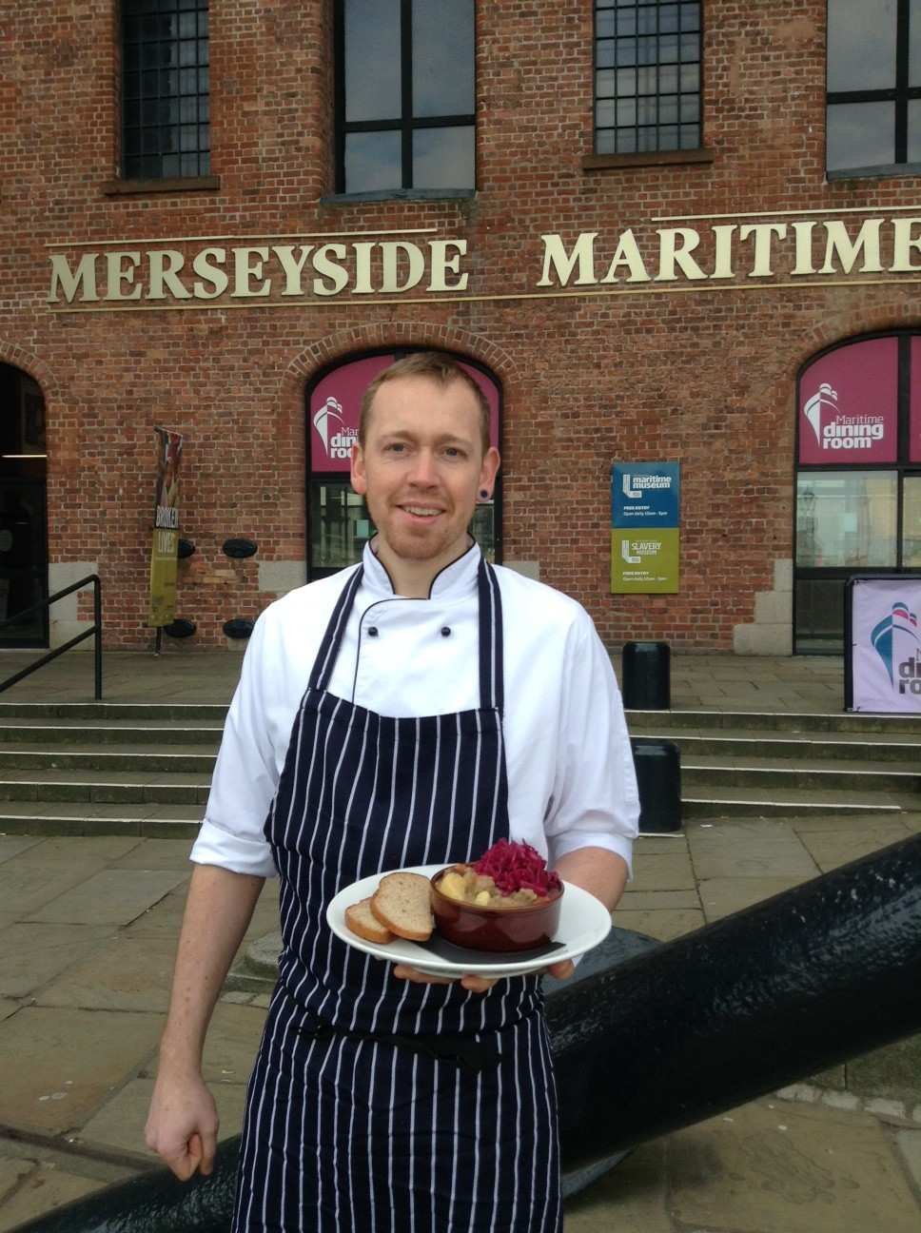
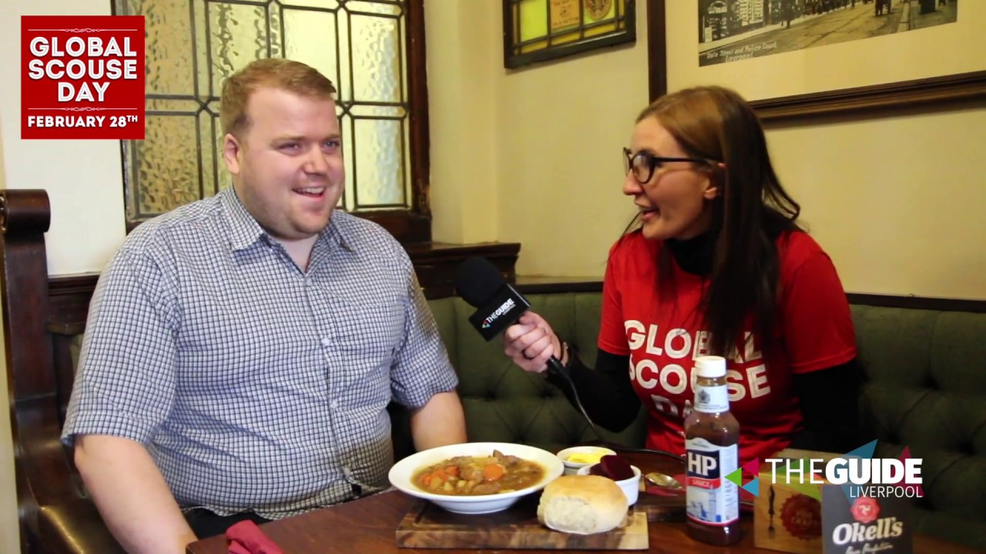
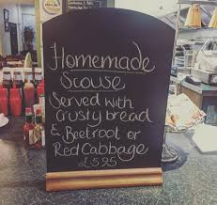
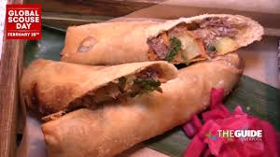
Over the course of the following five years, Global Scouse Day grew from a small gathering to an event that captured the city’s imagination… with over 100 bars, restaurants and cafes putting scouse on the menu on February 28th, and saw support from the Lord Mayor of Liverpool as well as Everton and Liverpool football clubs.

Slide 6
Since then, Global Scouse Day has become an annual fixture, raising funds for R Charity, The Whitechapel Centre, Clatterbridge Cancer Centre, and providing free food to the city’s homeless.
“We're open 365 days a year providing services to rough sleepers, people living in temporary accommodation and those at risk of becoming homeless. Last year, we worked with 4,025 people to end or prevent their homelessness.”
https://www.whitechapelcentre.co.uk/

Slide 7
Last year was our biggest ever Global Scouse Day, with venues as far a field as the US and Australia putting scouse on the menu for the day. This year, Liverpool is hoping to go even bigger!!

Slide 8
Where does the name “Scouse” come from?
The name derives from Lobscouse, a stew of meat, onions and ship’s biscuits enjoyed by Scandinavian sailors, who brought it to Liverpool.

Slide 9
How will we mark the occasion in school?
28 Feb – Global scouse day! This Sunday
1 March – we will talk about Scouse in our lessons – either onsite or offsite. We will discuss aspects such as the recipe, ingredients and its heritage.
Tuesday 9 March – Students will prepare the Scouse in classrooms. This will be slow-cooked overnight
Wednesday 10 March – Students will serve the Scouse to staff in their Zones. Staff may wish to make a voluntary contribution – all money will go to The Whitechapel Centre

Slide 10
What follow up work could you do?
Research the recipe
Practise making Scouse at home
Research the Whitechapel Centre – find 5 facts
Create an image (3D or 2D) of a meal of scouse
Design a day that could be celebrated each year which would help remember where you come from! What would people do on that day?

Slide 11
TO
Primary Dept
Brandon 2 March
We wish you all a Wonderful Birthday and have fun!

