Slide 1
Friday 29 January
Assembly

Slide 2
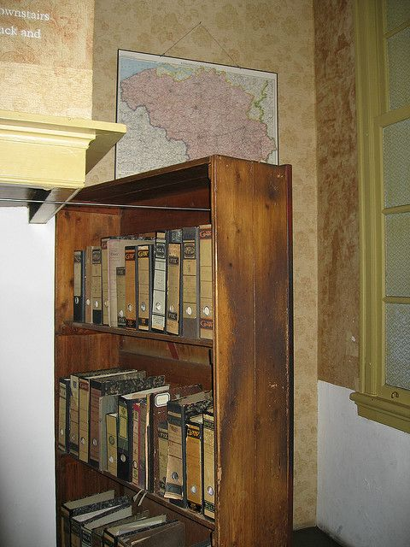

Slide 4
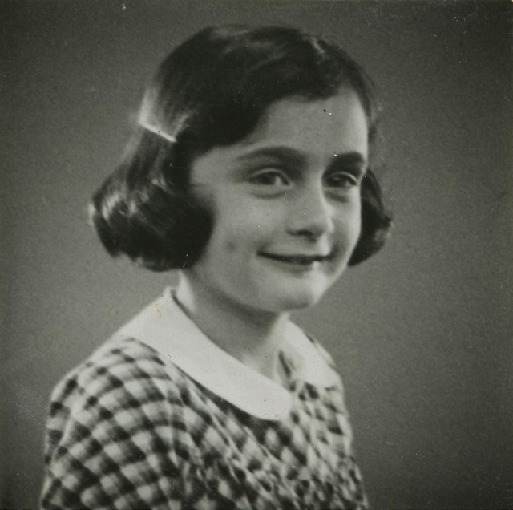
Holocaust Memorial Day

Slide 5
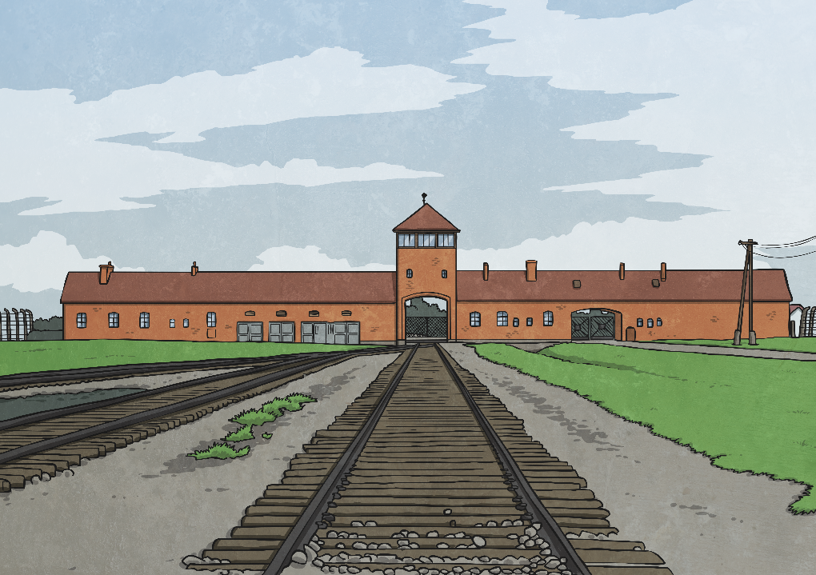
What Is Holocaust Memorial Day?
Holocaust Memorial Day is on 27th January every year. It is a day when we remember some specific events in the past when people were treated badly and killed because of who they were. Genocide is when a large number of people are killed on purpose, particularly because of their race, their religion or the colour of their skin.
The Holocaust was a genocide in the Second World War when lots of Jewish people were killed because of their religion.

Slide 6
Aims
To begin to know some facts about Anne Frank.
To recognise that words can be used for good.

Slide 7
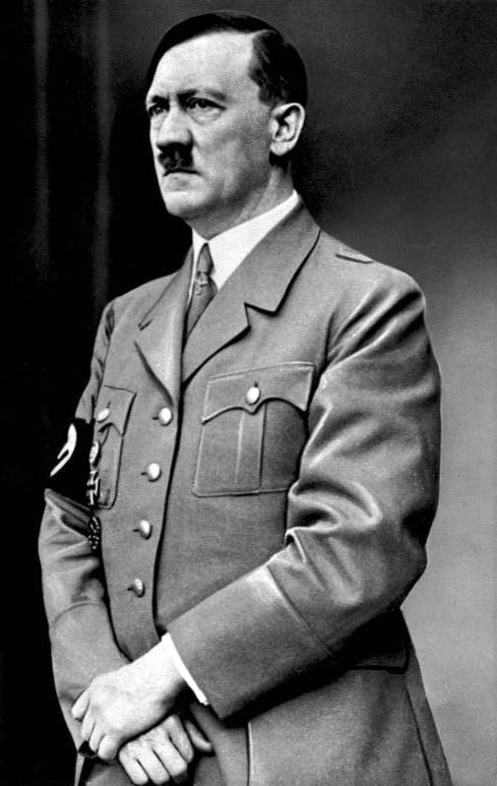
The Second World War
85 years ago, a man called Adolf Hitler was the leader of the Nazi Party in Germany. Nazi Germany began to invade other countries in Europe and this started the Second World War.
The Nazis believed that people who were Jewish (followed the Jewish religion, or had parents or grandparents who did) were to blame for Germany’s problems, and weren’t as good as German people.
The Nazis made laws so that Jewish people couldn’t own businesses or go to school. They started planning to get rid of all the Jewish people in Europe.
Adolf Hitler
Photo courtesy of Bundesarchiv (@flickr.com) - granted under creative commons licence - attribution

Slide 8
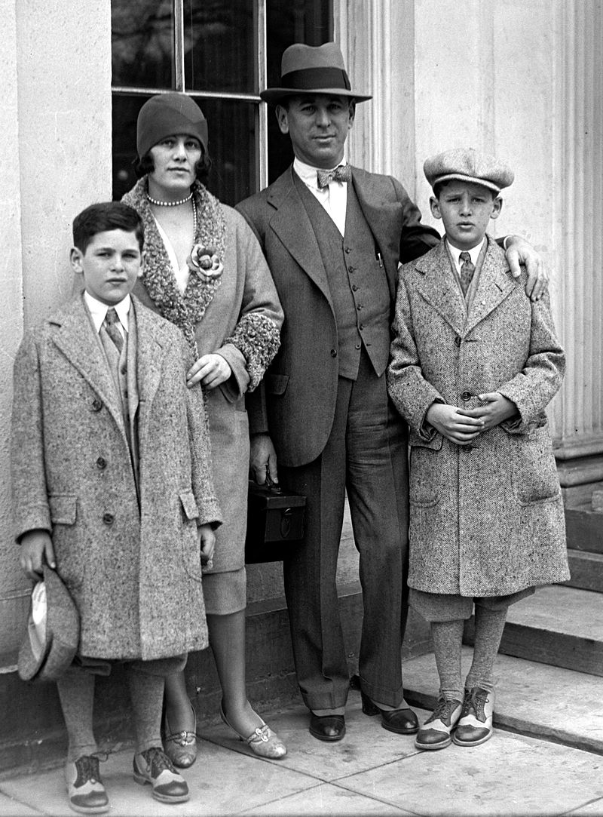
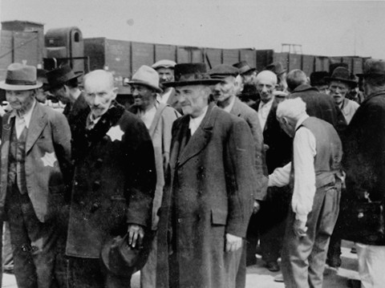
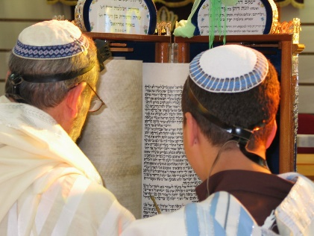
What Is Prejudice?
When you treat a group of people badly, and say mean and unfair things about them because of their race, religion or difference, this is called being prejudiced.
This is what Hitler and the Nazi party did to the Jews. They treated them badly and made their lives unbearable because they were different.
Why is this wrong?
Photo courtesy of Bernhardt Walter/Ernst Hofmann USHMM, Yad Vashem, National Photo Company, Sagie Maoz from Ashdod (@flickr.com) - granted under creative commons licence - attribution

Slide 9
The Frank Family
Anne was born on 12th June 1929.
She had an older sister called Margot, a mother called Edith and a father, Otto. They were a Jewish family.
When Otto realised that life was going to get very difficult for Jewish people, he moved the family to Holland.
There was a young girl living in Frankfurt, Germany at that time.
Her name was Anne Frank.

Slide 10
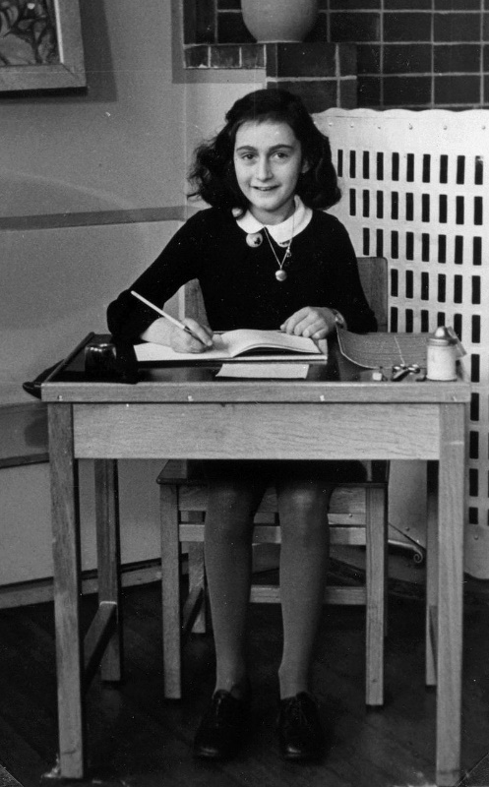
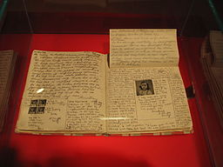
Kitty
Anne was an ordinary girl.
On her 13th birthday, Anne was given a diary.
She was very happy with this present, because she wanted to become a famous writer when she grew up.
Photo courtesy of By By Heather Cowper (@flickr.com) - granted under creative commons licence - attribution
Anne
Anne wrote, “I want the diary to be my friend, and I am going to call this friend, Kitty”.

Slide 11
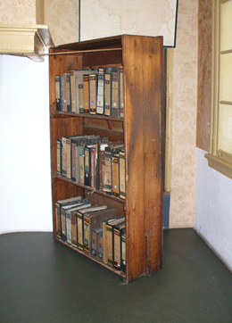
In Hiding
The Nazis’ treatment of Jewish people became worse and worse. People were being forced to leave their homes and go and live in concentration camps. Conditions in these camps were dreadful and the Frank family knew that they were very dangerous.
The Frank family went into hiding in a secret room they called the Annexe, on the second floor above Otto’s office. The entrance to the room was hidden by a bookcase.
Some of Otto’s loyal and brave colleagues risked everything by bringing food, clothing, newspapers and magazines to the family.
This is what the bookcase would have looked like.
Photo courtesy of By Bungle (@flickr.com) - granted under creative commons licence - attribution

Slide 12
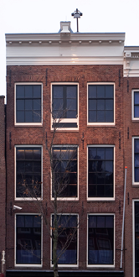
Living in Fear
They were unable to go out, fearful of being arrested or killed.
They had to remain absolutely silent during the day and the curtains had to stay closed, in case the neighbours caught sight of them.
Anne wrote:
“Not being able to go outside upsets me more than I can say, and I'm terrified our hiding place will be discovered and that we'll be shot”.
Photo courtesy of By Massimo Catarinella (@wikimedia.com) - granted under creative commons licence - attribution

Slide 13
https://www.youtube.com/watch?v=1JSEVBX3cfY

Slide 15
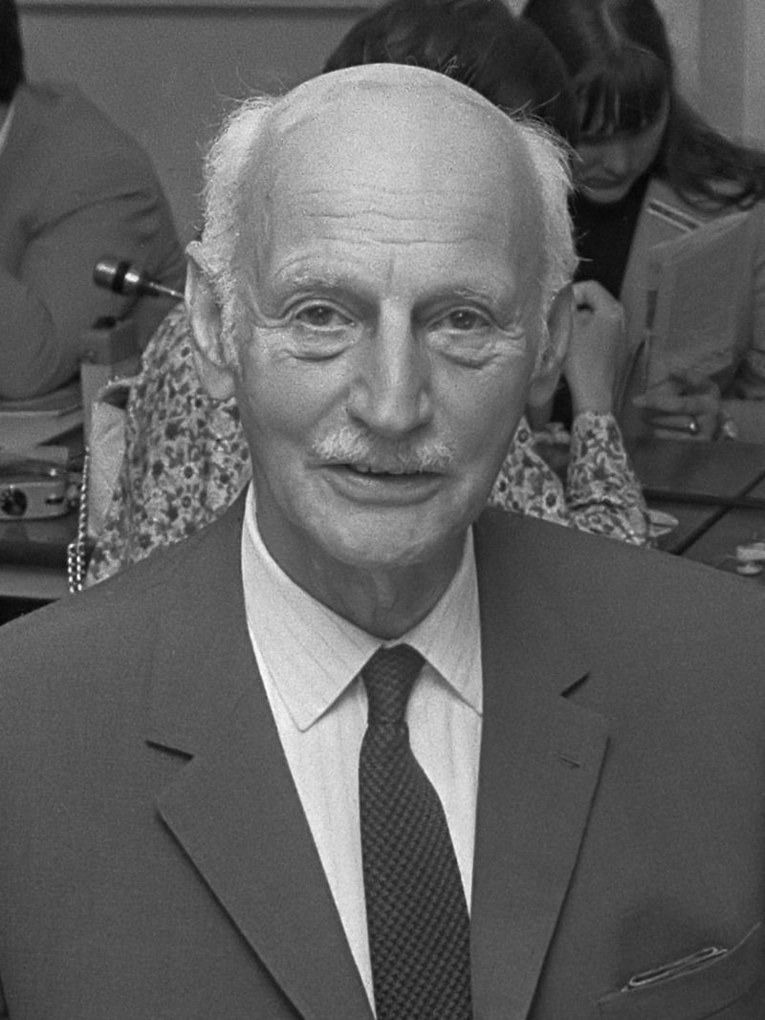
Anne’s Diary
Miep Gies was one of the friends who had helped the family in hiding. She found Anne’s diary in the Annexe after they were arrested and kept it safe throughout the war.
She gave the diary to Otto and he decided to publish the diary in honour of his youngest daughter.
In 1947, A Diary of a Young Girl was published.
Photo courtesy of By Eric Koch / Anefo (@flickr.com) - granted under creative commons licence - attribution

Slide 16
The Power of Words
I don’t think of all the misery but of the beauty that still remains.
How wonderful it is that nobody need wait a single moment before starting to improve the world.
What is done cannot be undone, but one can prevent it happening again.
We can all play our part in preventing this prejudice happening again. We can be kind towards everyone, even if they are not our special friend; we can try to understand how other people might be feeling; we can stand up for people; we can share these stories and ideas with other people through talking, writing and poetry.

Slide 17
Having learnt about this, what do we know? What can we do?
Music clip

Slide 18
Follow up work
Can you read some of Anne Frank’s diary?
Can you use the worksheet to talk about how it’s a great thing that we are all different?
Can you use different scenarios and talk about whether it would be fair to be treated in this way?
Can you write a poem about discrimination
Can you research more about the Holocaust memorial day
Can you pretend that you are writing a diary about the current state of the world for people to find in year’s to come
If you met Anne Frank what would you like to ask her?
Your teacher can give you the resources needed for the work above.

Slide 19
Secondary Department:
Patrice 31 January
We wish you a Wonderful Birthday and have fun!

