Slide 1
SEND Remote Education Ania Hildrey Abbot’s Lea School

Slide 2
Our Vision and Mission Statement
To be the international Centre of Excellence in Autism education, research and professional development
Our Project
SEND Remote Education training and support for special and mainstream schools locally, nationally and globally

Slide 3
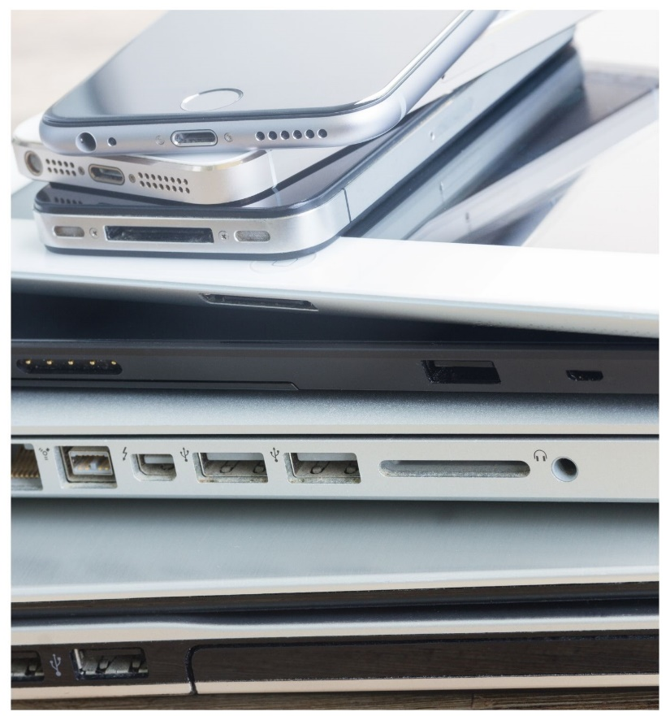
Research Review – Global Perspective
Many autistic students and those who have social anxiety are benefiting from homeschooling. (Nissim Matheis, 2020)
Around one million children in the UK do not have adequate access to a suitable device or internet connectivity at home (Nominet, 2020)
40% of schools indicated that a lack of teachers’ skills to adapt their teaching and learning delivery was their biggest challenge during distance learning (Glass, 2020)
POTENTIAL
BARRIER
NEED
Notes:
Nominet (2020) Digital Access for All Launches to Help Solve Problem of Digital Exclusion
https://www.nominet.uk/digital-access-for-all-launches-to-help-solve-problem-of-digital-exclusion/
Glass, D. International School leader Magazine (2020) How edtech made a difference
https://www.flipsnack.com/islmagazine/international-school-leader-magazine-september-2020-195g33jd1j.html

Slide 4
Research Review – National Perspective
“There are considerable differences in the levels of pupil engagement in remote learning, particularly amongst the most disadvantaged pupils. This supports a growing evidence base highlighting the risk of the attainment gap widening as a result of this pandemic. There is a pressing need for a comprehensive and long-term plan to address this issue.”
Carole Willis, Chief Executive at National Foundation for Educational Research
Teachers report that the following group of pupils are less engaged in remote learning than their classmates:
Pupils with limited access to IT and/or study space (81%)
Vulnerable pupils (62%)
Pupils with special educational needs and disabilities (58%)
Pupils eligible for Pupil Premium funding (52%)
Young carers (48%).
Data collected by the National Foundation for Educational Research in May 2020 on a sample of 1,233 school leaders and 1,821 teachers (total: 3,054) in England
Notes:
Megan Lucas, Julie Nelson and David Sims (2020) Schools' responses to Covid-19: pupil engagement in remote learning
https://www.nfer.ac.uk/schools-responses-to-covid-19-pupil-engagement-in-remote-learning/

Slide 5
Autism and Remote Education
3 in every 5 teachers report that vulnerable pupils are less engaged than their classmates. Senior leaders (57%) and teachers (75%) report a lack of pupil engagement in learning as one of their main challenges in supporting vulnerable pupils who are not attending school. (Julius and Sims, 2020)
1 in 5 family members of autistic students had to reduce work due to caring responsibilities.
7 in 10 parents say their autistic child has had difficulty understanding or completing schoolwork and around half said their child’s academic progress was suffering (National Autistic Society, 2020)
Notes:
Jenna Julius and David Sims (2020) Schools' responses to Covid-19: Support for vulnerable pupils and the children of keyworkers
https://www.nfer.ac.uk/schools-responses-to-covid-19-support-for-vulnerable-pupils-and-the-children-of-keyworkers
National Autistic Society (2020) Left stranded: our new report into the impact of coronavirus
https://www.autism.org.uk/what-we-do/news/coronavirus-report

Slide 6
SEND Remote Education Survey
Online survey distributed 21/12/2020 – 17/01/2021
100 teachers from 13 countries (4 continents)
Collecting quantitative and qualitative data on current remote education practice:
Infrastructure and available devices
Educational activities and support offer
Reflection on students’ engagement
Suggestions and ideas for future practice

Slide 7
Remote Education Activities
Live teaching is among most frequently delivered activities (62% of participants offer live teaching over Zoom, Teams or similar)
28% of teaching staff give students PowerPoint presentations to go through individually
Group interaction and activities are used by 35-39% of teaching staff (online chat, collaborative documents, online quizzes)
Reading and completing worksheets individually is an activity offered by 50% of teaching staff

Slide 8
How do we improve engagement with remote education?
Deliver more of…
Deliver less of…
Re-think ► Re-design ► Re-engage

Slide 9
Central to effective remote teaching is the establishment of teacher presence, whereby teachers actively engage with their students through different forms of dialogue, activities and assessment
McAleavy and Georgen (2020)

Slide 10
Project Stages
STAGE 1 | Literature review and SEND Remote Education Survey
Report | Research and practice of remote education around the world
STAGE 2 | Connecting with special schools, offering training and support
STAGE 3 | Piloting chosen strategies in partner schools
Report | Impact on engagement and creation of our evidence-based practice toolkit
Notes:
Systematic approach does not mean a blanket one-size-fits-all solution, but diversified offer based on collective practice and evaluations

Slide 11
Join our project (contact?)

