Slide 2
Aims
To understand what the Big Birdwatch is
To understand who runs it
To understand why it’s important
To get involved and help our country!

Slide 3
What is the Big Birdwatch?
The world’s biggest garden survey
People like you and I count the birds outside our houses for one hour
We send the information to the RSPB
You can do this at any point you wish on 29 Jan, 30 Jan or 31 Jan 2021

Slide 4
How do I do it?
1) Pick a time You can choose any hour between 29 and 31 January. So whether you’re an early bird or a night owl, you can still take part.
2) Tell us what you see Count the birds you see in your garden or from your balcony*. Ignore any birds that are still in flight. To avoid double-counting, just record the highest number of each bird species you see at any one time – not a running total. This year our advice is to take part in the safety of your own home. This could include a birdwatch from your window if you overlook a green space or courtyard.
3) Submit your results Online: You can submit your results online at rspb.org.uk/birdwatch from 29 January until 19 February. By post: If you’d rather send your results by post, you can download a submission form below. Please post your results to us before 15 February.
Every count is important so, if you don’t see anything, please still submit your result. Finding out which birds don’t visit your area is as important as understanding those which do!

Slide 5
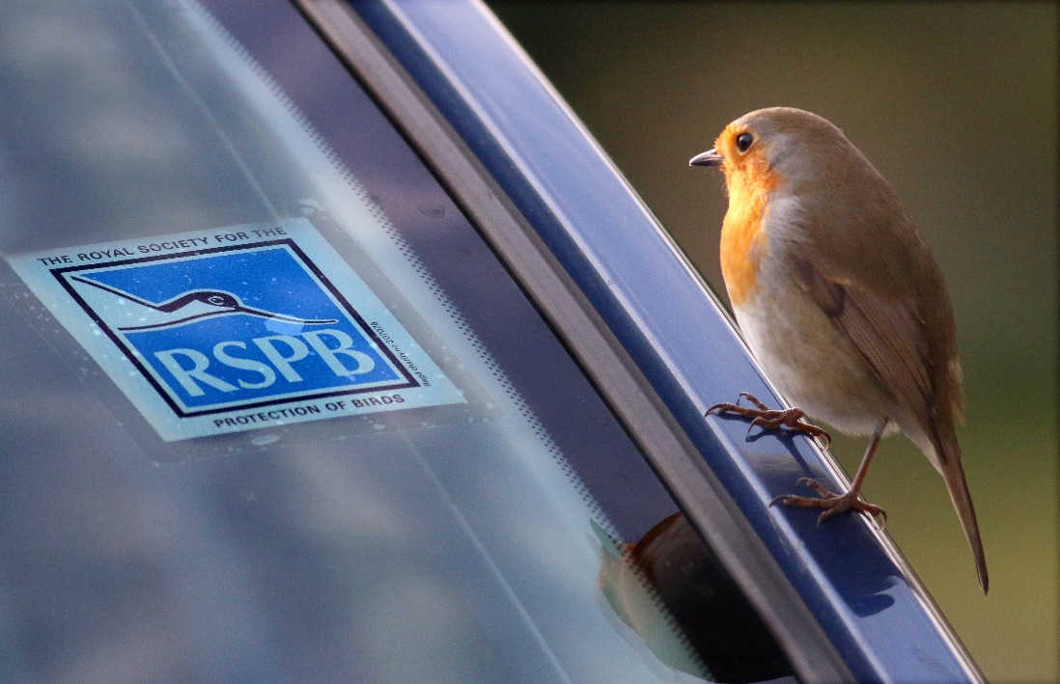
Who runs it?
The RSPB is a charity which was founded in 1889 to ensure birds were protected in England, Scotland and Wales.
RSPB stands for:
R
oyal
S
ociety
for the
P
rotection
of
B
irds
Photo courtesy of steveransome (@flickr.com) - granted under creative commons licence – attribution

Slide 6
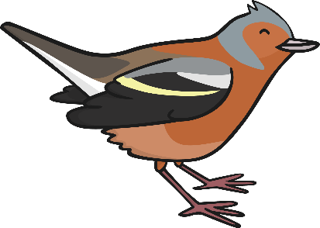
Why Do Birds Matter?
We often think that birds are just something pretty to look at.
However, they actually serve many vital uses in the environment.
Did you know that birds…
contribute to the diversity of plant life through pollination and seed dispersal;
control insect outbreaks and create important nesting areas for other species;
help rid the world of disease through scavenger “clean-up” services, like carrion crows and magpies.
Birds provide important economic benefits, and serve as important indicators for scientists about the state of the environment.
https://www.sciencedaily.com/releases/2016/07/160712110430.htm

Slide 7
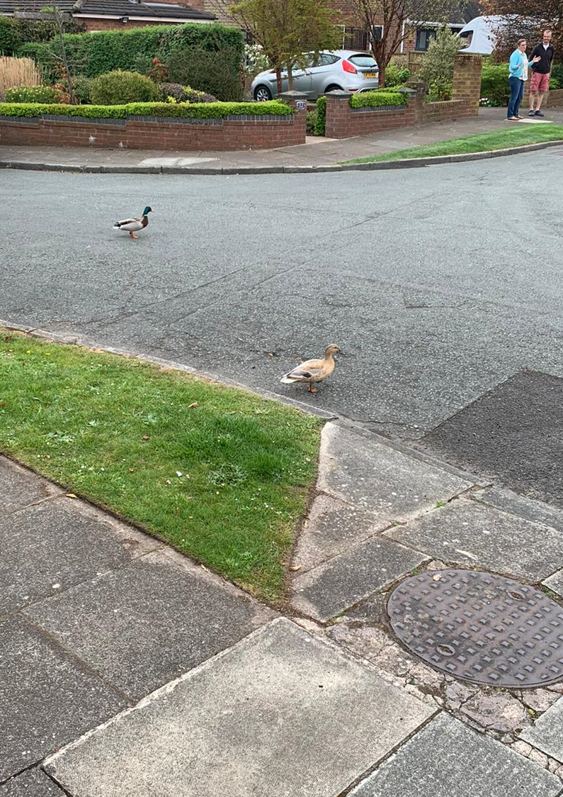
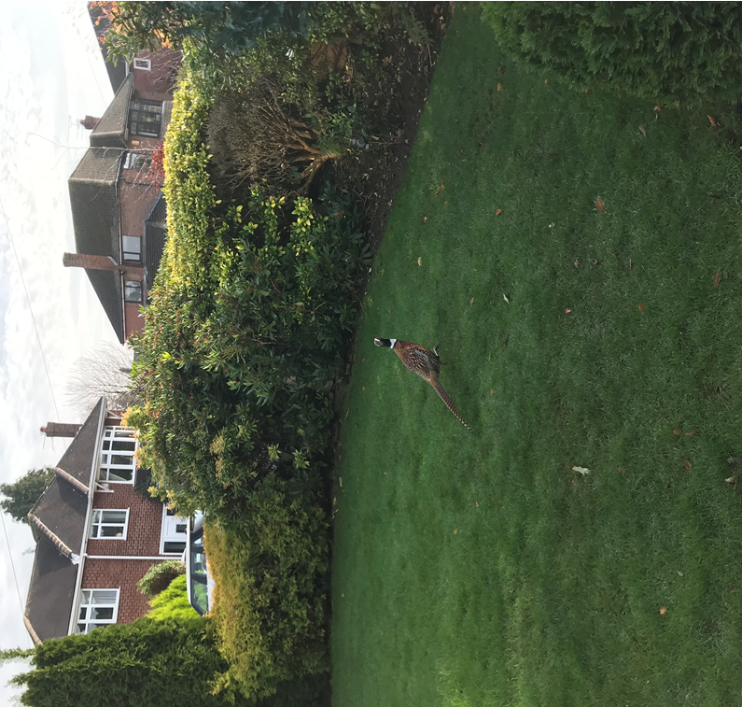
Why do you think I saw a pheasant and ducks at my house on Easter Day (during lockdown!?) – they don’t usually visit me!
What does it teach us about the environment last Easter?

Slide 8
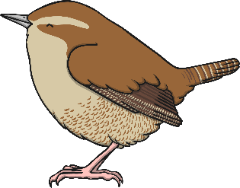
Identifying Birds
Identifying birds can be tricky. Here are some tips to help you:
Many birds do not look like they do in books. They are sometimes a bit bigger or smaller in real life. Their feathers are replaced about twice a year, so they may look duller at different times in the year.
In colder weather, birds often fluff out their feathers, which makes them look rounder and fluffier than usual.
Use your ears as well as your eyes. You may think you know what birds sound like, but listen to some clips on the RSPB website and see if there are any you haven’t heard before.
https://www.allaboutbirds.org/news/how-to-learn-bird-songs-and-calls/

Slide 9
Follow up learning and helping

Slide 10
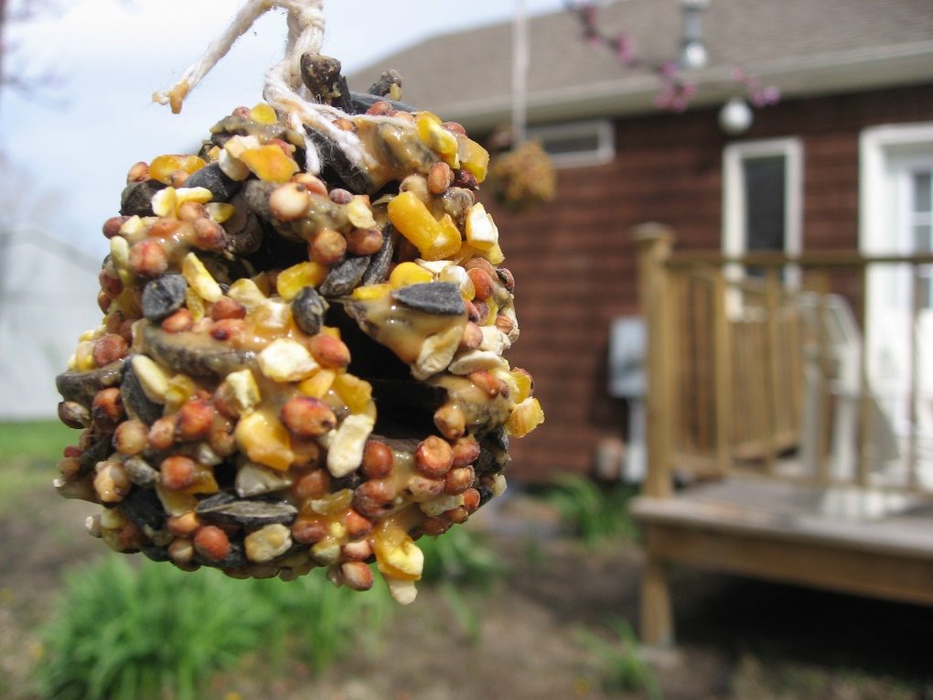
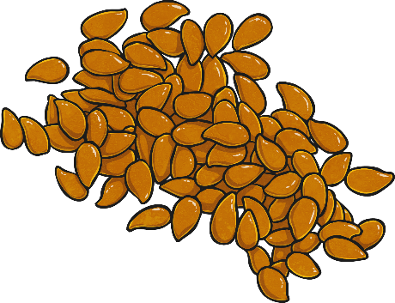
Make Bird Feeders
Birds need food all year round, and in the winter it can be harder for them to find it.
Make a bird feeder using pine cones and lard stuffed with seeds and nuts to make a tasty snack for those hungry birds.
Photo courtesy of domestic_meagan (@flickr.com) - granted under creative commons licence – attribution

Slide 11
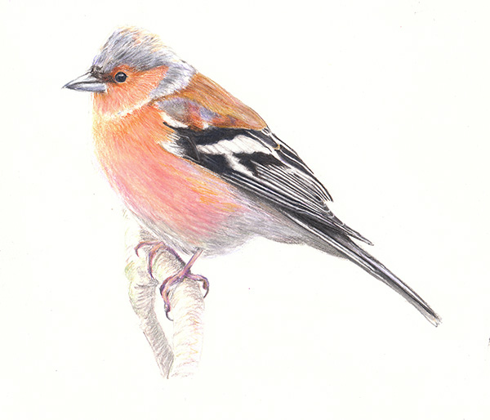
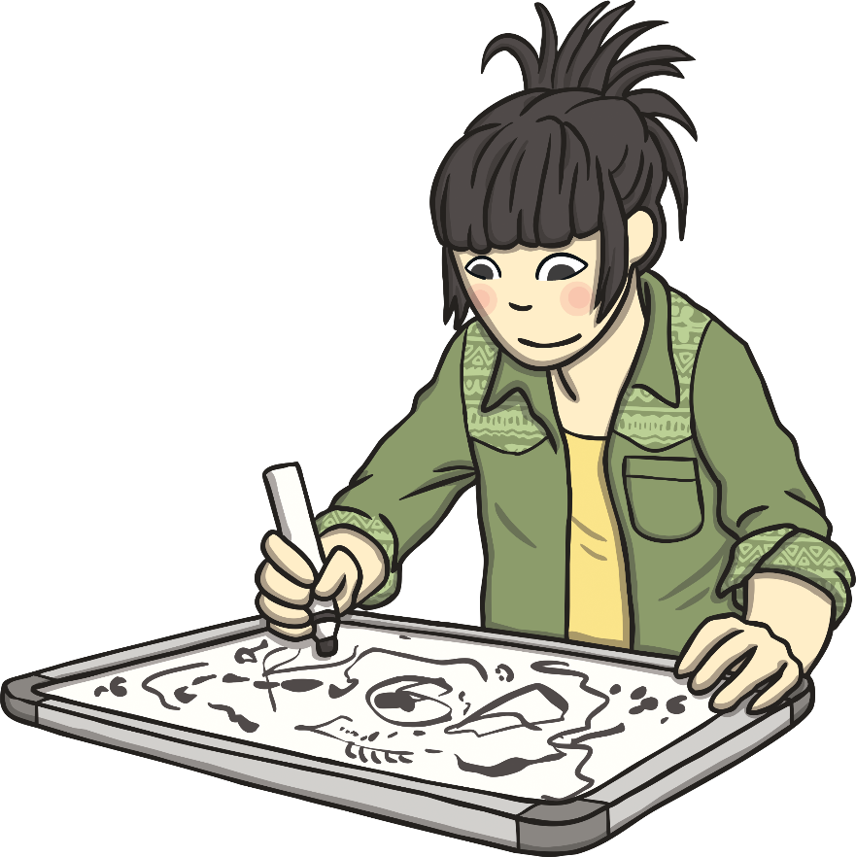
Get Creative!
Have a go at drawing birds. Look really closely, using binoculars, to observe their colouring, feathers and shape.
Photo courtesy of ianrees (@flickr.com) - granted under creative commons licence – attribution

Slide 12
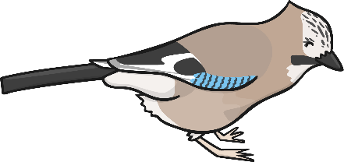
Danger! Danger!
Design your own poster warning people about the dangers humans can pose to birds:
Litter can poison or damage birds, especially if left in rivers or ponds.
Leaving poisons down for vermin can also poison birds. It needs to be used very carefully.
People who wander too close to ground nesting birds can unsettle them and cause distress.

Slide 13
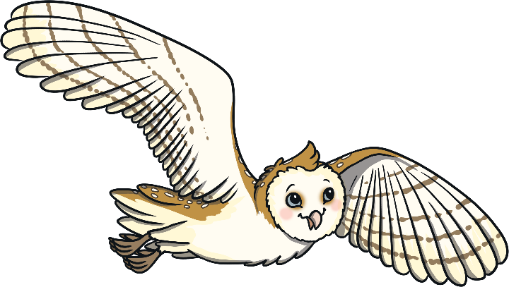
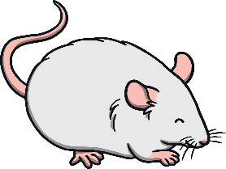
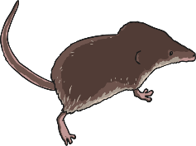
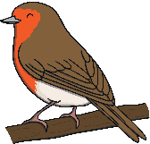
Barn Owl
Produce an information sheet about a certain type of bird
Barn owls are nocturnal. They hunt at night.
They can turn their heads right around to look behind them!
They are carnivores. They eat small animals like mice, shrews and birds.
excellent hearing to find small animals in the dark
good eyesight to help them hunt in the dark
heart-shaped
face
brown feathers on the back
white feathers
on the belly
long legs for reaching into long grass to catch food
sharp talons for catching prey

Slide 14
Learn how to recognise the sounds
https://www.allaboutbirds.org/news/how-to-learn-bird-songs-and-calls/

Slide 15
Other activities (your class teams have these resources)
Wordsearch
Reading Comprehension
Learn how to draw a bird
Learn how to make bird origami
Download your sighting checklist
Top trumps
https://www.rspb.org.uk/about-the-rspb/

Slide 16
Primary Department:
Matthew 26 January
Secondary Department:
Alex 28 January
We wish you all a Wonderful Birthday and have fun!

