Slide 3
We are first going to think about a time when somebody thought being different was terrible…

Slide 4
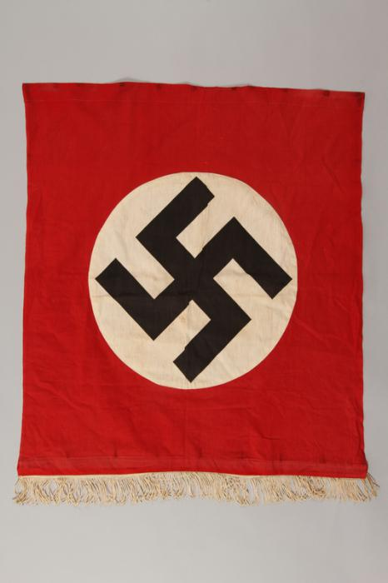
This became the symbol of the Nazi party, led by Hitler.
The Nazi party wanted everybody to be the same#
Nazi people did terrible things to anyone who was “different” in their eyes
This is now a very bad symbol and if you see anybody using it, you should tell an adult you trust.
This symbol will be used in the following video clip, as it represents a moment in history when it was used.
The student had permission to use this symbol in a very appropriate context.
Please remember, that we should never use this symbol in other situations.

Slide 6
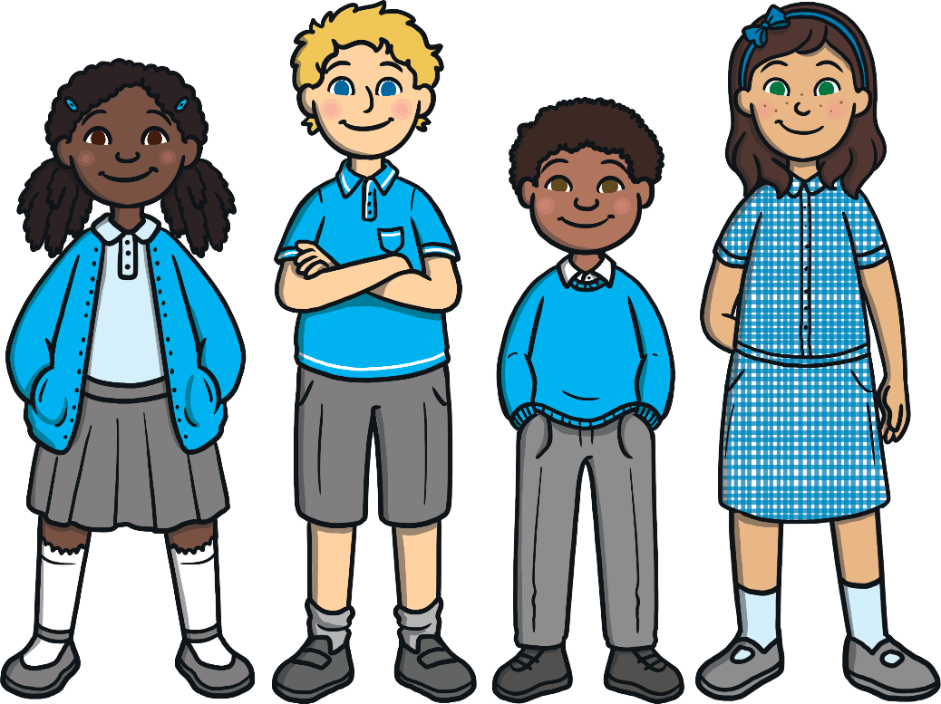
What Things Make Us Different?
No two people are ever the same! Look around your classroom or house and think about different people you know. What makes you different from each other?

Slide 7
What Things Make Us Different?
Hair colour
Skin colour
Type of family
Eye colour
Height
What else?

Slide 8
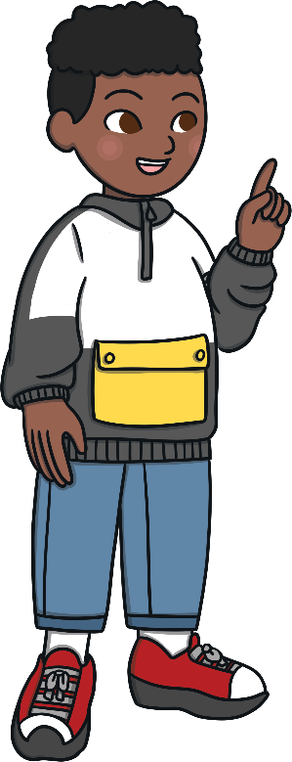
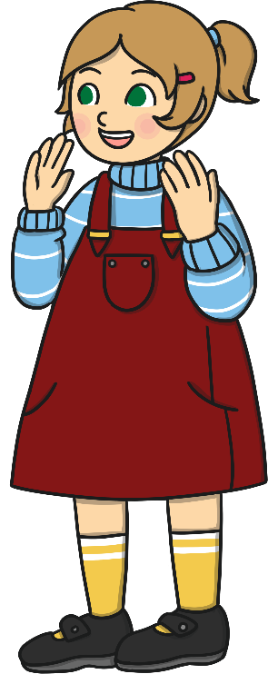
What Things Make Us Special?
Tell somebody one thing about them that is special. It might be the colour of their hair, or something that you know they like or are really good at.

Slide 9
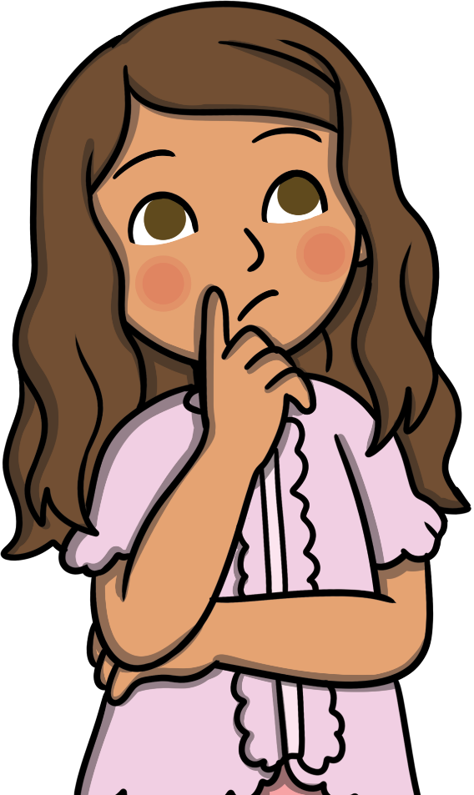
What Things Make Us Special?
Just imagine if everyone looked exactly the same and we all liked the same things.
Would life be as fun if we all looked the same and thought the same things? Probably not!
Talk to someone about what you think life would be like if everyone looked the same and were good at the same things.
What problems might that cause?

Slide 10
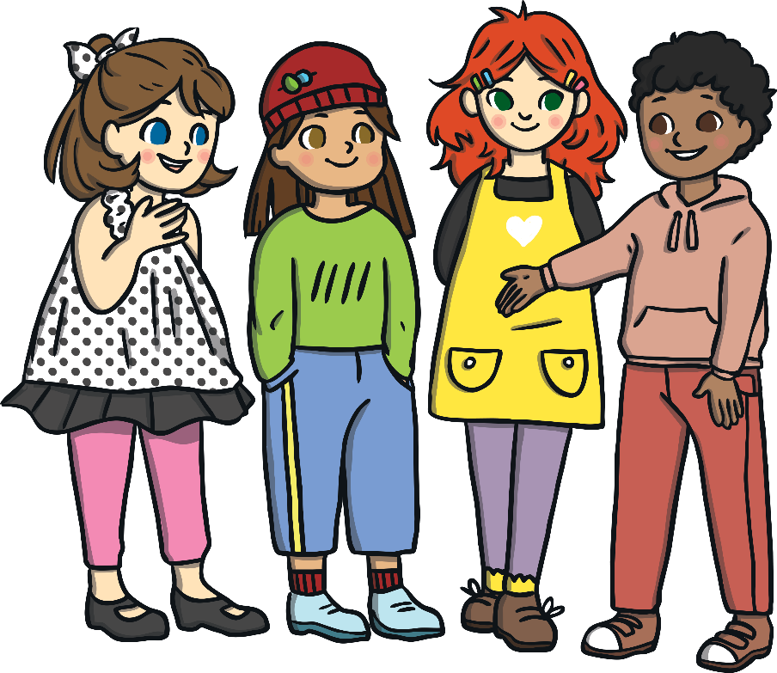
Why Are People Different?
Lots of people in this country have come from other countries – or their families came from other countries. This is a good thing, because it means we have a mix of lots of different people living together.
We call this mix of different people living together diversity.

Slide 11
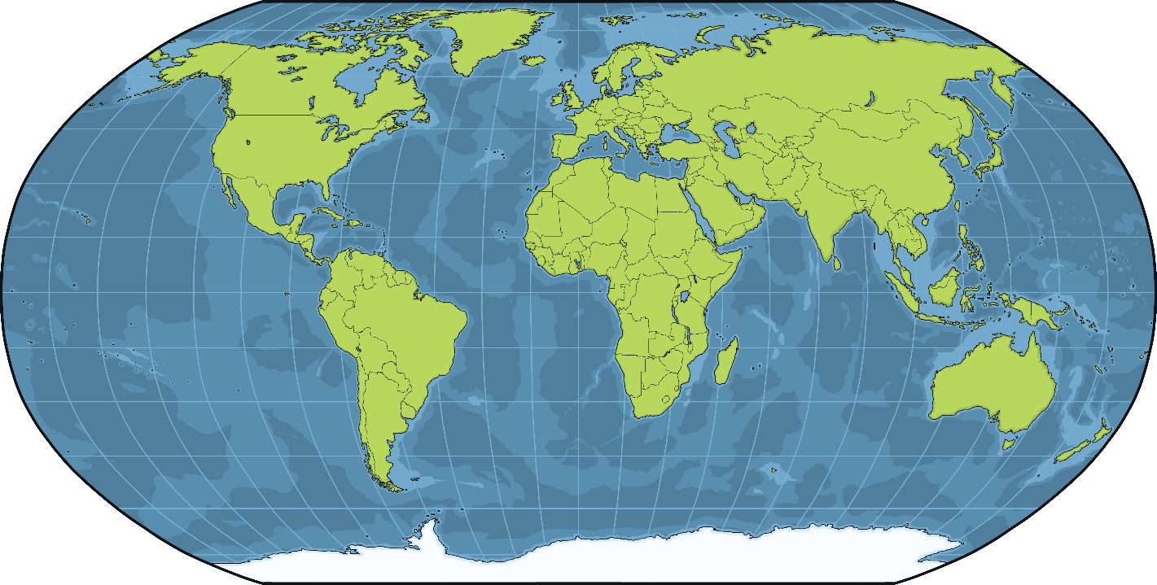
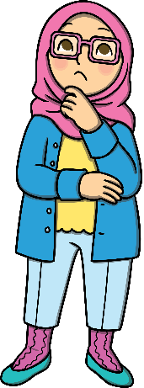
Why Are People Different?
Look at this map of the world.
Do you or anyone in your family come from a different country? Do you know anyone who comes from a different country? Do you have any family who live in a different place?

Slide 12
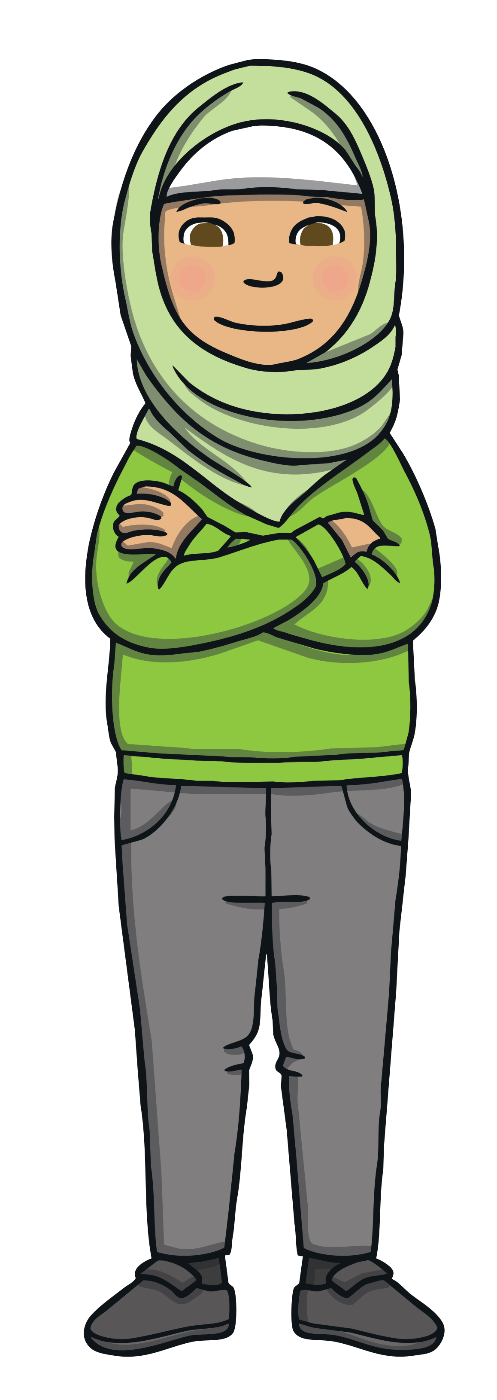
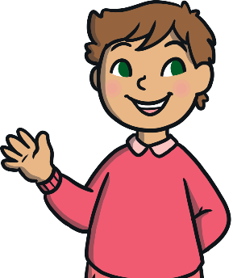
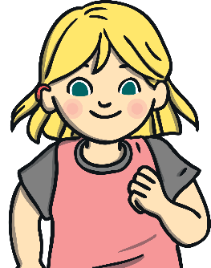
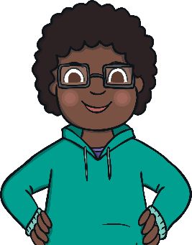
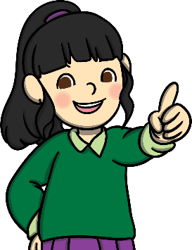
Respecting Differences
It is very important to respect people’s differences and not make fun of them. Being different is what makes us all special and interesting!
If someone is unkind about the ways someone is different, this is
called discrimination.

Slide 13
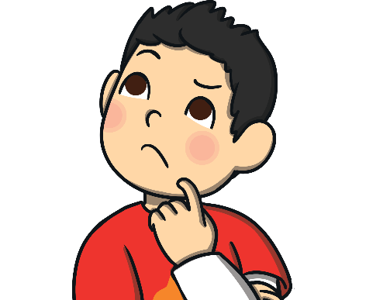
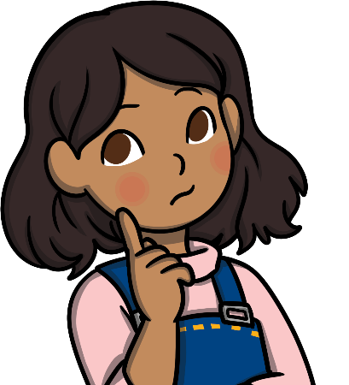
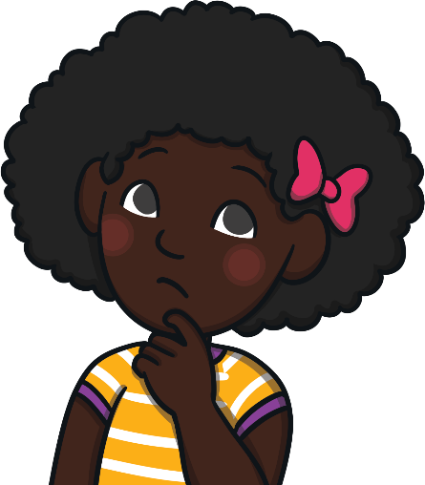
What To Do If Discrimination Is Happening
If you thought you were being bullied because of your differences, what do you think you should do?
If you heard someone being unkind about differences at school, who would you tell? What would you do?
If you heard someone being unkind about differences at home, who would you tell? What would you do?

Slide 14
What To Do If Discrimination Is Happening
If you thought you were being bullied because of your differences, what do you think you should do?
If you heard someone being unkind about differences at school, who would you tell? What would you do?
If you heard someone being unkind about differences at home, who would you tell? What would you do?

Slide 15
Follow up work.
Your teacher has a range of resources for you. However, you could also:
* Write a poem about being different
* Learn something new about a different culture
* Talk to a friend and find three ways in which you are the same and three ways in which you are different
* Research a famous historical figure that was treated badly because of their differences

Slide 16
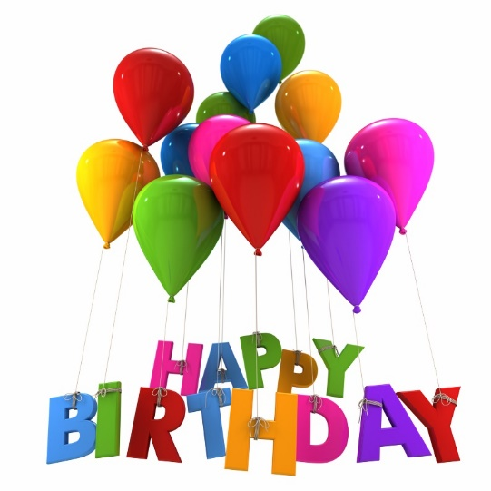
Secondary Dept
Leighton for 14 February
Maksymilian for 16 February
Louis for 18 February
Liam for 21 February
Harley for 23 February
Primary Dept
Ben for 13 February
Layal for 15 February
Lucas for 16 February
Wyatt for 23 February
We wish you all a Wonderful Birthday and have fun!

