Slide 1
Friday 5 March 2021

Slide 2
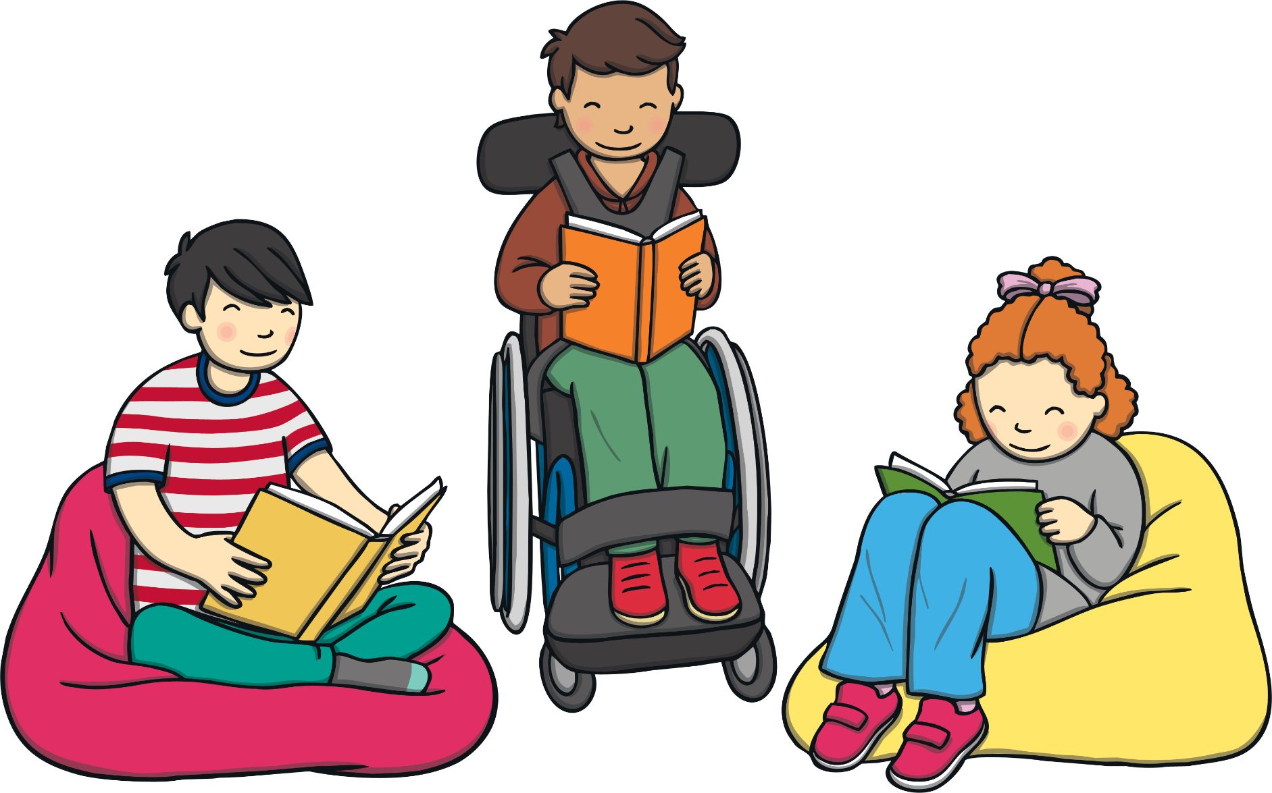
What Is World Book Day?
It is a day set aside each year to celebrate books, authors, and reading!
What are some of your favorite books?

Slide 3
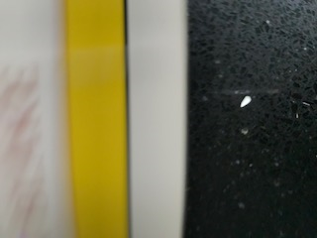
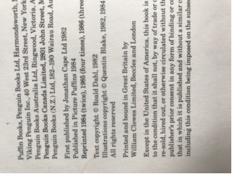
Mrs Tobin’s reading journey
As a child, I loved to look at books and I really enjoyed being read to
Here is one of my all-time childhood favourites. Can you use the clues to guess what it is? (your family or teachers might help you!)
1984

Slide 4
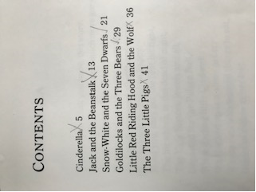
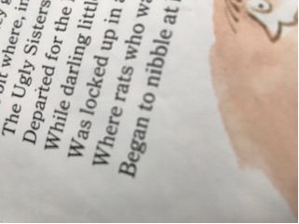

Slide 5
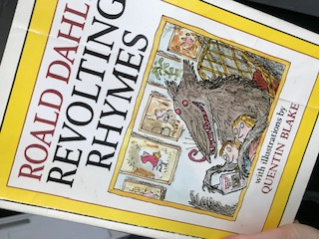

Slide 6
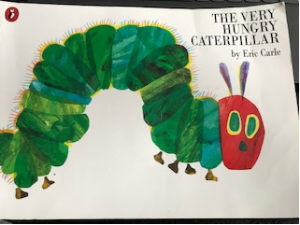

Slide 7
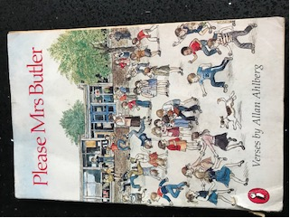
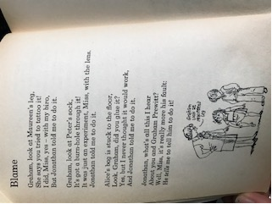

Slide 8
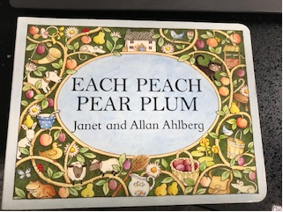
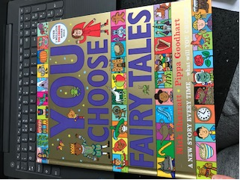
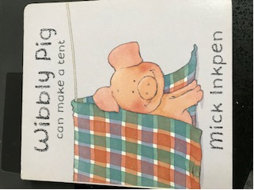
My daughter…

Slide 9
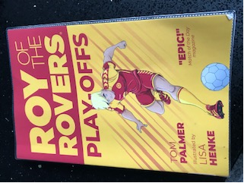
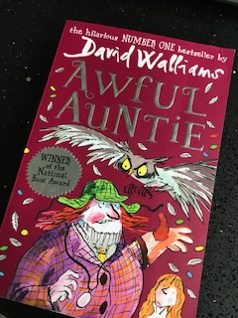
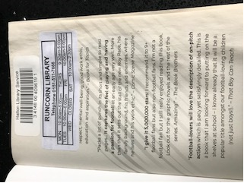
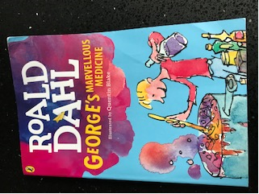
My son…

Slide 10
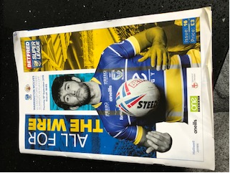
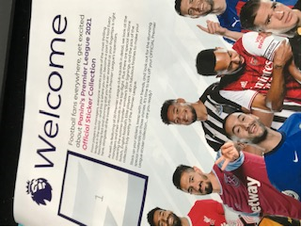
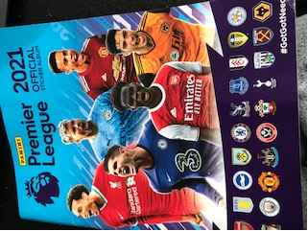

Slide 11
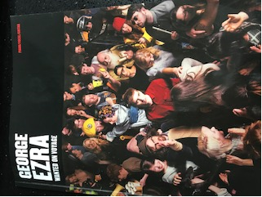
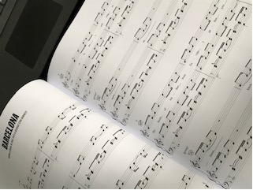
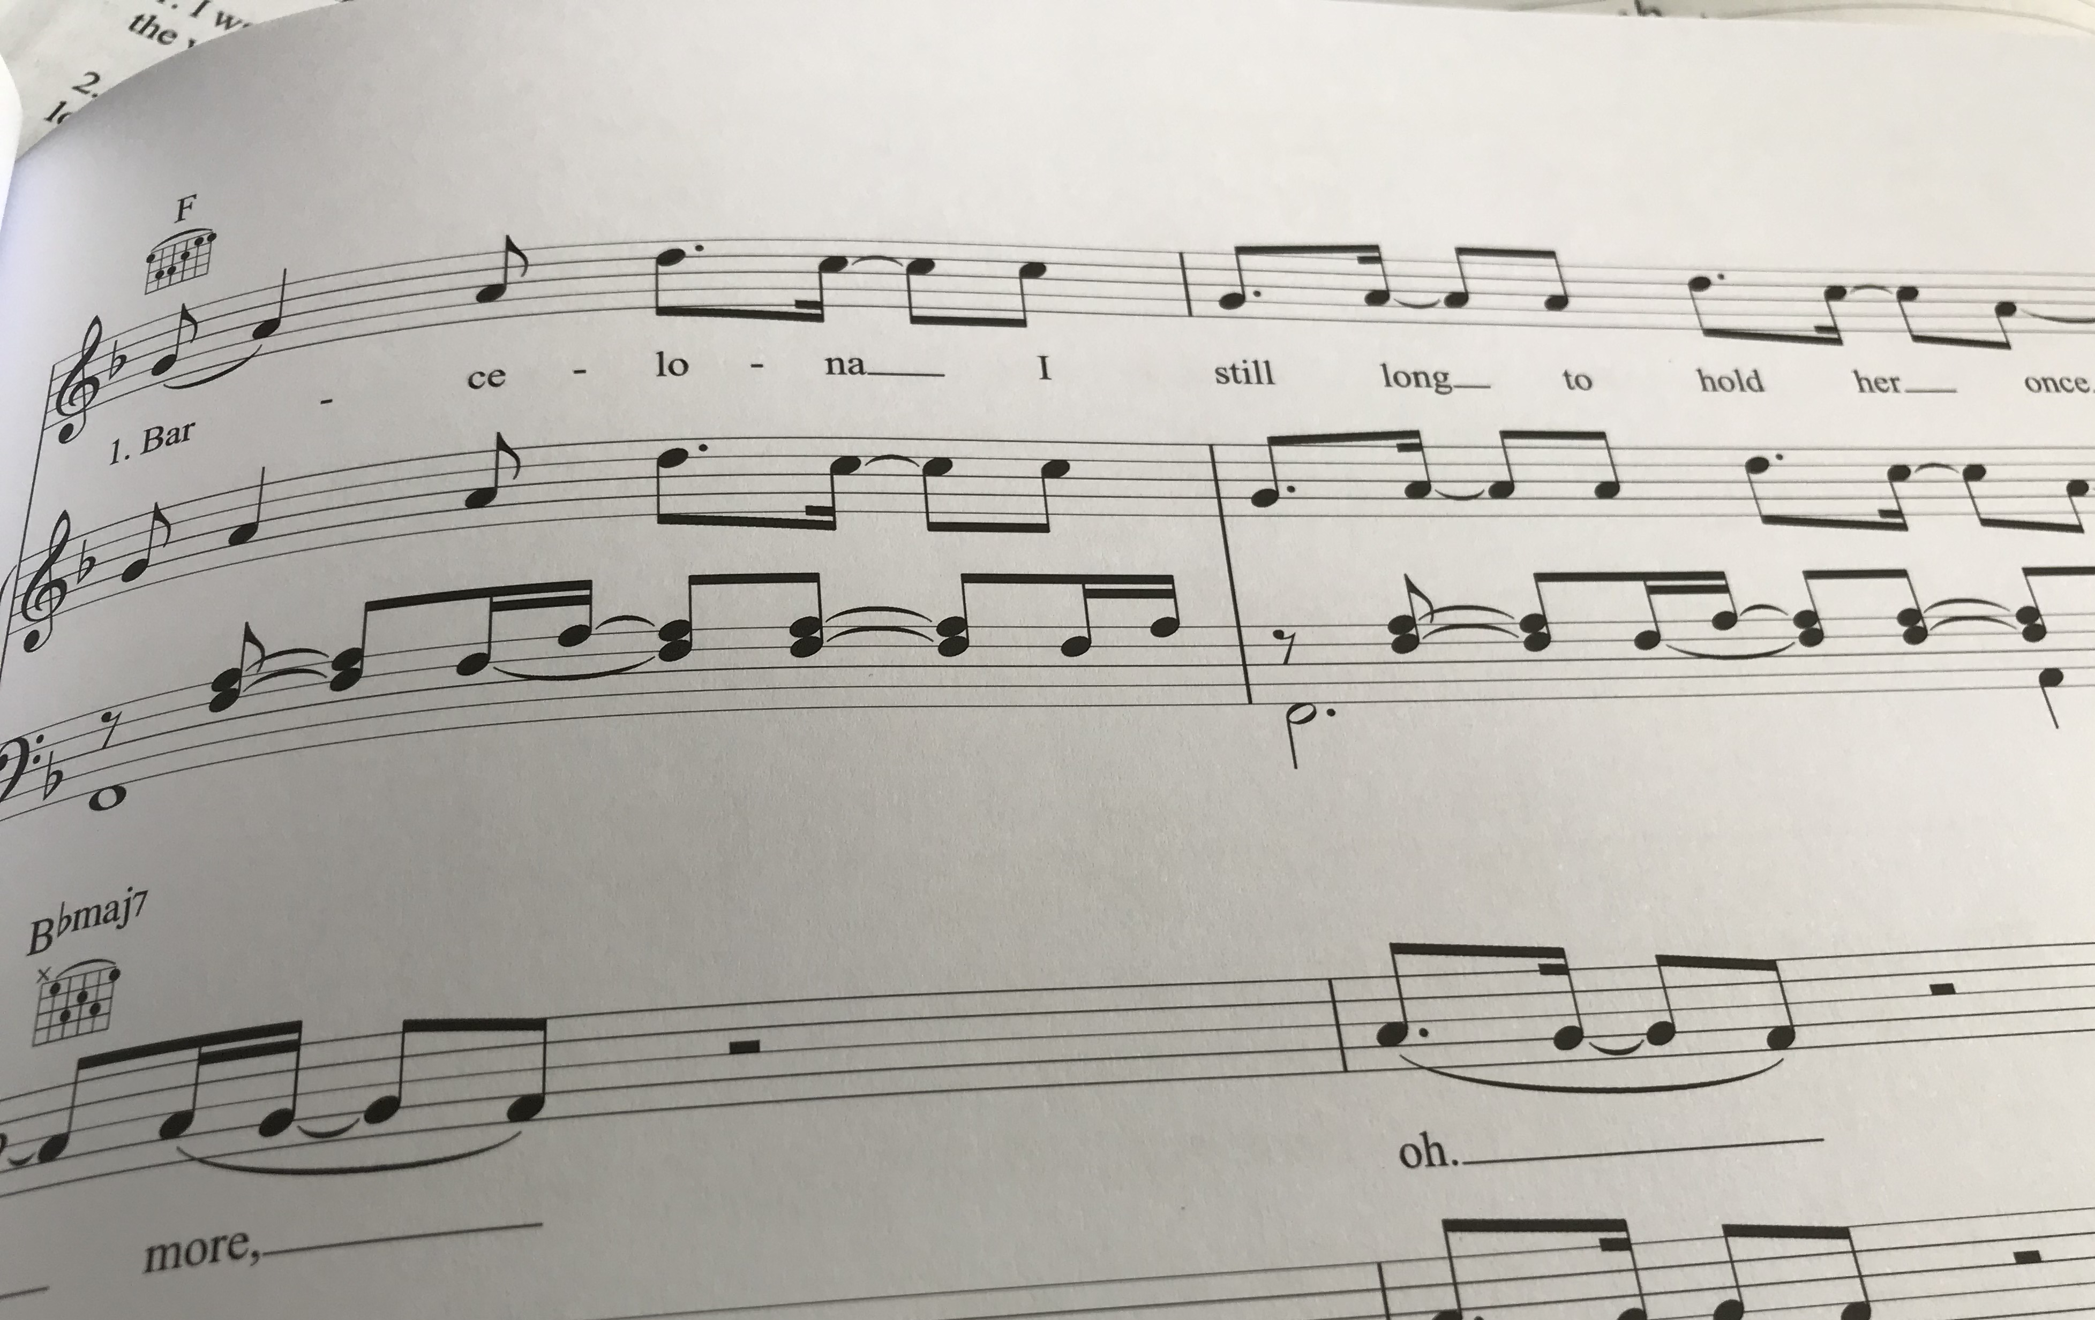
Me

Slide 13
Challenge: Conduct an interview with a family member or a adult at school 1. What is the first book you can remember reading? 2. Who read to you when you were younger? 3. Do you prefer reading or listening? 4. Have you always liked the same type of books? 5. What types of books do your families like? 6. What book would you recommend for me? And any other questions you would like to ask them about reading!

Slide 14
Follow up work
Scavenger hunts!
Ask your teacher for a copy if you wish to take part!

Slide 15
Happy Birthday!
Primary Dept
Mikey 5 March
Jason 7 March
Harley 8 March
Secondary Dept
William 5 March
Martin 5 March
Kaiyeem 5 March
Owen 8 March
Ashley 10 March
We wish you all a Wonderful Birthday and have fun!

