Slide 1
Abbot’s Lea School
Exam information session
23 September 2021

Slide 2
Welcome and Introductions
Mr Matthew Lyons, Key Stage 4 Leader
Mr Ryan Mason, Key Stage 5 Leader

Slide 3
Today’s session
Aims:
1. Share our school-based support for the exam process; before, during and after
2. Share our methods of supporting the exam process at home, in preparation for exams
3. Share information of the levels of the each exam

Slide 4
Our School
“You may never know what results come of your action, but if you do nothing there will be no result.” Mahatma Gandhi

Slide 5
Our Philosophy of Education: The ASD Model ©
In our work with the students, we will focus equally on:
1. Academic progress
2. Specialist therapeutic support
3. Development of life skills

Slide 6
Preparation for Exams
Accumulative, holistic work to help each student be the best version of themselves
Lessons focussed on all the criteria for the exams, to ensure the students have the knowledge they need
Speaking, listening and communication modelling in various lessons in preparation for that part of the exam
Exam questions are used regularly in lessons to prepare students

Slide 7
School based support
Reasonable adjustments are made for all the students, this is related to their EHCP and specific to them
This includes 25% extra time, regular breaks and prompts
Students can also have access to a reader and scribe if that is stated in their EHCP

Slide 8
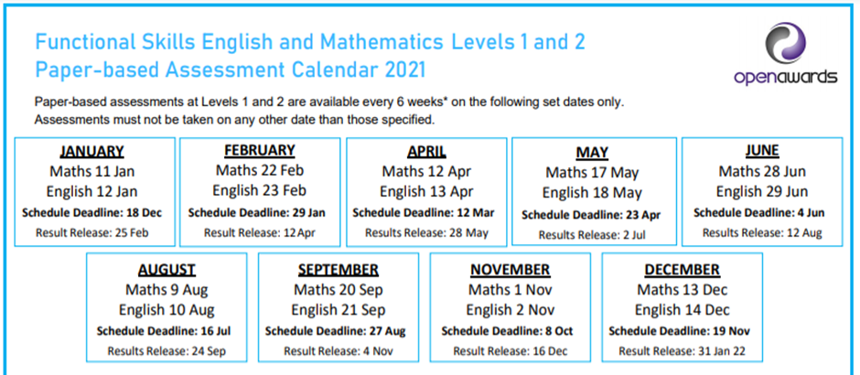
Dates of the exams
The dates for 2022 are yet to be confirmed, as soon as we know we will inform parents

Slide 9
Dates of the mock exams
KS5 18th, 19thand 20th October 2021 (classroom based)
KS4 15th, 16th and 17th November 2021 (classroom based)
KS4 and KS5 14th, 15th and 16th March (Exams in the Hall)
“Mock exams can be attempted multiple times to makes student more perfect in particular subject. Shows how well they are prepared for the exam. Shows their strength as well their weakness. It guides them on which topics they have to focus more.” Gyan Gossip

Slide 10
Support from home
Revision support, this can take the form of online activities – for example Seneca
We have produced a Parents handbook that offers guidance, this will be emailed after the presentation
Sleep is important during exam periods as this will help with recalling information
Help the students with some light exercise during the build up to the exams to help focus the mind
On the morning of the exam a nutritious breakfast is always helpful.

Slide 11
Year 11 specific courses
Open Awards Level 1 Certificate in Science – This consists of 8 units completed over year 10 and 11. The students produce coursework for each unit, there are no exams in this course
OCR Entry Level 2/3 Life and Living skills Diploma – This is all coursework and is covered over year 10 and 11.

Slide 12
Exam levels
Functional Skills | Equivalents
Functional Skills – Level 3 | This is equivalent to A Levels
Functional Skills – Level 2 | This is equivalent to GCSE Grades A*-C (now referred to as 4 - 9)
Functional Skills – Level 1 | This is equivalent to GCSE Grades D or E (now referred to as 2 or 3)
Functional Skills - Entry Level | This is pre-GCSE level

Slide 13
Useful websites
https://senecalearning.com/en-GB/
https://openawards.org.uk/what-we-offer/functional-skills/
https://quizlet.com/en-gb
https://www.bbc.co.uk/bitesize/subjects/zjd8jty
https://www.cgpbooks.co.uk/resources/cgp-s-free-online-10-minute-tests/free-functional-skills-maths-online-10-minute-test
https://www.skillsworkshop.org

Slide 14
Any exam questions – ALS contacts
Mr Matthew Lyons, Key Stage 4 Leader
matthew.lyons@abbotsleaschool.co.uk
Mr Ryan Mason, Key Stage 5 Leader
ryan.mason@abbotsleaschool.co.uk

Slide 15
Any questions
feedback@abbotsleaschool.co.uk

