Slide 1
Abbot’s Lea School
Supported Internship
information session
14 February 2022

Slide 2
Recording of the session
We will be recording the session shortly, please turn off your video and sound now.
Please feel free to change or delete your username on your Zoom screen if this makes you more comfortable.
Please feel free to put some questions in the chat box and well answer them when suitable.

Slide 3
Welcome and introductions
Mrs Emily Tobin, Deputy Headteacher – Teaching and Learning
Mr Nathan Fernyhough, Employability Manager
Mrs Rebecca Roberts, Internship Job Coach
Mr Ryan Mason, Key Stage 5 Leader
Mr Phil Nicholls, Independent Travel Team

Slide 4
Today’s session
Aims:
1. To share information on the Supported Internship programme at our school
2. To share some insight from this year’s internships
3. To share the focus on next steps and application process for Supported Internships
4. To share information on Independent Travel Training

Slide 5
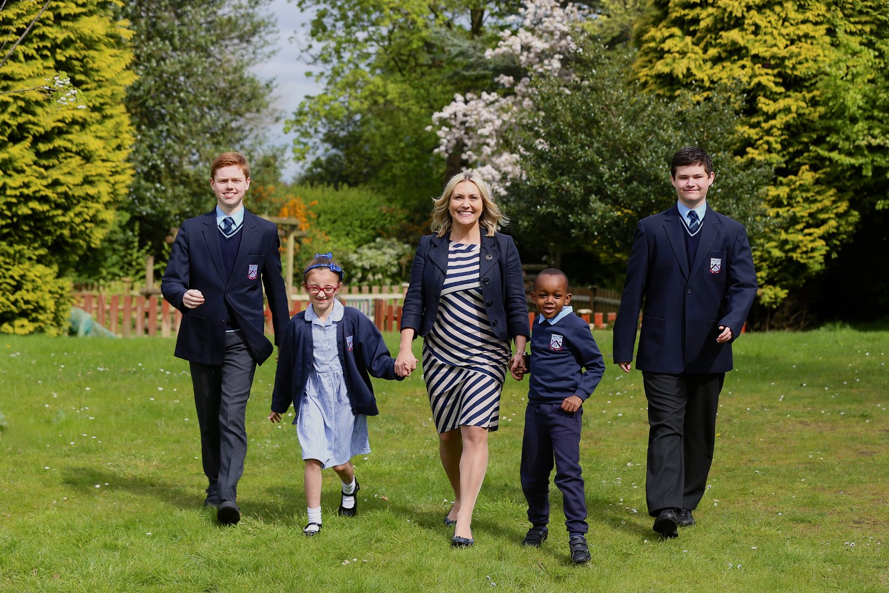
Our School
“Purpose of education is to prepare students for life, it’s that simple!” Ken Robinson

Slide 6
Our Philosophy of Education: The ASD Model ©
In our work with the students, we will focus equally on:
1. Academic progress
2. Specialist therapeutic support
3. Development of life skills

Slide 7
Supported Internships
We want all children and young people, no matter what their special educational needs or disability (SEND), to be able to reach their full potential and receive the right support to succeed in their education and as they move into adult life.
Aims of a Supported Internship:
Supporting students to develop the skills valued by employers.
Enabling students to demonstrate their value in the workplace.
Developing confidence in their own abilities to perform successfully at work.
Abbot’s Lea School, as well as most FE Colleges in the area, run Supported Internship programmes with employers across the City.

Slide 8
Supported Internships
Supported internships are a structured, work-based study programme.
Students in Year 11, 12 and 13 who are ready to leave school and who show interest in practical hands-on work-based learning may apply for a Supported Internship.
The internships provide the opportunity for young people to achieve sustained, paid employment by equipping them with the skills they need for work, through learning in the workplace.
Supported interns remain on roll at Abbot’s Lea, but spend most of their learning time - typically around 70% - in a workplace.

Slide 9
Abbot’s Lea School SI programmes
Throughout the internship programme, students are supported by an Intern Coach assigned to them and funded through Department for Work and Pensions (DWP).
Interns will be matched to a suitable employer based on their interests and skills. We do this through vocational profiling and pre-internship work such as task analysis.
Additionally, if not yet secured, Functional Skills English, Maths and ICT continue and students have a number of opportunities to gain additional accreditation specific to their work placement (for example: Basic Food Hygiene, First Aid, Health and Safety certification, etc.) as part of their personalised study curriculum.

Slide 10
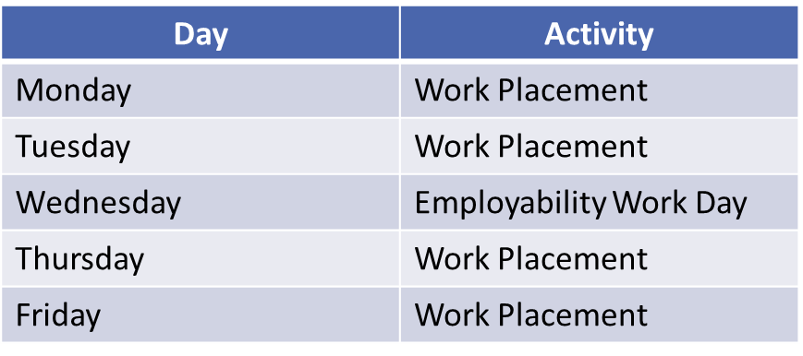
Abbot’s Lea School SI programmes
After a Supported Internship concludes, students leave ALS roll and should progress to:
- FE College
- Apprenticeship training
- Employment

Slide 11
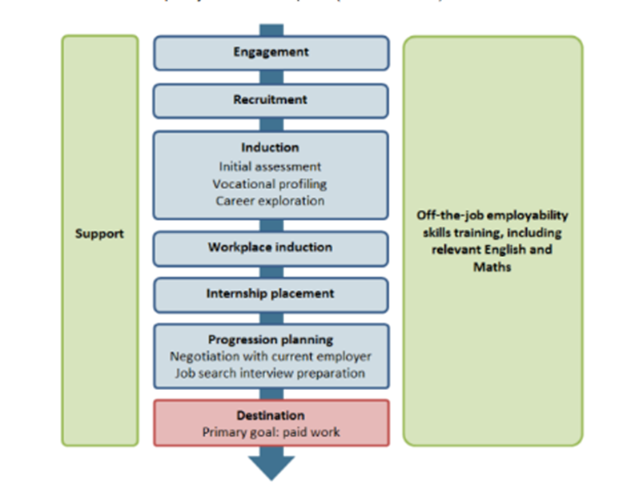
Abbot’s Lea School SI programmes
Preparation and Timeline:

Slide 12
Independent Travel training

Slide 13
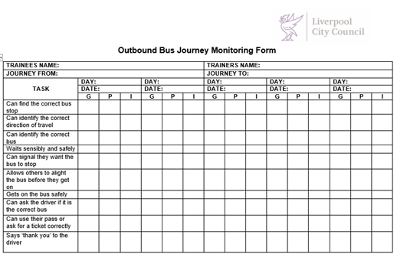
Independent Travel training

Slide 14
Independent Travel training
Phil.Nichols@Liverpool.gov.uk

Slide 15
Next steps and deadlines
1. Visit the school website and social media links to experience the supported internships
first hand
2. Discuss potential course choices with your child
3. Once your child identifies a programme they like, complete an application form
4. Inform ALS (via Class Team) about your child’s choices
Deadlines:
A letter of application sent to Ryan Mason or Nathan Fernyhough must be received by 17 February 2022
All EHCP post-16 reviews must be updated with the destination by 31 March 2022

Slide 16
Next steps – ALS contact
Mr Nathan Fernyhough, Employability Manager
nathan.Fernyhough@abbotsleaschool.co.uk
Mr Ryan Mason, Key Stage 5 Leader
ryan.mason@abbotsleaschool.co.uk

Slide 17
Any questions
feedback@abbotsleaschool.co.uk

