Slide 1
Abbot’s Lea School
BUG Club
Thursday 4th October 2021

Slide 2
What is Bug Club?
It provides access to online versions of a range of eBooks through a personalised online homepage for each student.

Slide 3
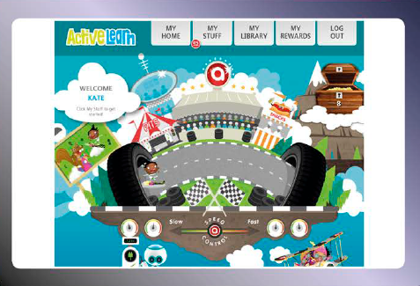
Accessing eBooks
www.activelearnprimary.co.uk

Slide 4
Benefits of using eBooks
The online reading world ensures children can access independent reading resource anywhere at any time.
Quiz questions give children plenty of opportunity to develop their reading and comprehension skills whilst moving through the book band levels.
Answers to the quiz questions will be sent back to our teacher site so that we can see how your child is progressing.

Slide 5
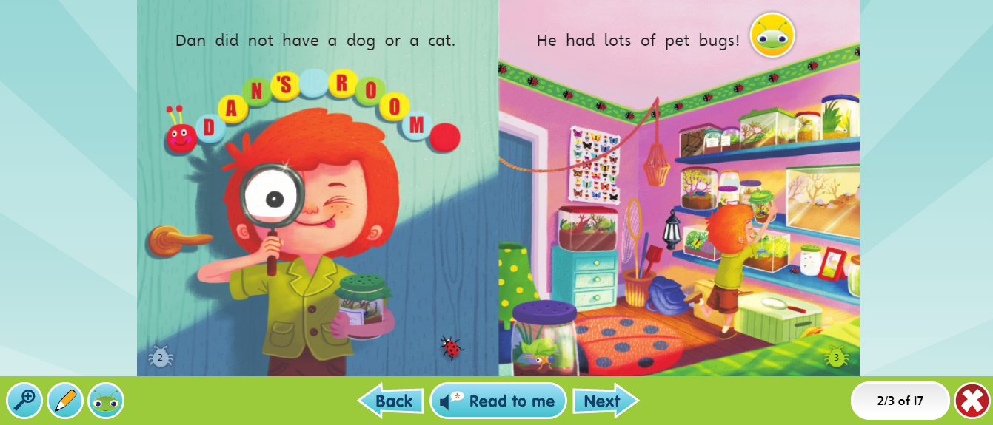
Using an eBook
Your child will see their eBooks in the ‘My Stuff’ area on their homepage.
Read the eBook and click on the bug icons to open the quiz questions.

Slide 6
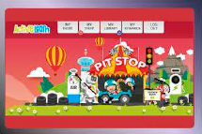
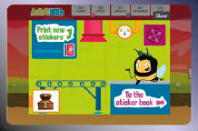
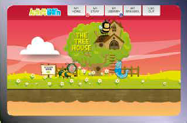
Recognition and games
When your child has finished all of the quiz questions in an eBook, they will gain some coins.
They can spend these coins in one of the interactive games on their homepage.

Slide 7
Getting the most out of eBooks
Encourage your child to attempt all quizzes on eBooks.
When your child has finished a book, it will move to ‘My Library’. Ask your child to re-read a favourite eBook again to build their confidence and consolidate learning.
When sharing a book with your child, try to take opportunities to talk about the book - before, during and after reading.

Slide 8
Any questions?

